Slide 1
CA 160: Contemporary artists research
Sylvia Roberts
Contemporary Arts Librarian
sroberts@sfu.ca
Notes:
I’m Sylvia Roberts, subject specialist librarian for Contemporary Arts
My pronouns are she/her.
I’d like to start out session by acknowledging that at SFU Vancouver campus we are on the unceded traditional and current territories of the Squamish, Musqueam and Tsleil-waututh nations. I’m grateful to have lived here for more than 30 years as a person of European settler heritage. I’m taking steps to learn how to decolonize my perspective and practices as a librarian towards reconciliation with Indigenous peoples and to working effectively with all of SFU’s diverse community.
My goal for you is to leave here today with an approach to your research AND some excellent sources of information.
I’m a big picture thinker so we’ll start with a high level discussion of what you might consider when searching for high quality information about artists, highlight some key types of sources that will provide excellent evidence to support your art making assignment and I’ll demonstrate a few search strategies. After about an hour of this, we’ll have a short break and a tour of the Belzberg Library here at SFU Vancouver. Then we’ll return to the lab where you can work in your groups and we can offer coaching and direction.
As the Contemporary Arts librarian, I have expertise in sources & records of arts practice, how information is typically shared between different players in the field of visual arts and in art publishing. I provide research guidance and training to CA folks and also make selections for the library collection that match the programs of teaching and research in the school.
However, I am not an artist. My role is to help you find excellent evidence to support your decision making as you work together on creating your art object for the assignment.
YOU DO NOT HAVE TO MAKE NOTES – there is a research guide

Slide 2
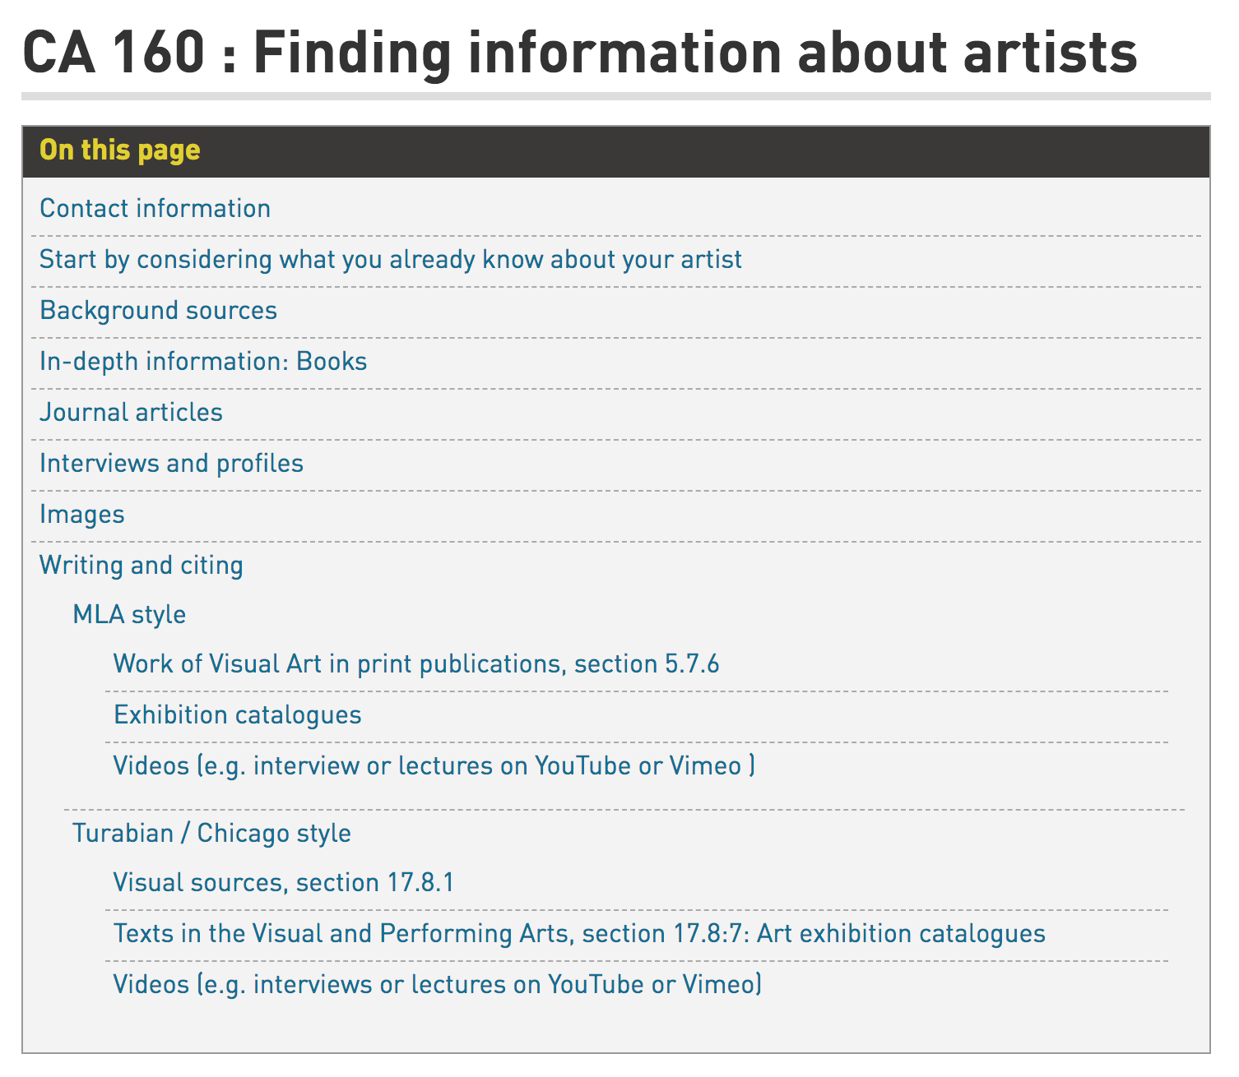
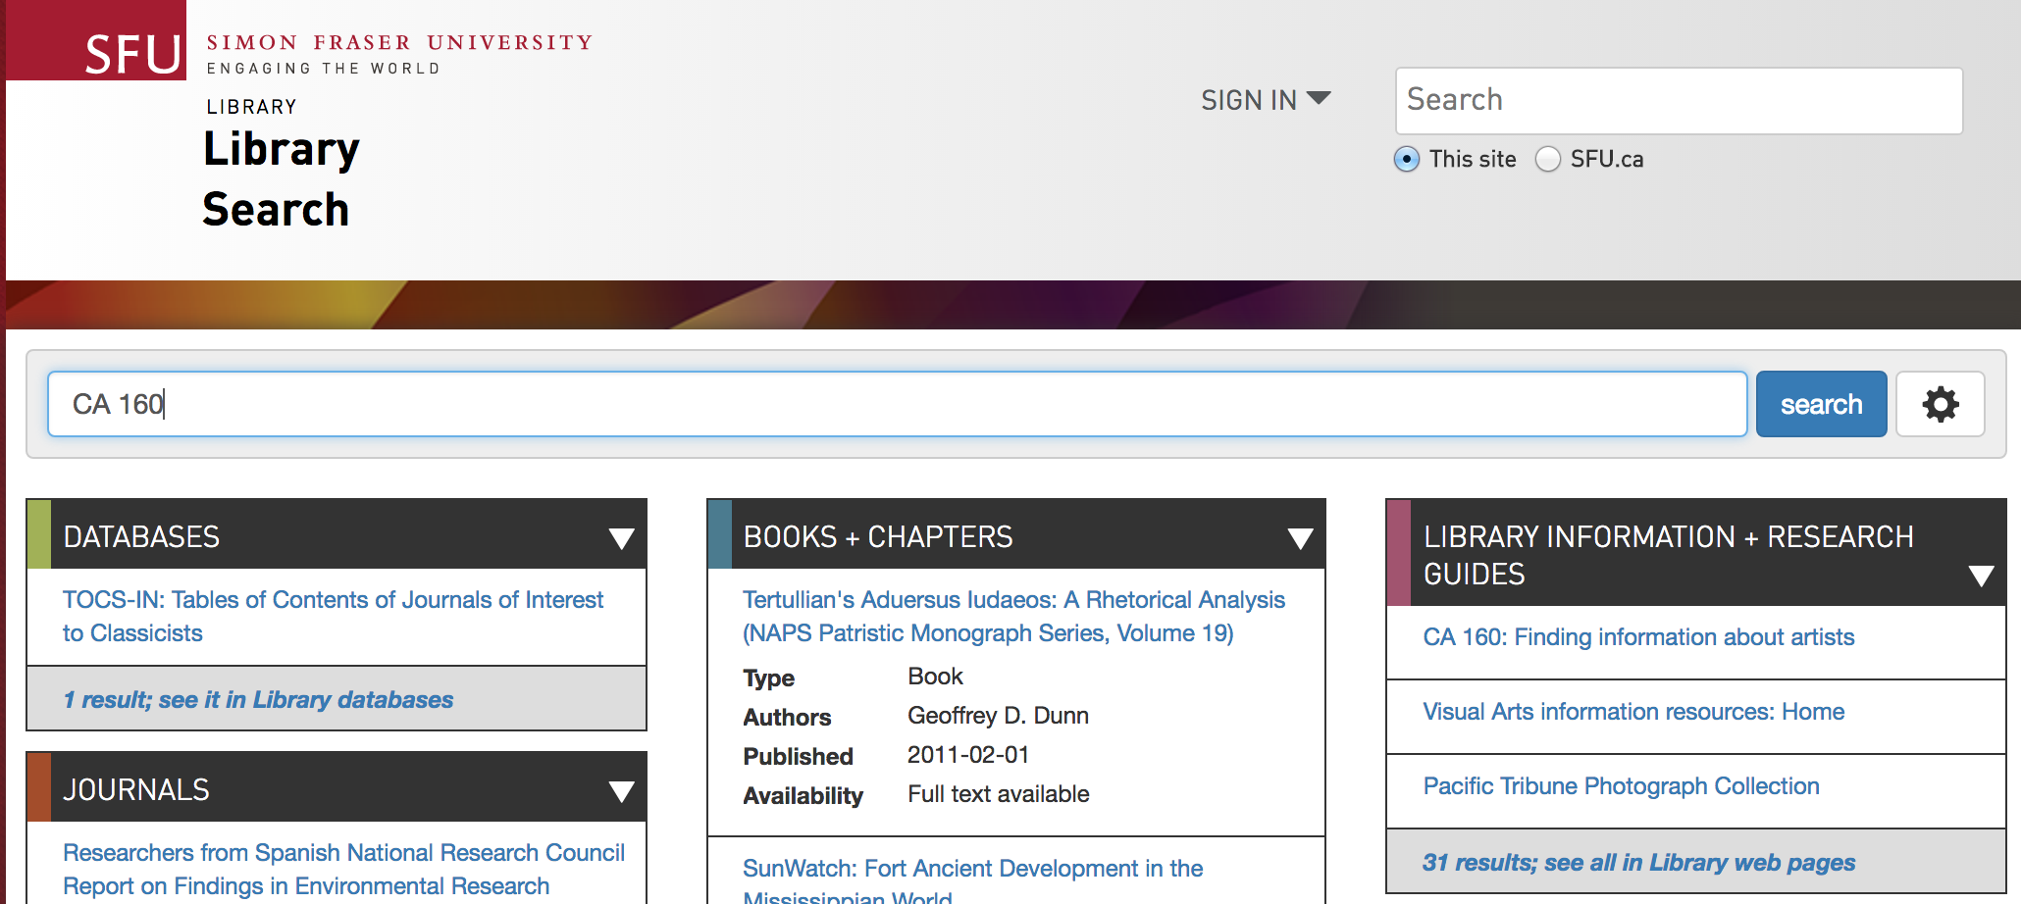
Notes:
https://www.lib.sfu.ca/help/research-assistance/subject/contemporary-arts/ca160
In chat box

Slide 3
Has anyone started their research yet?
Notes:
Or looked for information about contemporary artists or art works?

Slide 4
What did you find? Was it a credible source of information? How could you tell?
Notes:
Would this type of information be useful for your current project?
How many of you started by looking for images of the artists’ work?

Slide 5
What kind of information do you need for this project?

Slide 6
Suggested question to answer
What is their practice like? (materials, process, scale/scope)
Has it changed over time?
What were they thinking?
influences (education / teachers / milieux)
affiliations (space, time, medium)
identity (LGBT+, feminist, abilities)
interests & ideas (themes of work)
What do art experts think about their work?
What’s relevant to the context of production? (economic, social, cultural, political)
Notes:
Story about CBC reporter who’d interviewed G about Jeff Wall’s work and then said they were going to Woodwards to photograph the large photo-mural there – in fact, a work of Stan Douglas’s

Slide 7
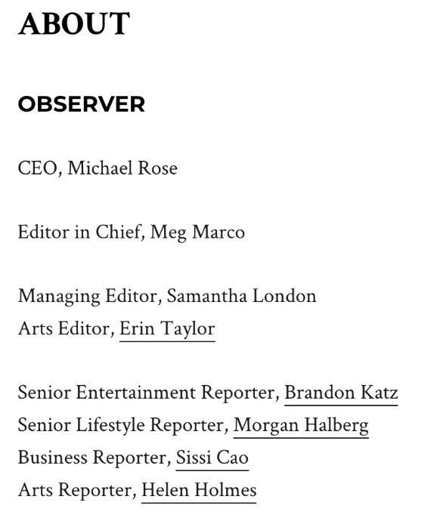
What can you tell from an image?
Maurizio Cattelan’s New 9/11 Artwork Aligns With His Penchant for Controversy
By Helen Holmes • 07/16/21
Notes:
…a gigantic resin block being penetrated by what appears to be a jumbo jet in an explicit and unapologetic reference to the events of 9/11. Cattelan has apparently been trying to launch something like “Breath Ghosts Blind” for years: according to the New York Times,…
The artist, as it turns out, had been present in New York City on the day 9/11 took place. “I had to walk home from LaGuardia, which took hours, and the things I saw stayed with me,” he continued. “Achieving a certain distance, not just in space but in time, becomes a necessary step in order to remember,”
“Helen is a reporter who covers artists, museums, the international auction scene, restitution, NFTs and the increasingly digital art world in general. She's written for the New York Times Magazine, Glamour, GQ, VICE, Rolling Stone, and Splinter News, among others. She tweets @helenbholmes”
Observer is advertising supported newsletter – link to about information at bottom of page

Slide 8
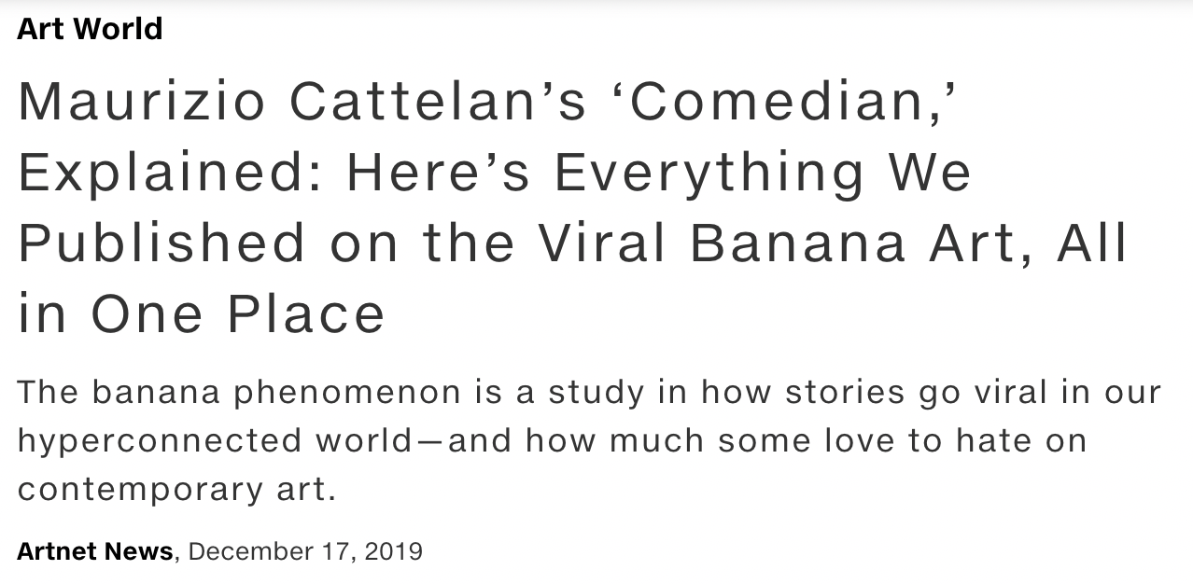
Sane artist, different work
Notes:
` +.

Slide 9
Sane artist, different work
Notes:
` +.

Slide 10
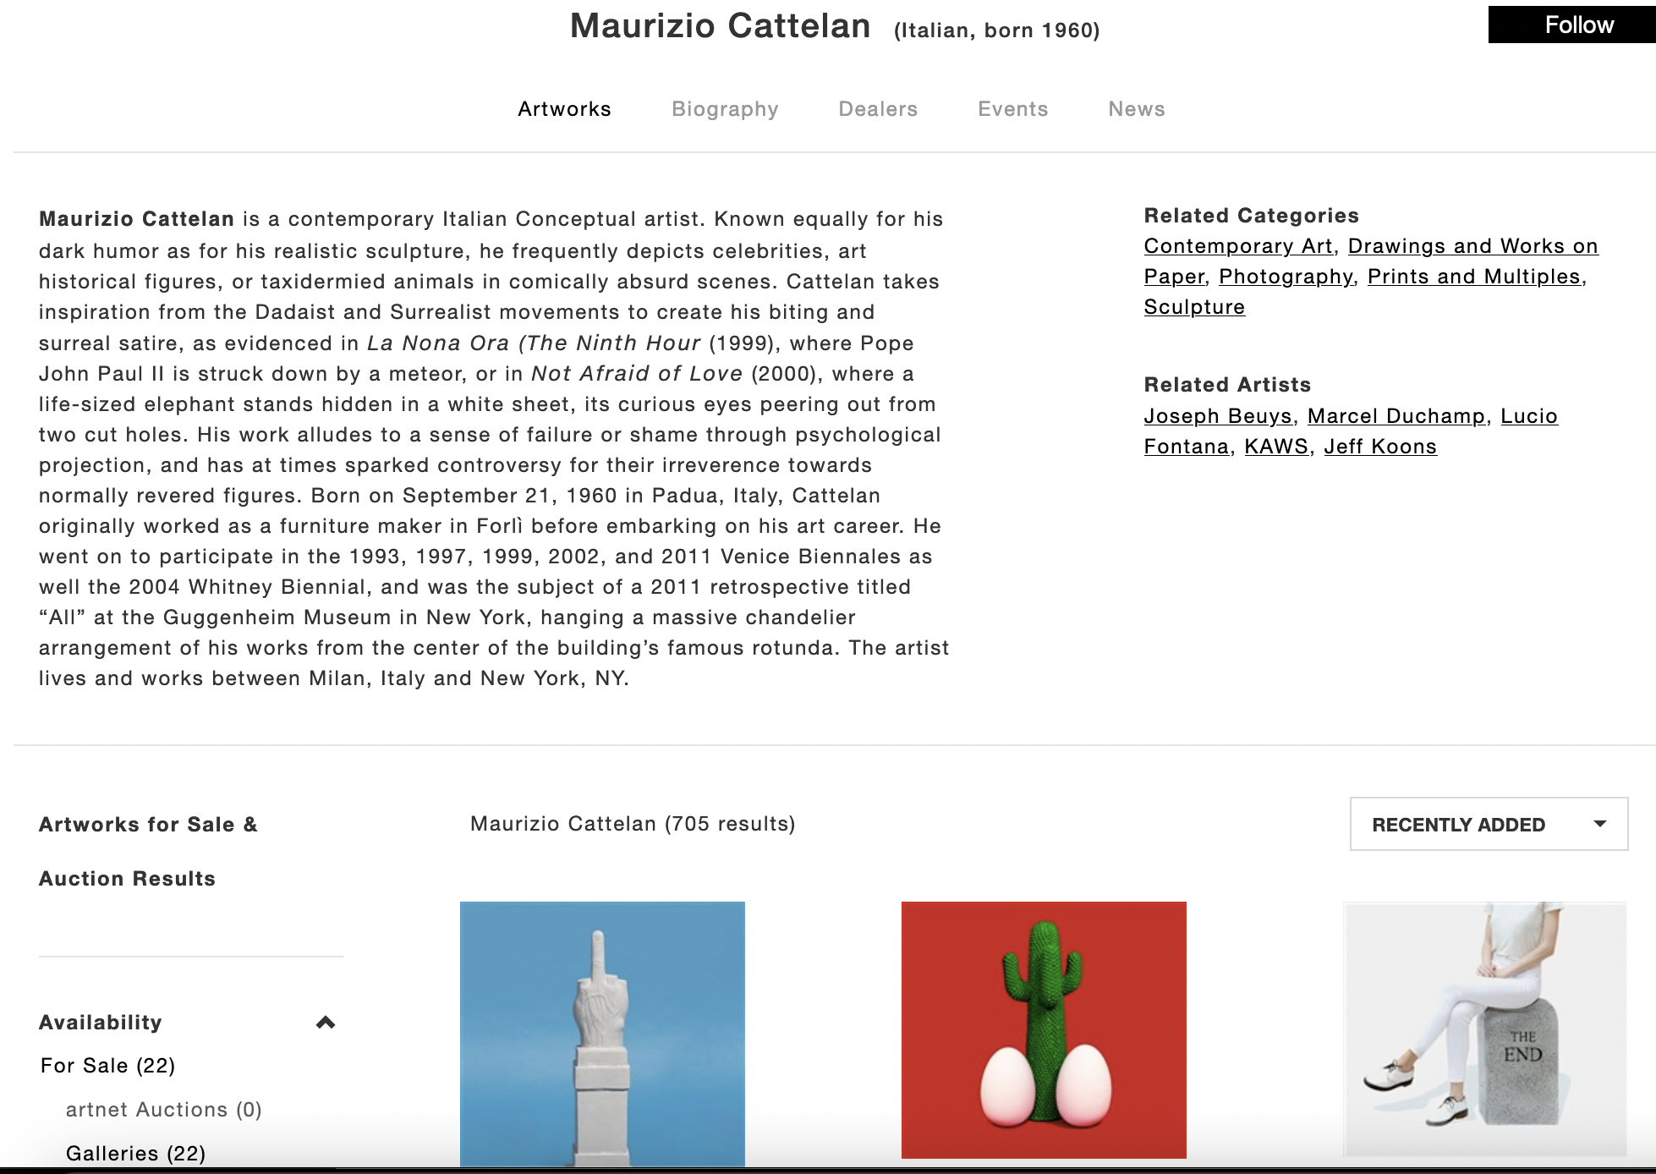

Slide 11
Who produces information about artists?
Artists
Commercial gallery or agent representing the artist (gallerist)
Public / private museums
Those exhibiting the artist’s work
With that artists’ work in their collection
Scholars (curators, academics, other artists)
Journalists (specialized or general)
Educators (students, professors, teachers)
Collectors
Art enthusiasts
Notes:
Gallerist is a person who owns an art gallery or who exhibits and promotes artists' work in galleries and other venues in order to attract potential buyers
If you were going to rank these sources, in terms of who would produce the most reliable information about an art’s practice, who would you put at the top? Who would be at the bottom?
Can you think of reasons why you should approach some of these sources with criticality?

Slide 12
Consider the nature and purpose of the writing
The CRAAP test
Currency – when was it published?
Relevancy – importance? intended audience?
Authority – expertise? credentials?
Accuracy – reliable, supported by evidence
Purpose – Inform? Teach? Sell? Persuade?
Notes:
Triangulation refers to the use of multiple methods or data sources in qualitative research to develop a comprehensive understanding of phenomena
“test validity through the convergence of information from different sources. “

Slide 13
Overviews & leads to details
Oxford Art Online (SFU library subscription)
Wikipedia
Professional biography
Practice, affiliations, influences, sample work
List of exhibitions, prizes, press
Bibliography
Notes:
Put Wikipedia and OAO in the chat box. Search for your artist. Spend 3 minutes skimming article to see what you can find out about them.
Wikipedia https://en.wikipedia.org/wiki/Main_Page
Oxford Art Online https://databases.lib.sfu.ca/record/61245131820003610

Slide 14
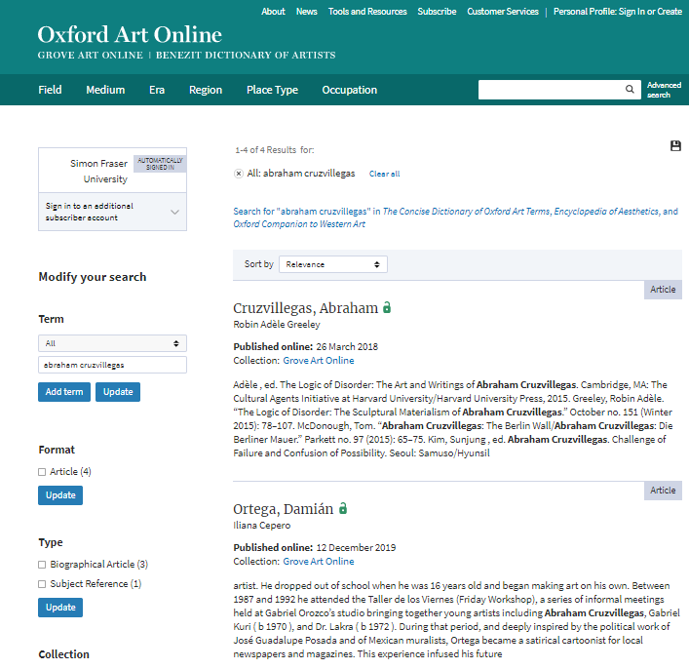

Slide 15
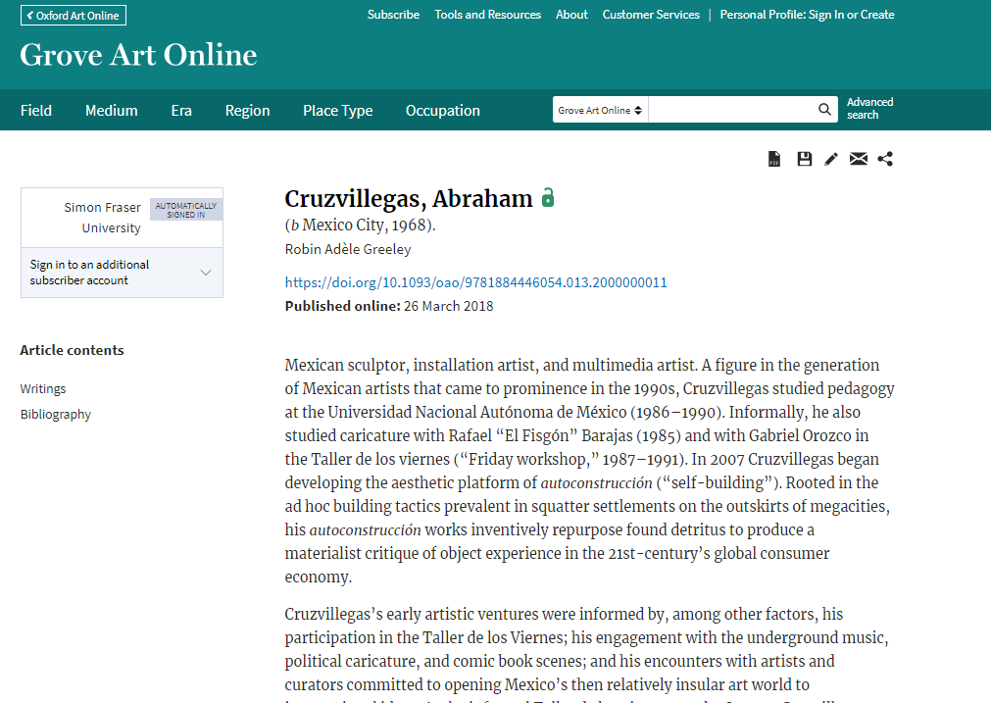

Slide 16
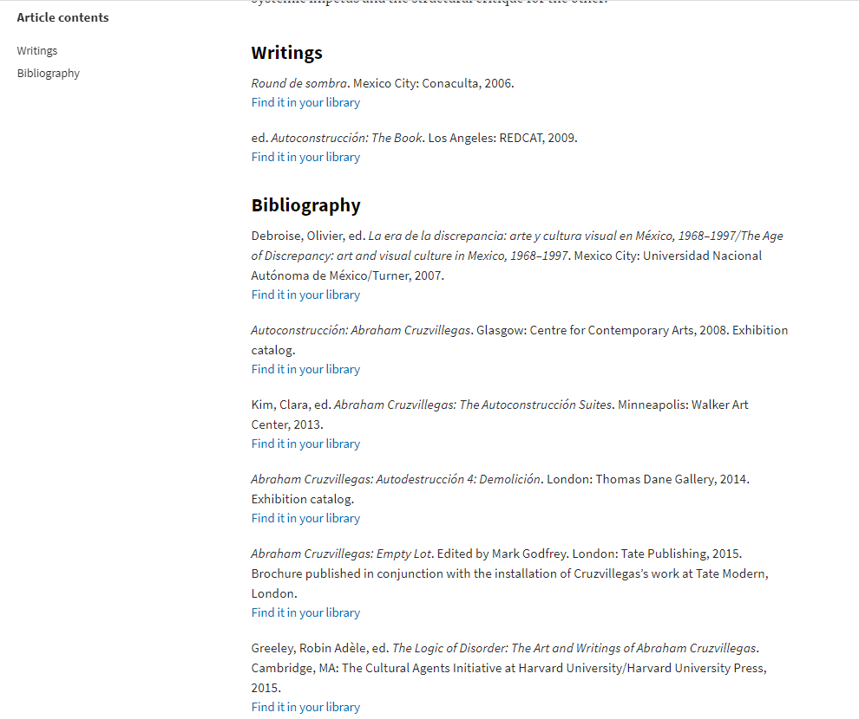

Slide 17
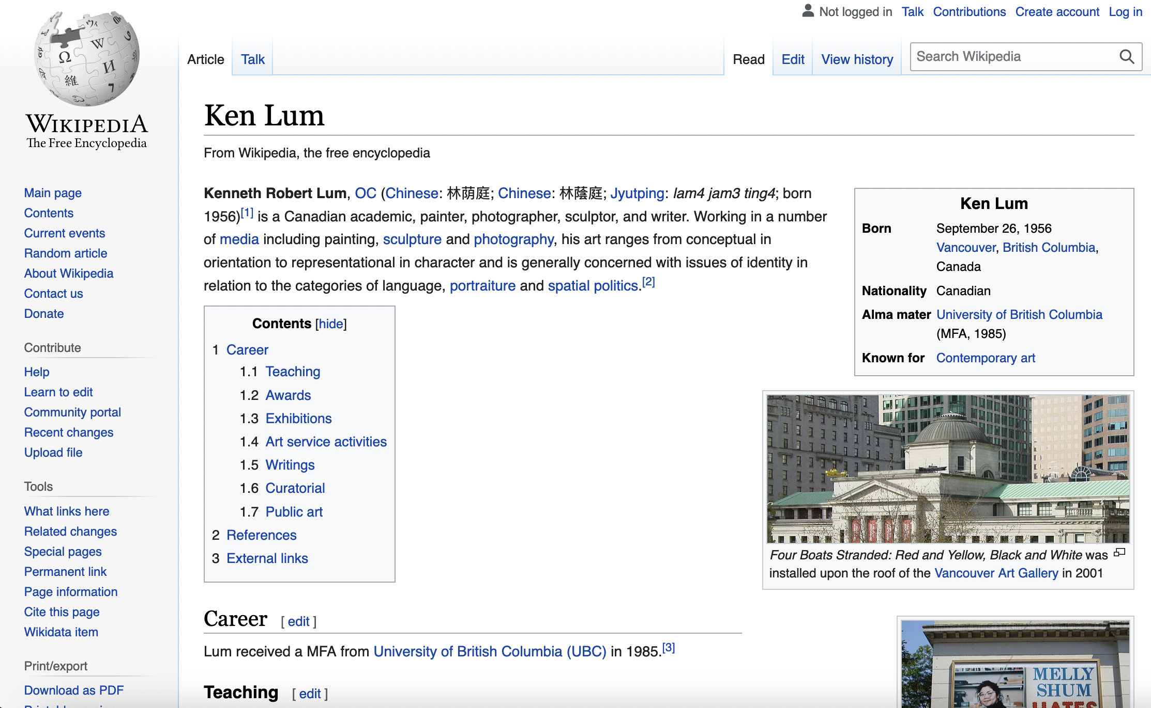

Slide 18
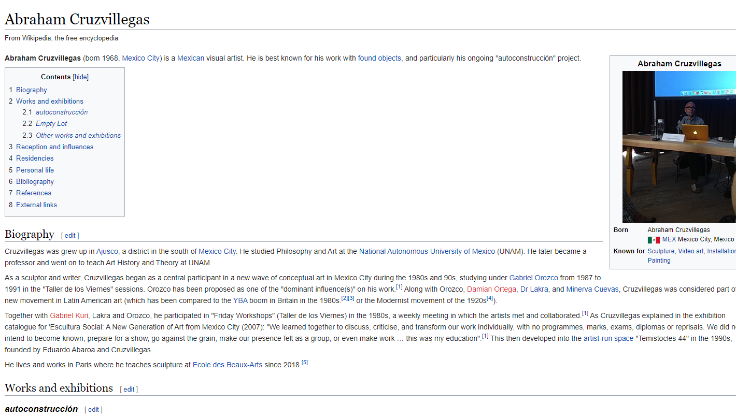

Slide 19
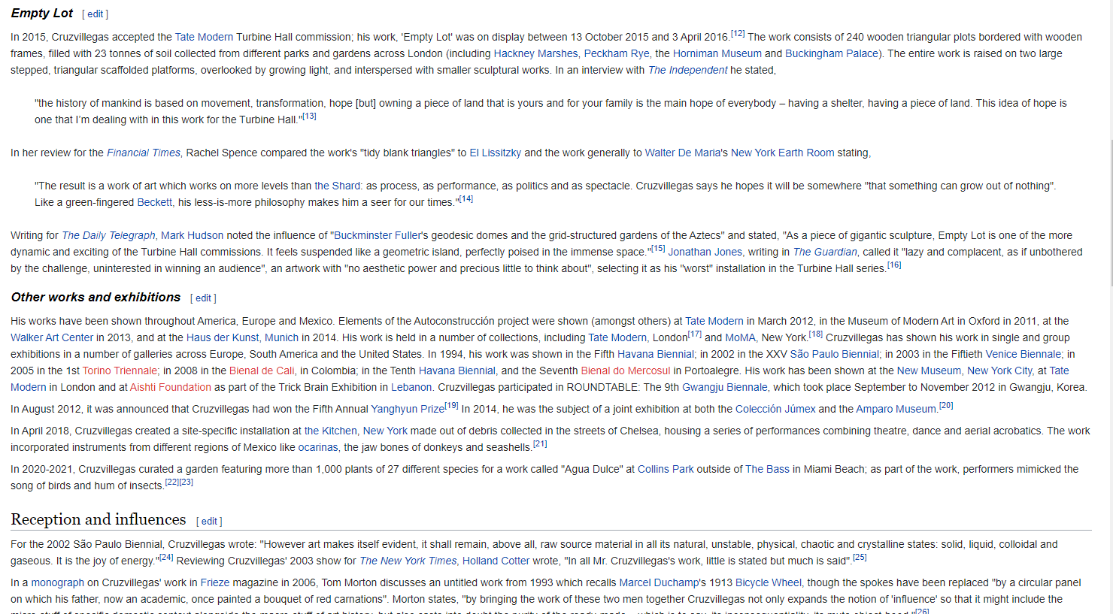

Slide 20
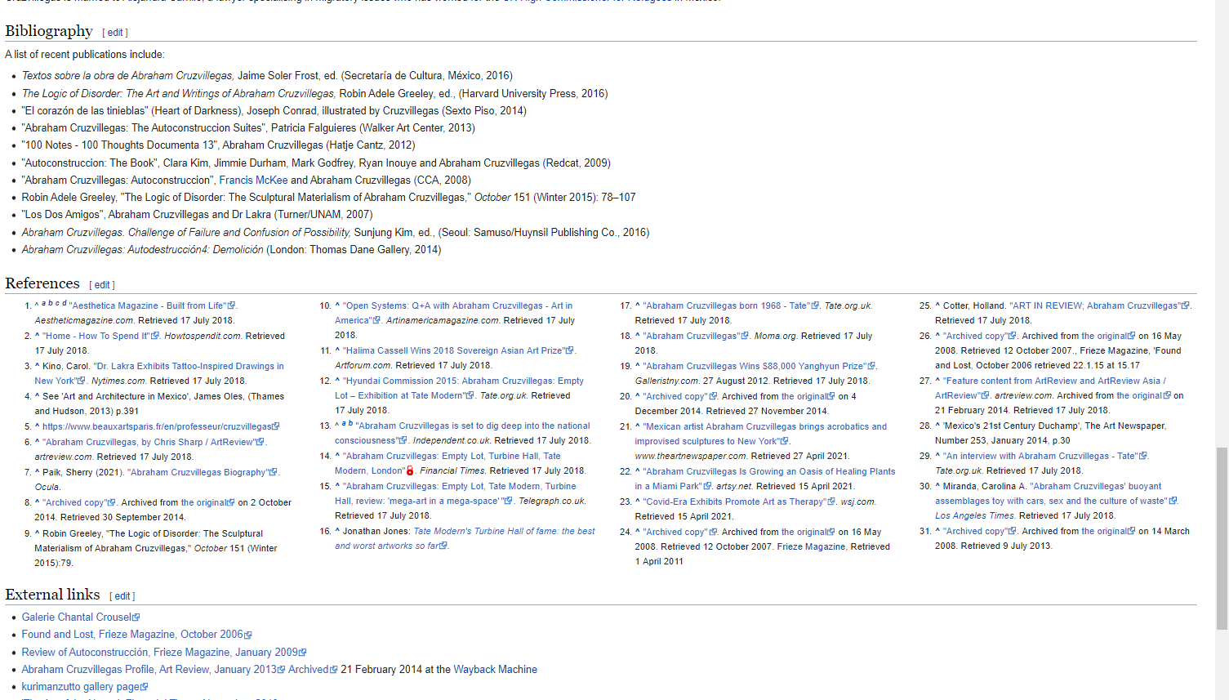
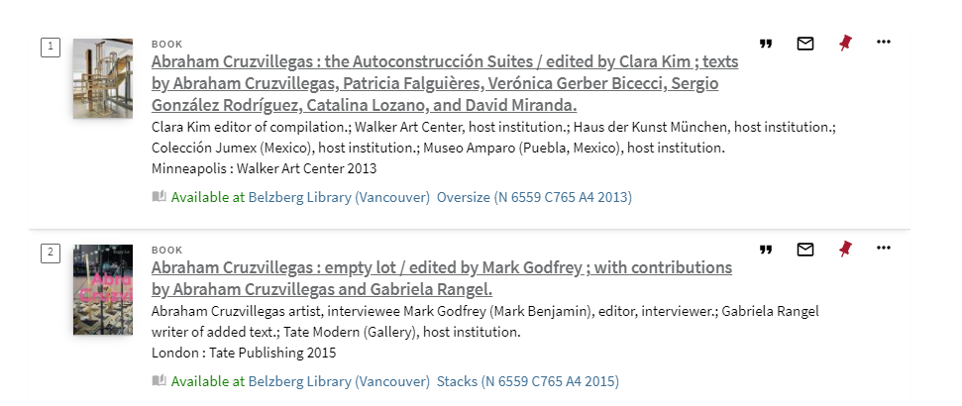

Slide 21
Specialized library sources on artists’ work
Information produced by scholars, curators
Exhibition catalogues ( solo and group)
Books, chapters in books
Journal articles
Information produced by journalists and those working in the contemporary art field
Major news sources
Art magazines, e.g. ArtFORUM, Border Crossings,

Slide 22
Exhibition catalogues
These document specific exhibitions and provide in-depth examination of artists / art
Publishers are usually museums / art galleries
Expert commentary / analysis
Images with details (scope varies)
In depth analytical writing and context
Biography of other sources
Often print format
Artist listed as authors for exhibitions
Notes:
Exhibition catalogues usually look like books – often document an exhibition at an art gallery or museum
Contain images of the artists’ work and often writing about it by experts
can range from a short brochure to hundreds of pages
can cover one artist’s work (in whole, retrospective, or in part) or several (group show based on criteria like nationality, way of working, thematic element) THEY LOOK LIKE BOOKS

Slide 23
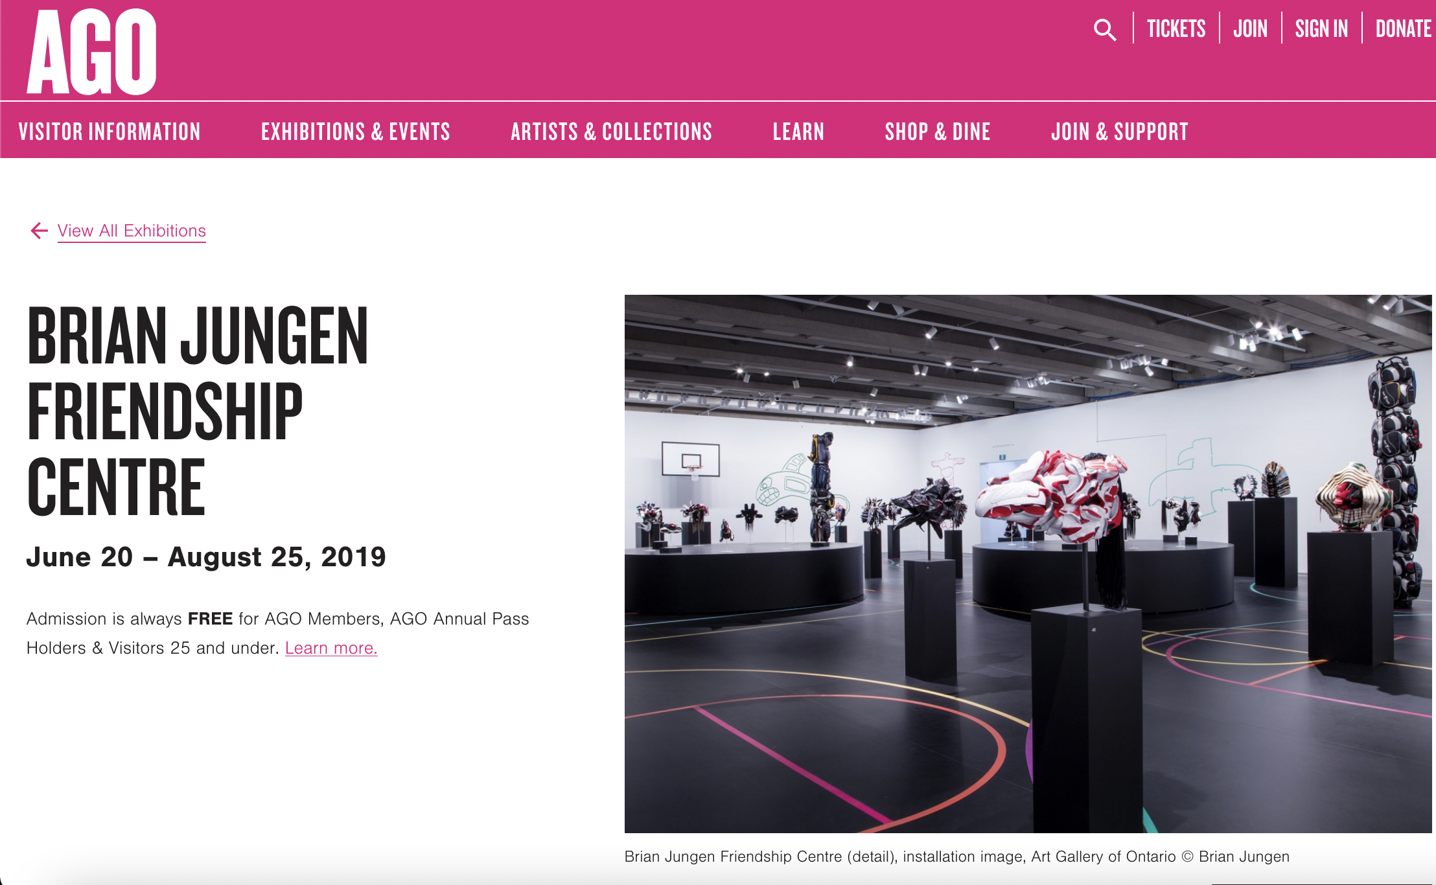

Slide 24
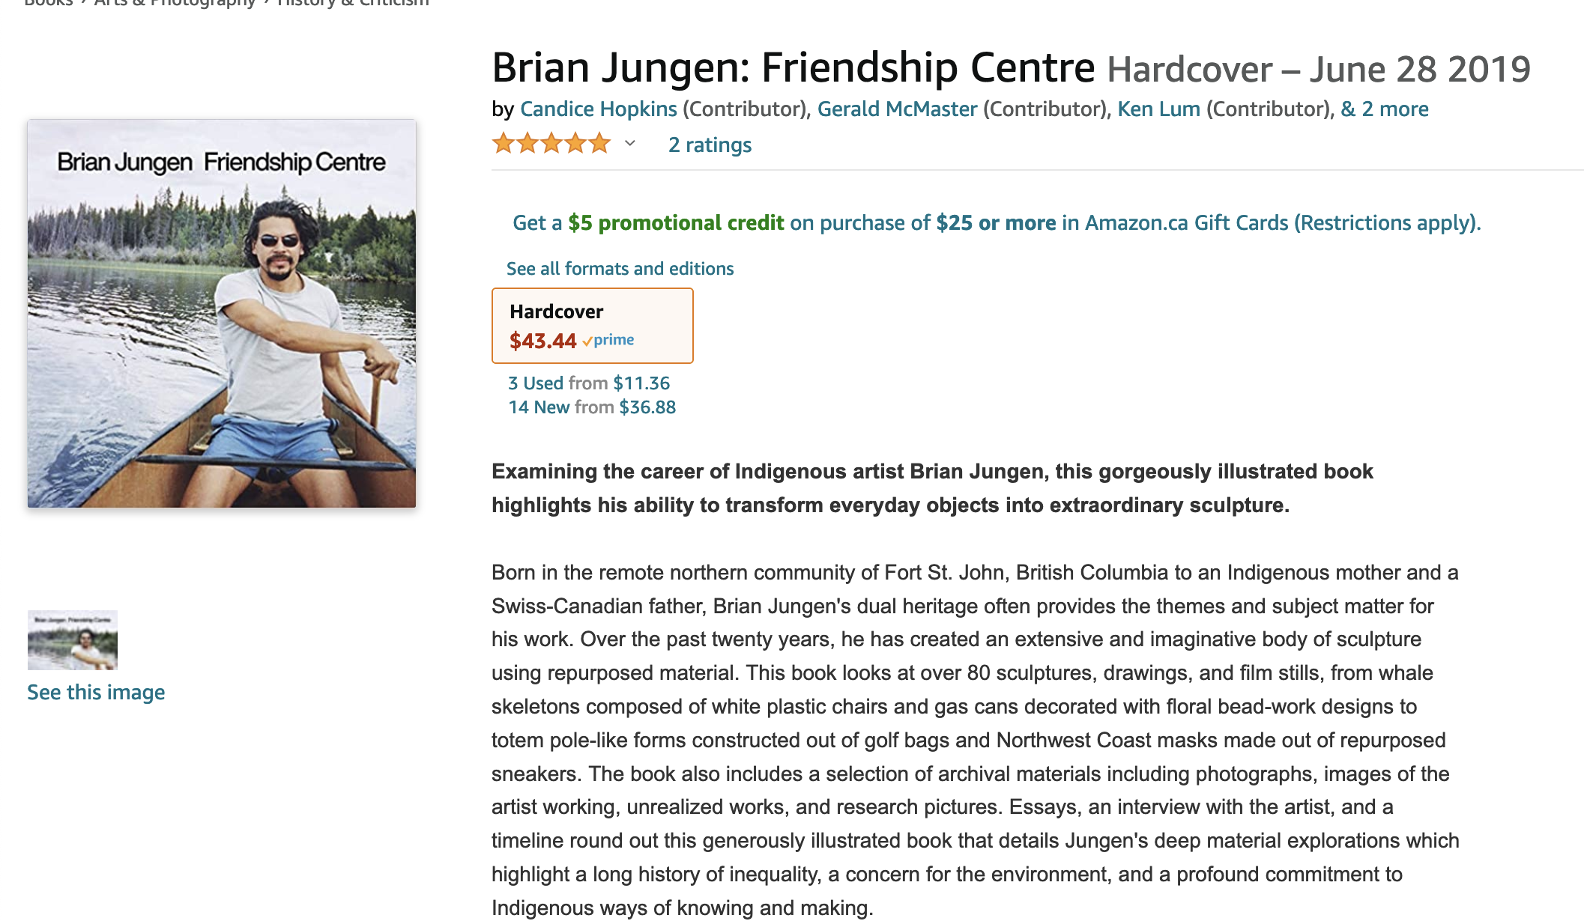

Slide 25
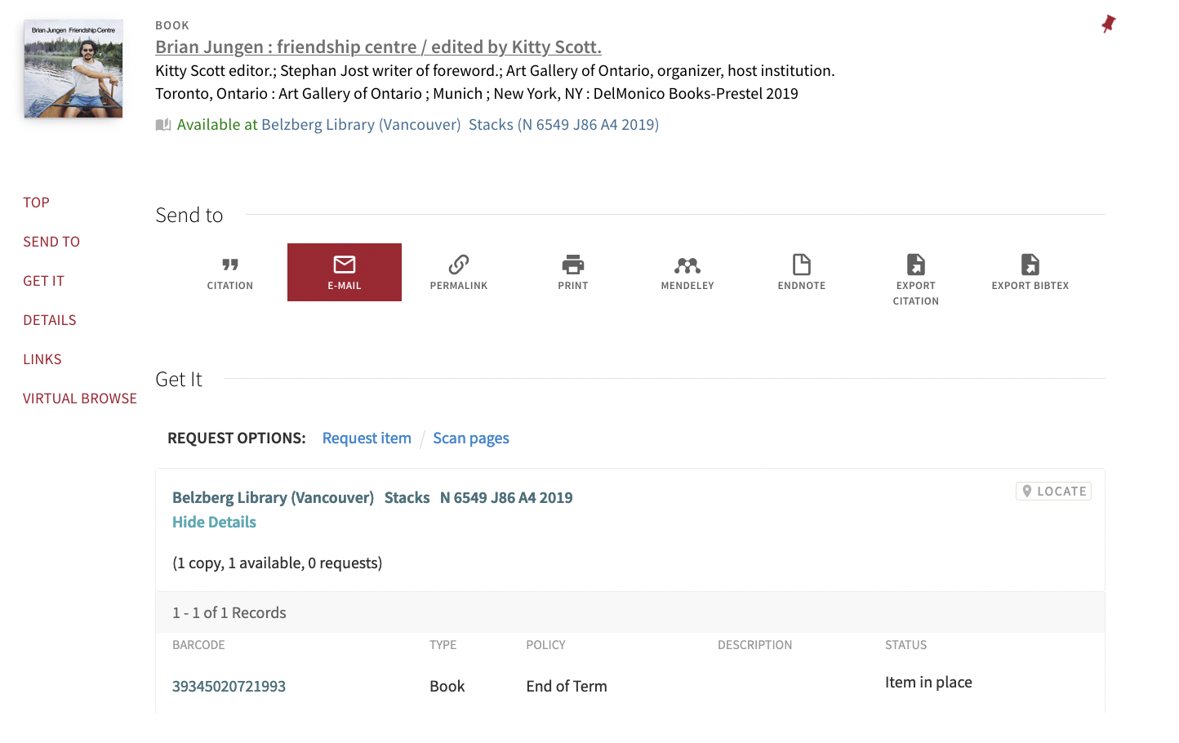

Slide 26
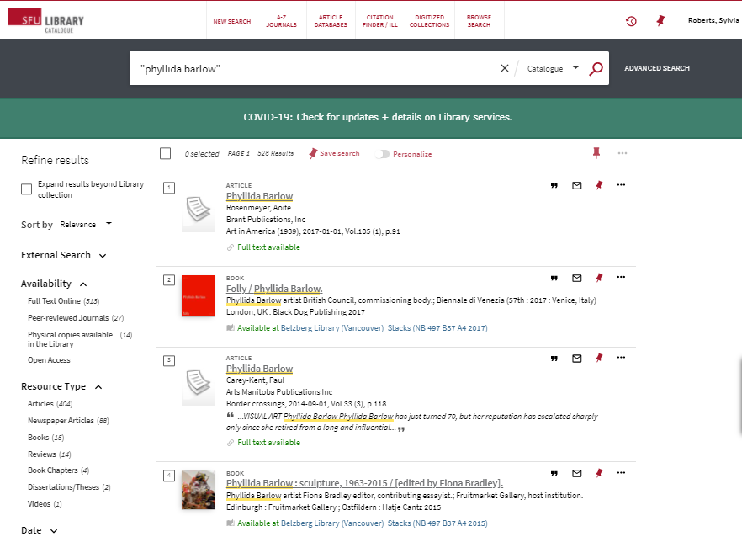
Notes:
Scholar write about contemporary art in journals, books that focus on the artist or artists or themes
Art magazines particularly useful when researching contemporary art: contain articles and reviews – audience is everyone working in or interested in the contemporary art world
What is their nationality and where do they work/exhibit now?
Are they affiliated with particular groups of artists or types of practice, either formally or informally?
What media do they use?
Have they won awards or been featured in international showcases, such as biennales or art fairs?

Slide 27
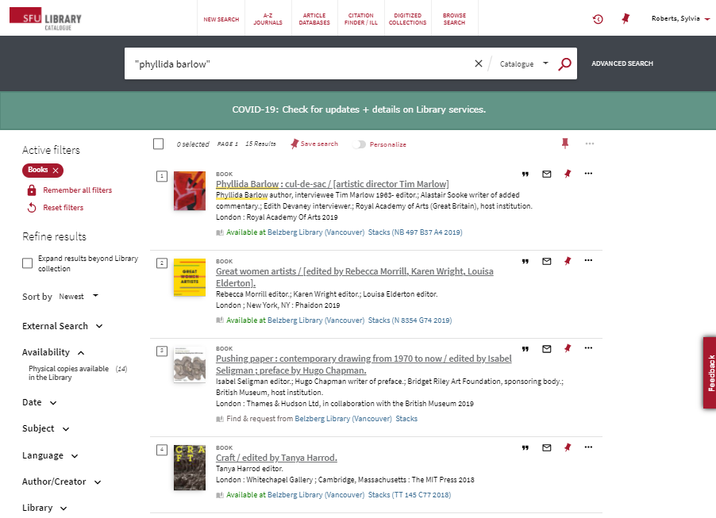

Slide 28
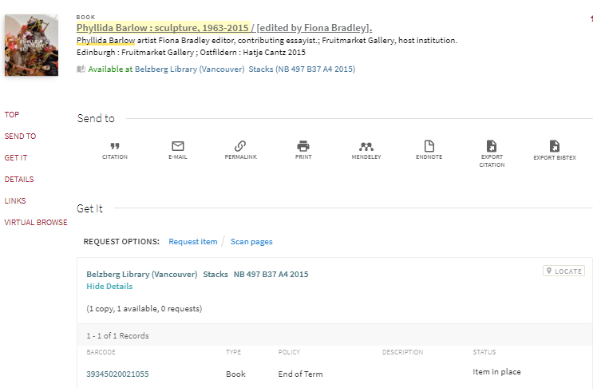
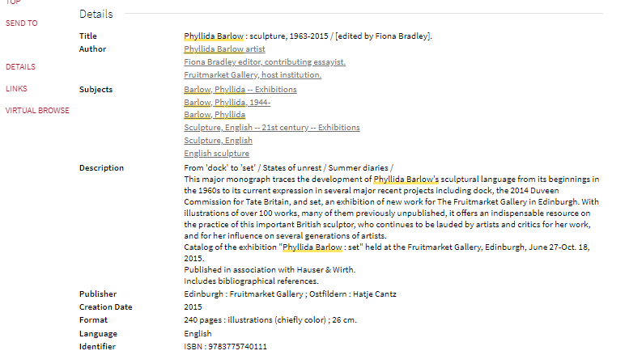

Slide 29
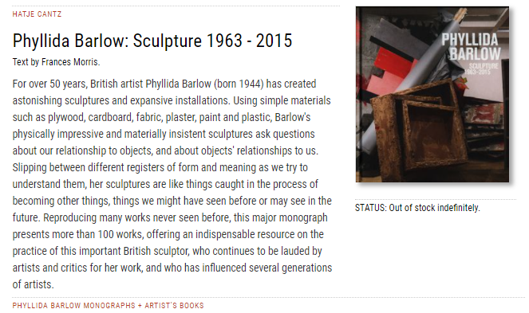

Slide 30
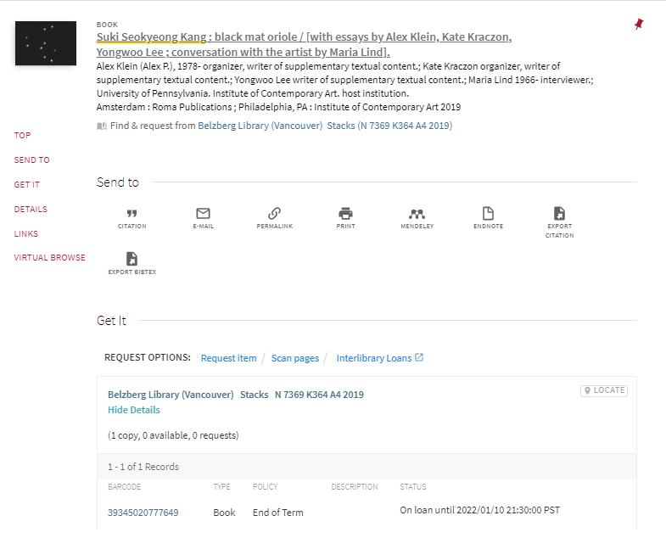

Slide 31
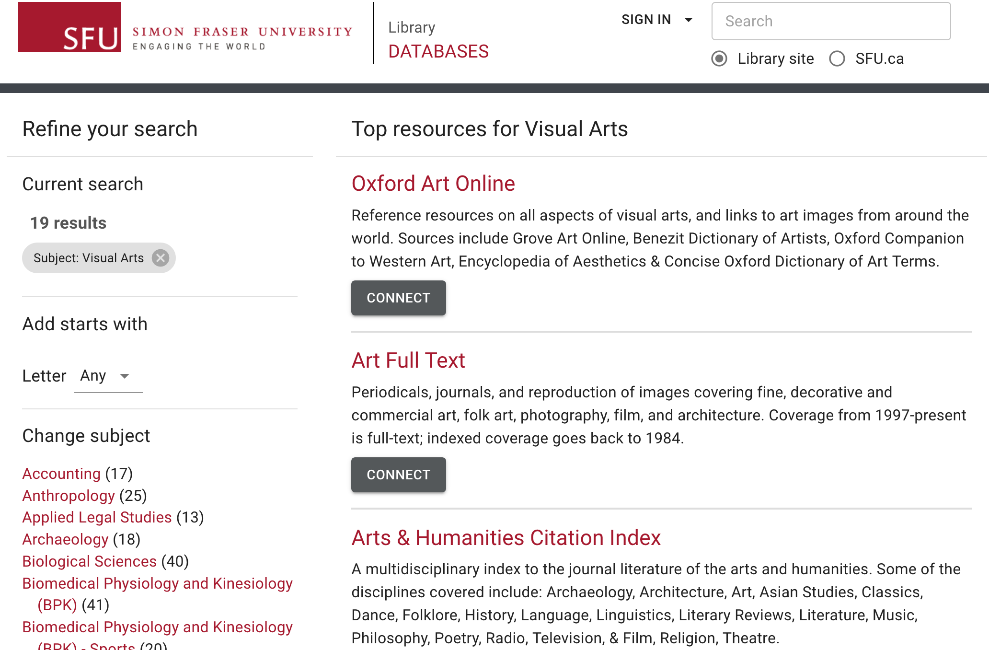

Slide 32
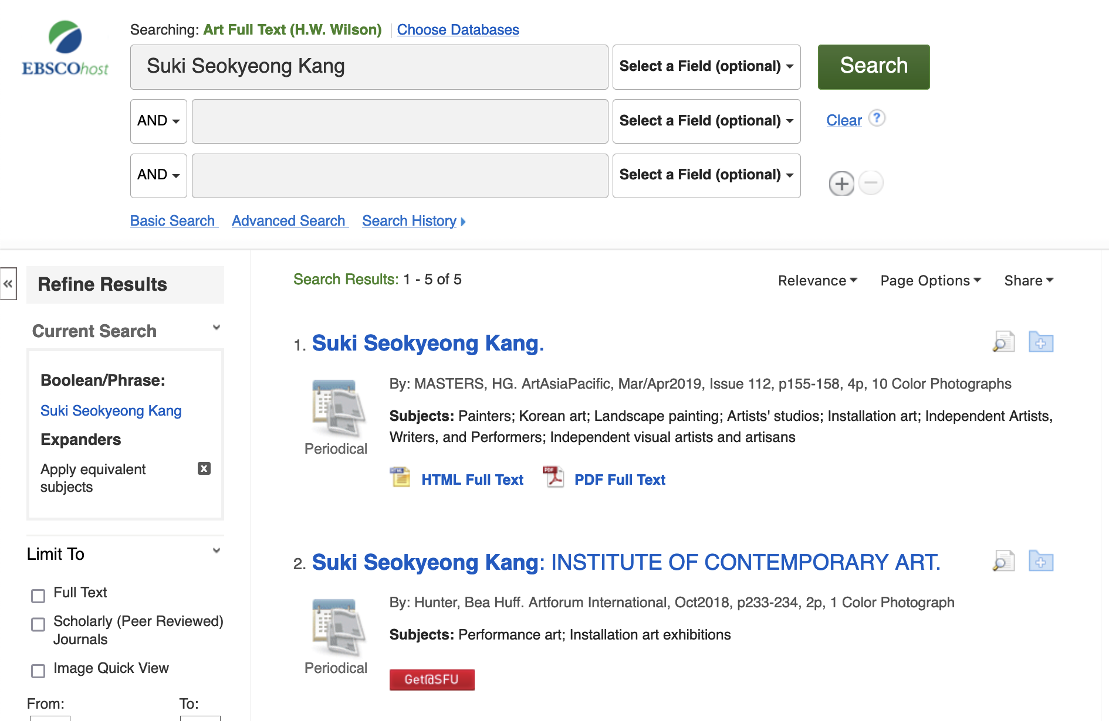

Slide 33
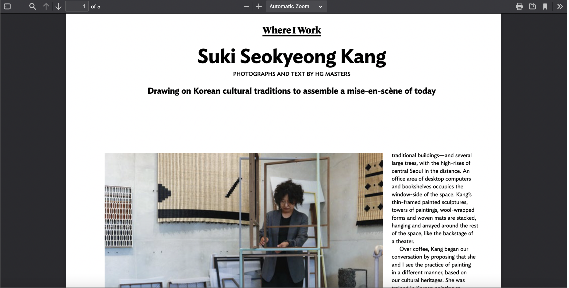

Slide 34
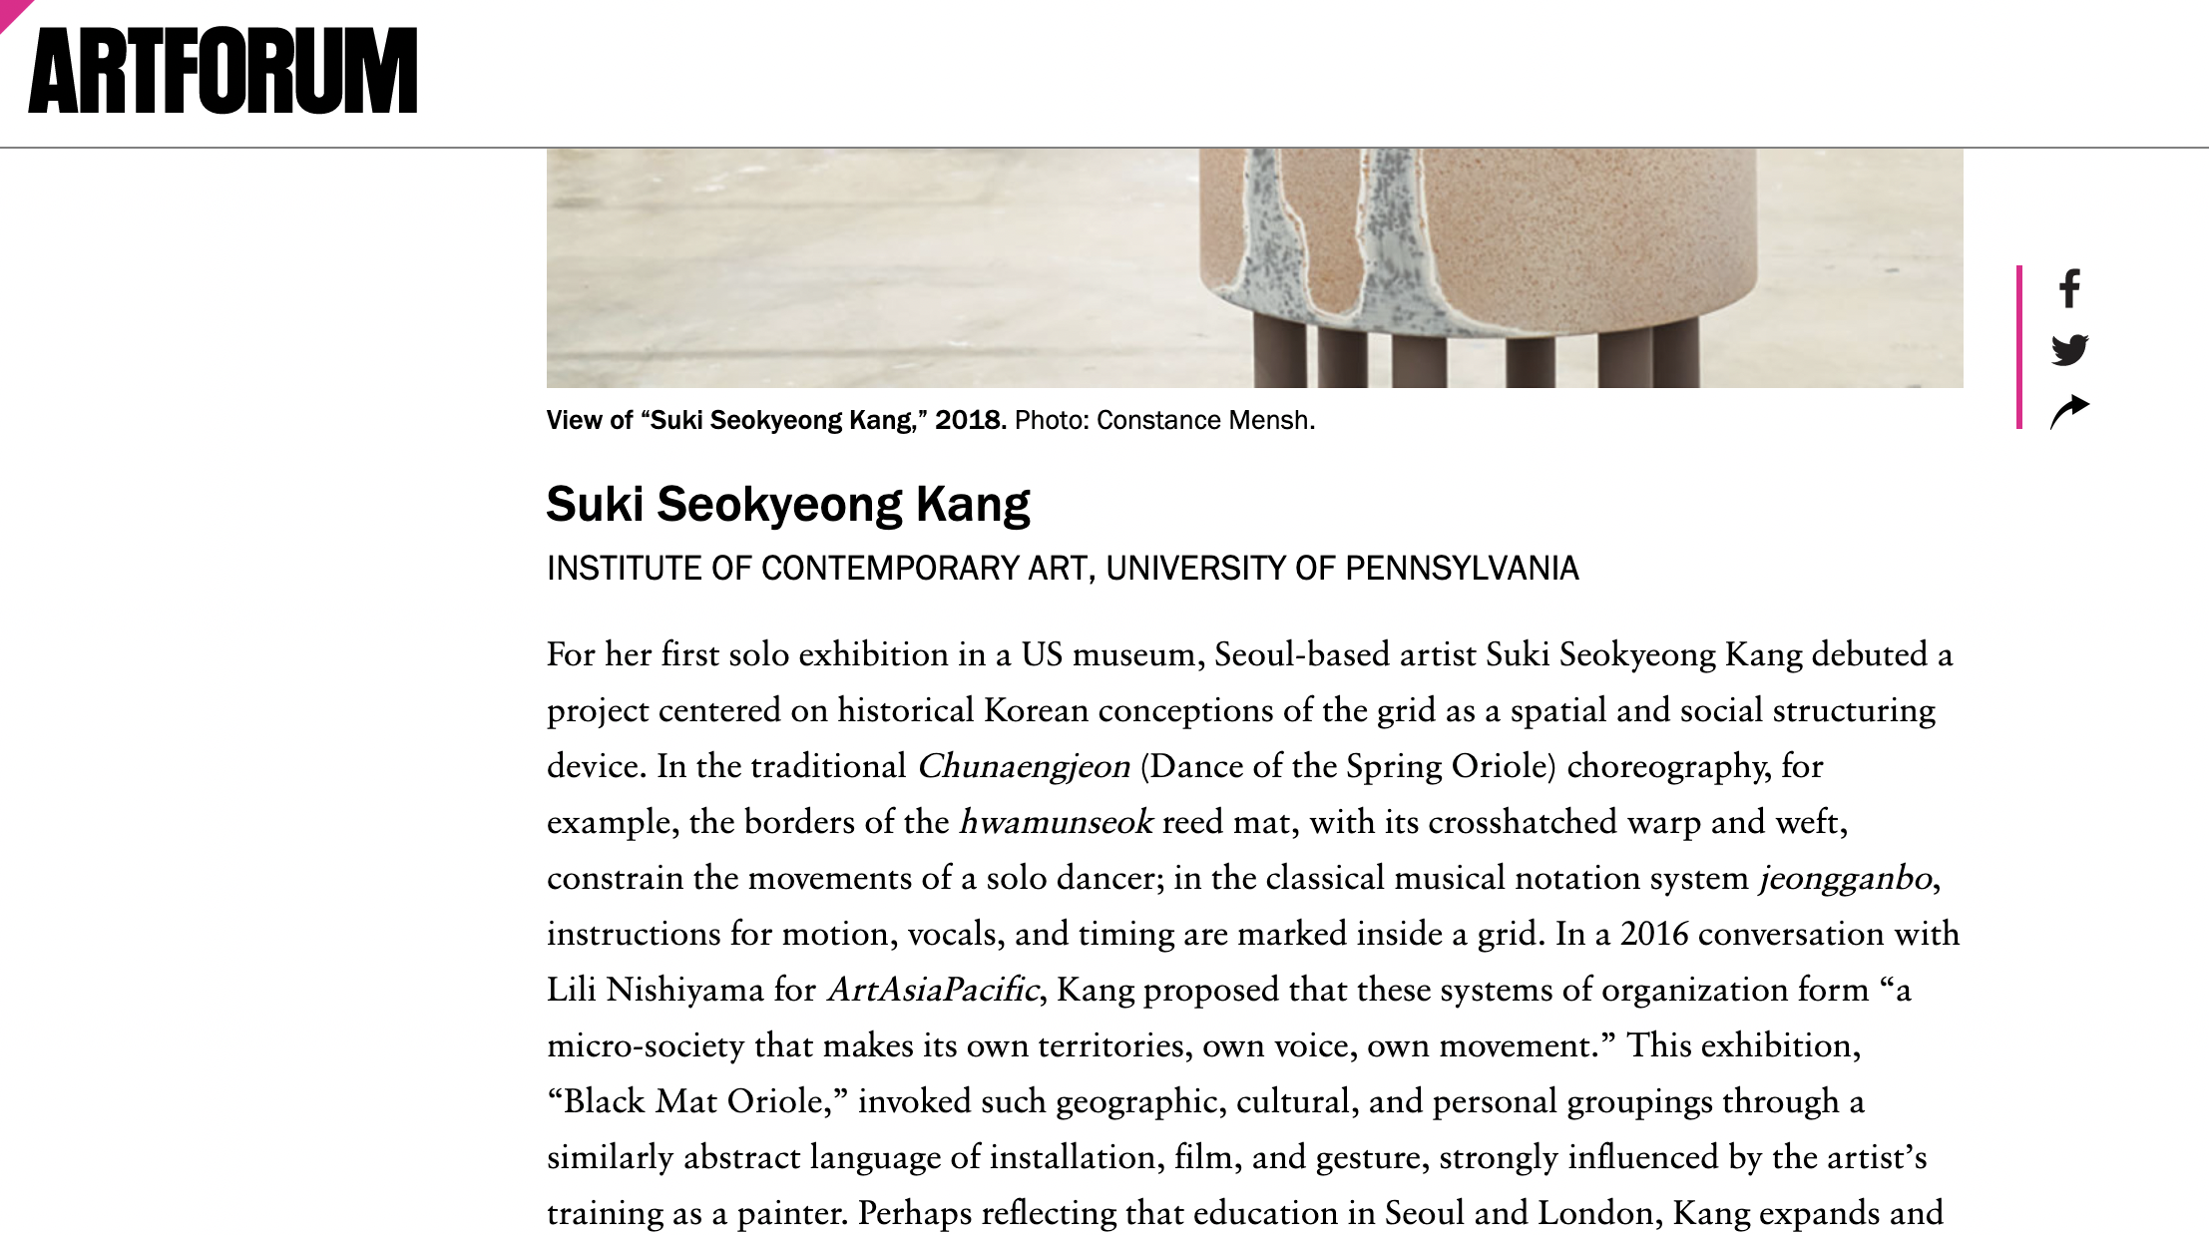

Slide 35
Useful free sources
Artist’s web site
Commercial gallery who represents the artist
Large art galleries’ & museums’ web sites (artist represented in collection, exhibitions)
Youtube & Vimeo (tours of exhibitions, interviews, panel discussions, artist’s talks)
Social media - Instagram
Other?
Notes:
In America, art gallery usually refers to a private, commercial gallery whereas art museum is a private or public institution, usually with a collection
In Canada, we call them all art galleries, e.g Vancouver Art Gallery, Contemporary Art Gallery,
Large museums, like the Tate in Great Britain or the Museum of Modern Art in New York, will often have biographies of artists as well as works in their collections
May also have
Commercial art galleries who represent the artist will have this and also lists or links to reviews, exhibition catalogues and other writings on their artist’s work

Slide 36
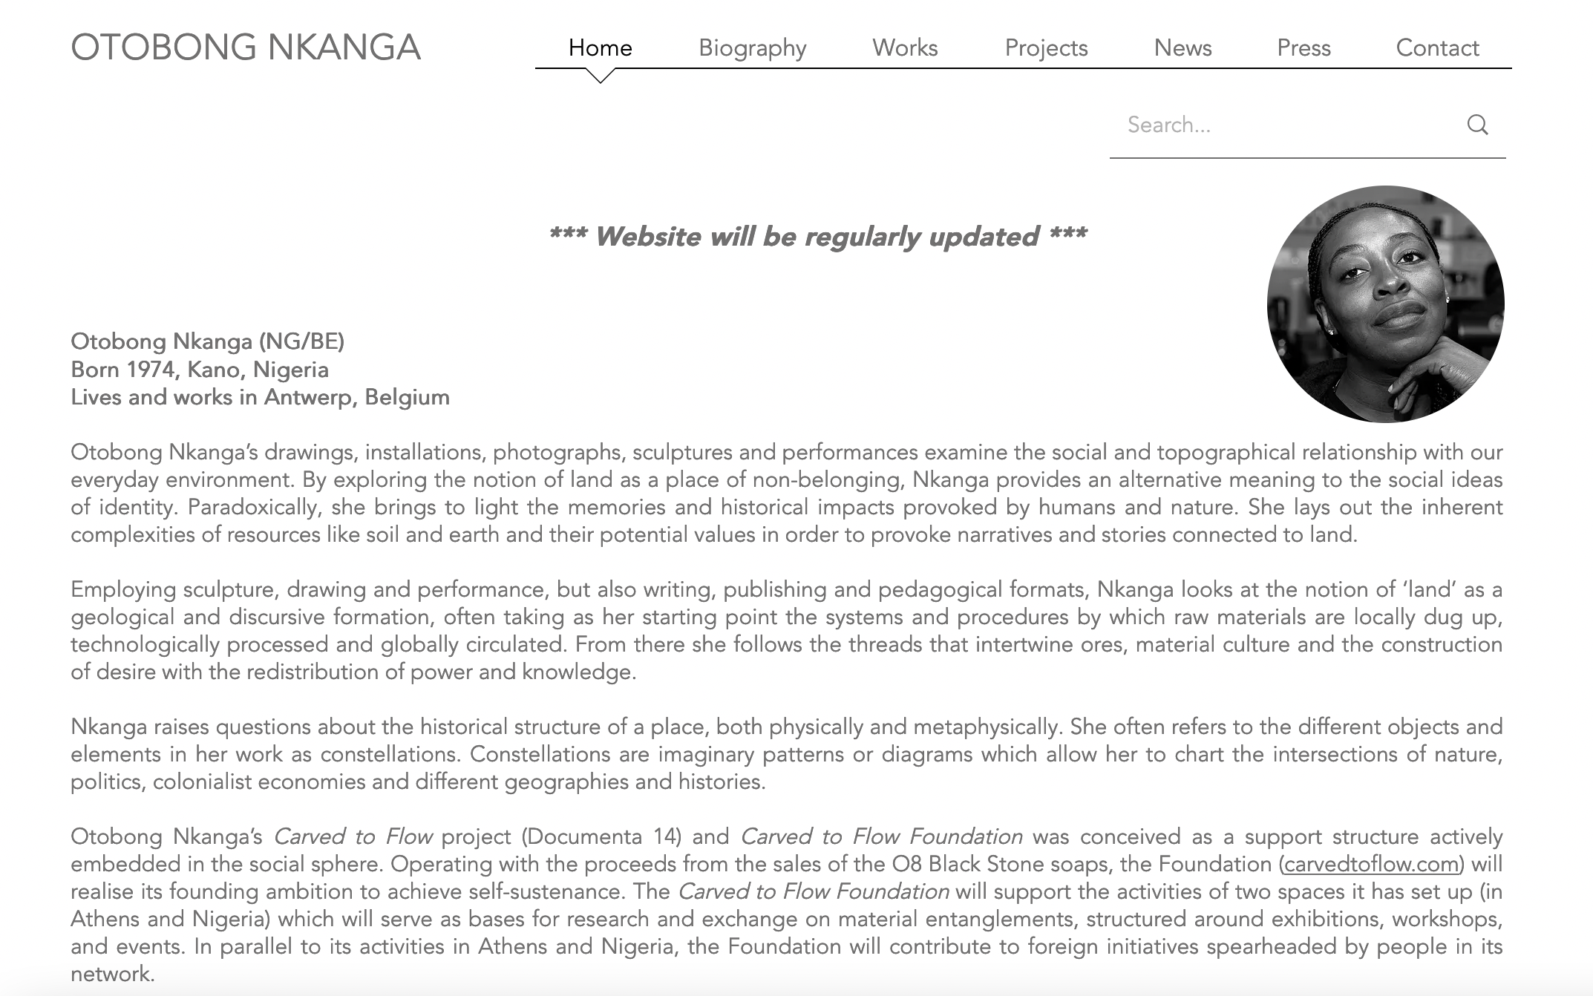

Slide 37
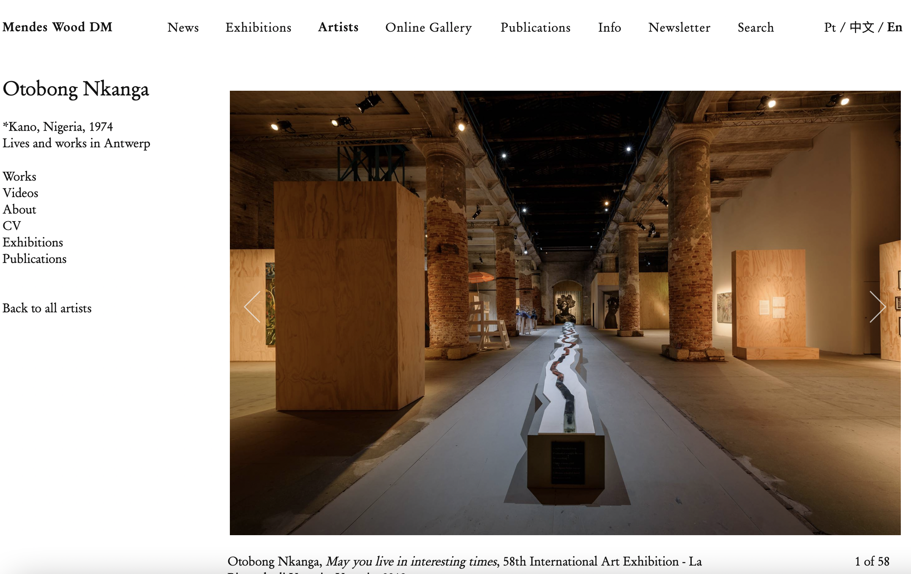

Slide 38
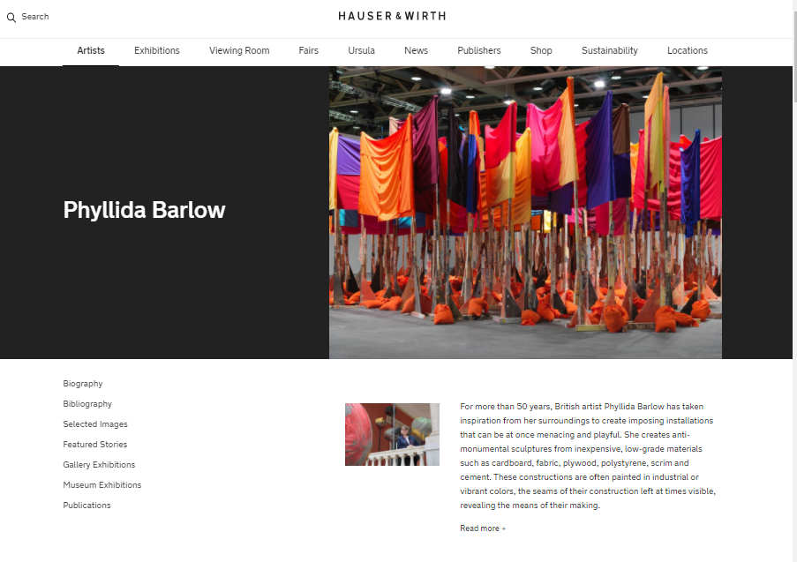

Slide 39
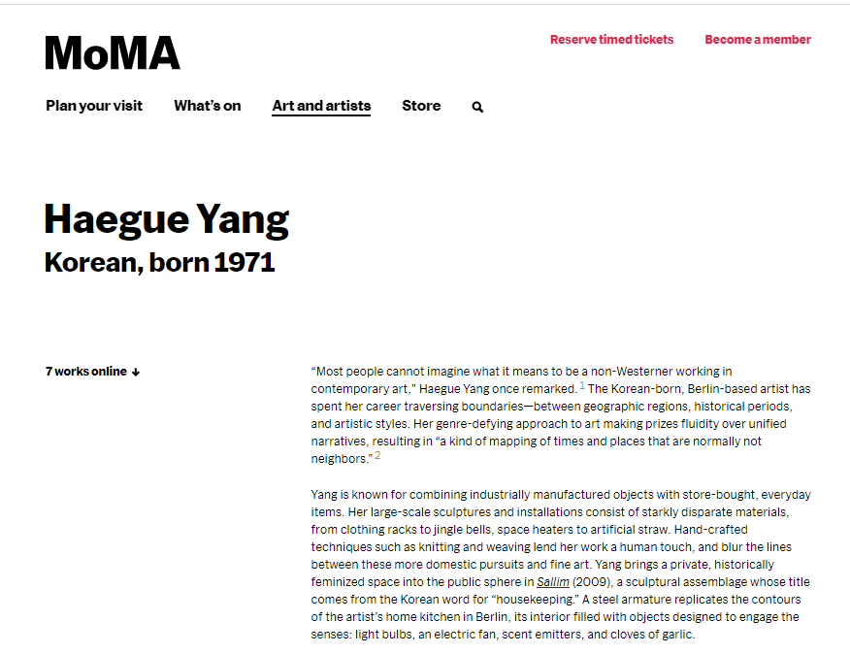
Notes:
This is a list of artists with work in our collection or who have been included in a MoMA exhibition. It is updated continually.

Slide 41
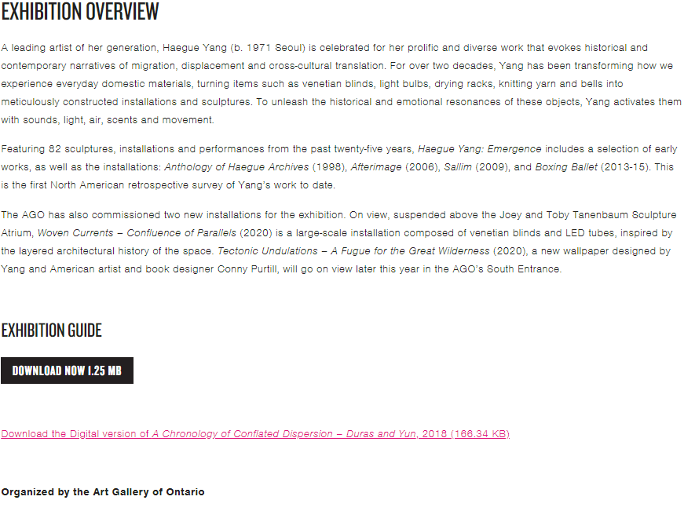

Slide 42
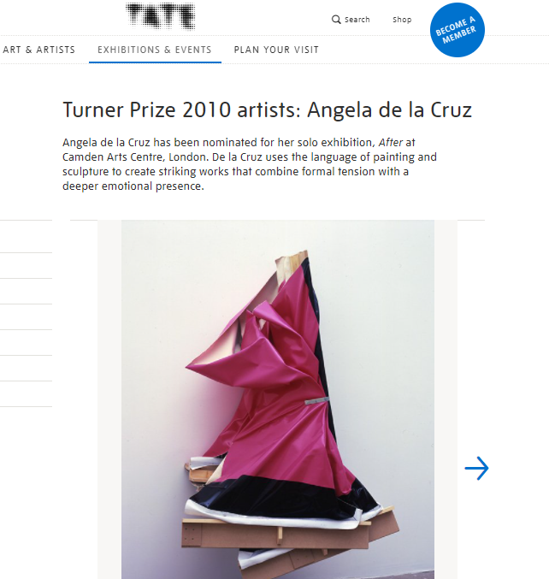
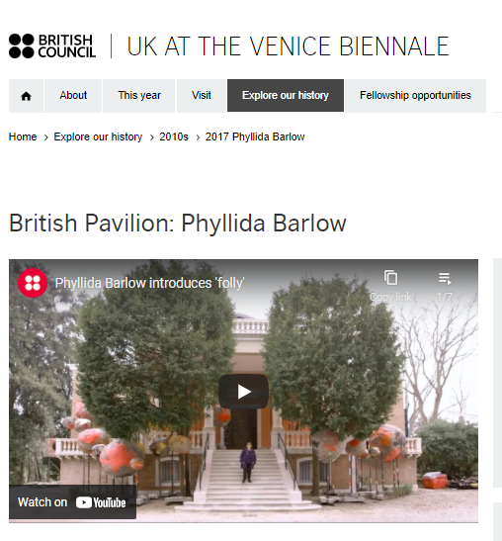

Slide 43
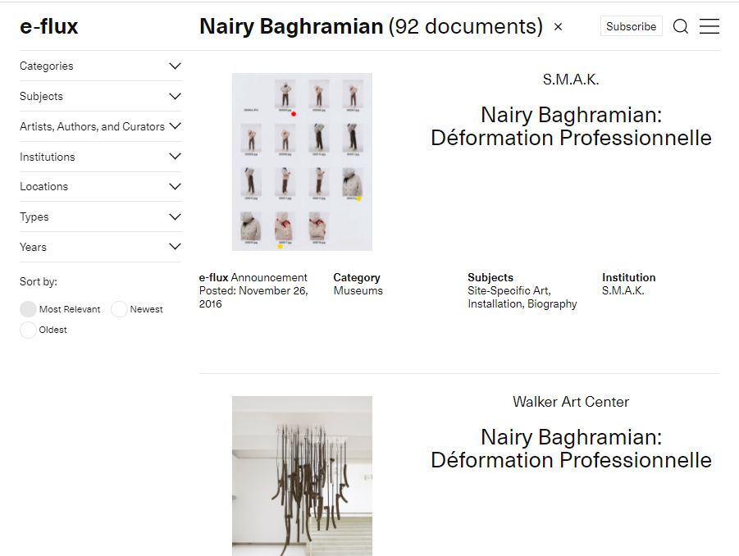

Slide 44
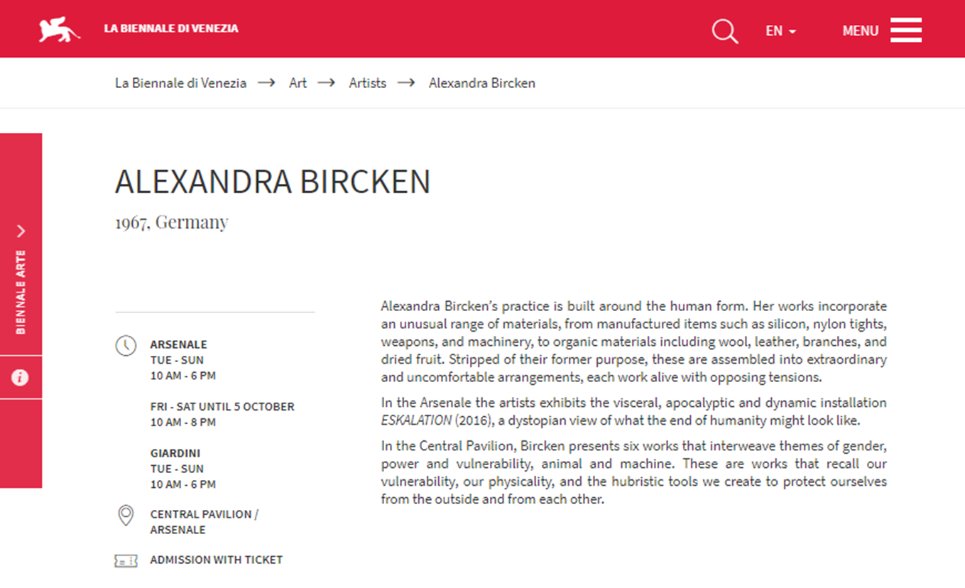

Slide 45
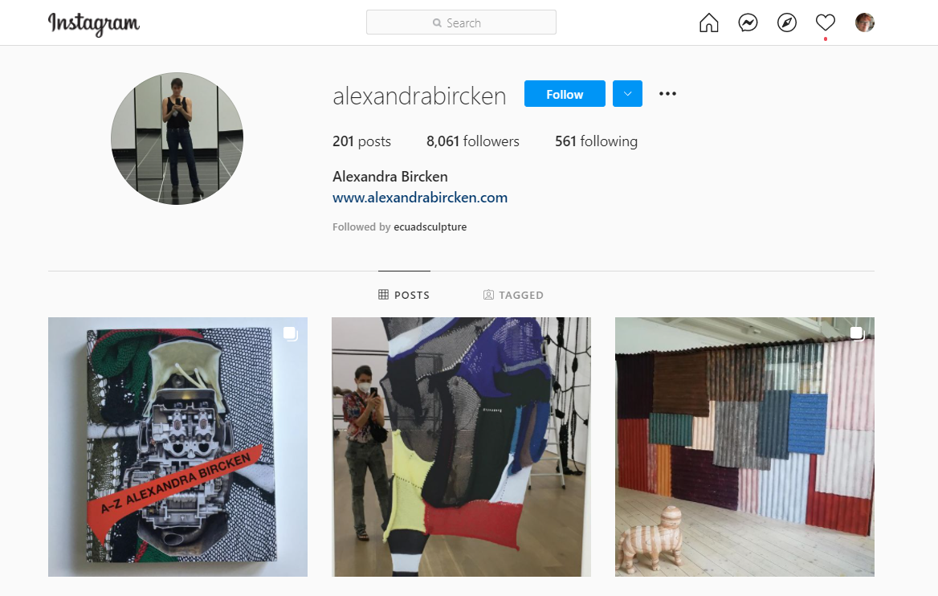

Slide 46
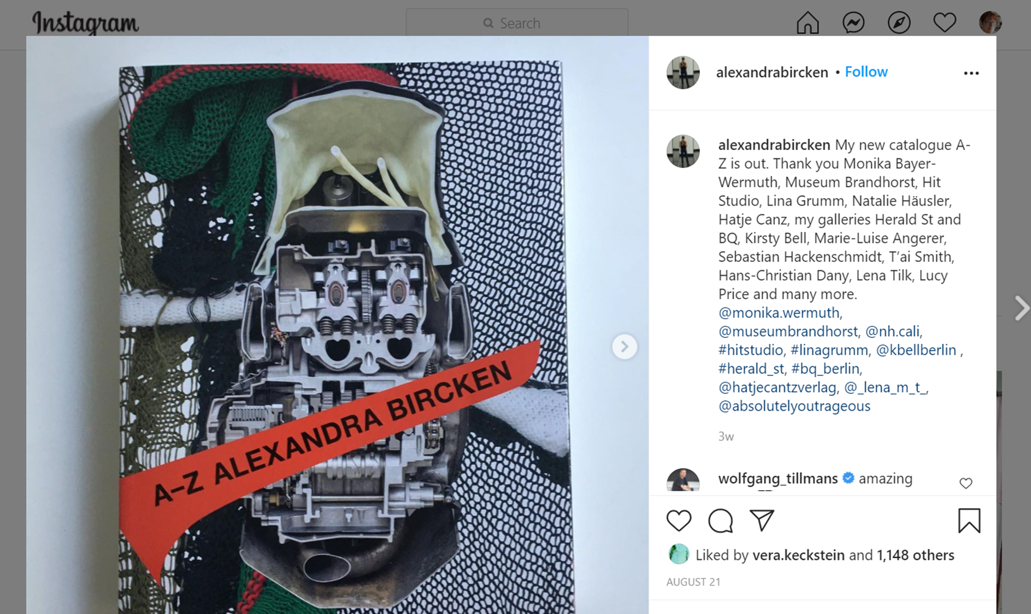

Slide 47
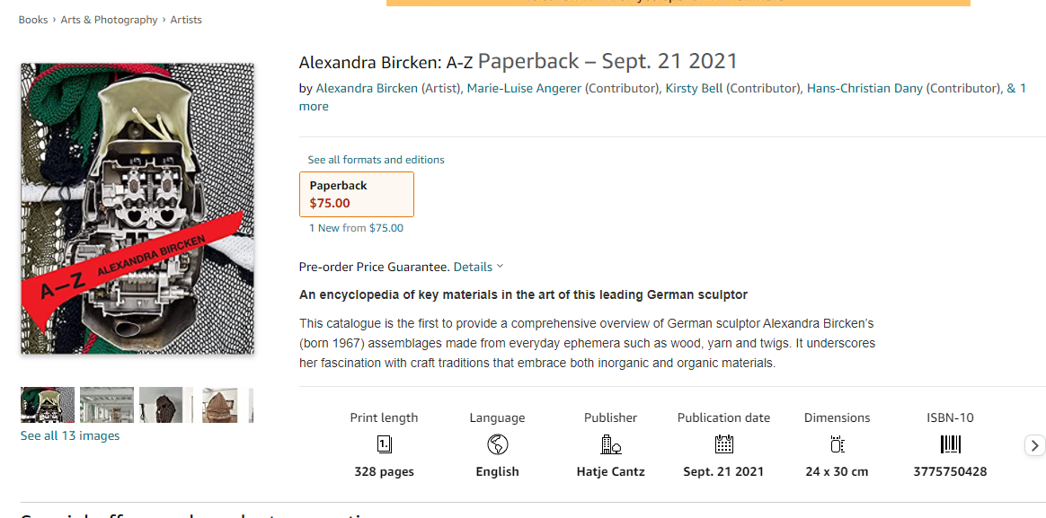

Slide 48
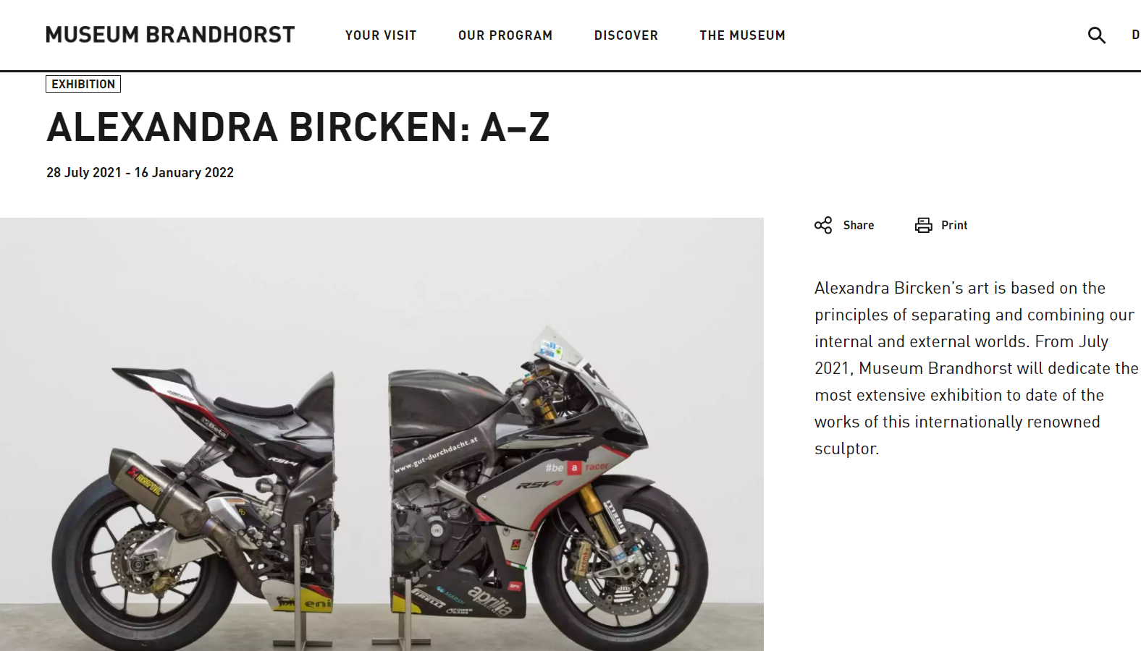
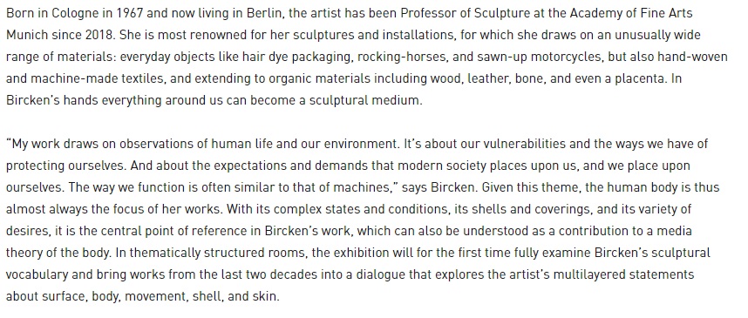

Slide 49
Artists missing documentation….
Length of career?
Internationally famous?
Exhibited in English speaking countries?
Other reasons? social / cultural / political / economic reasons?
Notes:
Many artists have been underrepresented at different points in history due to racism, sexism, homophobism, transphobism and other isms = also may live & show far from traditional art centres or engage in work that’s non-traditional (“new media”) so museums / galleries may be slower to show – gallerist might not be able to monetize work

