Slide 1
Writing & researching your literature review
Robyn Long
Graduate writing facilitator
Sylvia Roberts
CMNS librarian
sroberts@sfu.ca
Notes:
Get students sitting in groups of ~4
Introduce ourselves
If you need to take a break at some point, you can feel free to get up and join us again later.

Slide 2
Graduate Writing is a Marathon

Slide 3
Goals:
Consider the purpose & structure of literature reviews
Discuss strategies for completing & managing your literature search
Consider the structure and voice of your own literature review
Notes:
Our aims & general timeline:
GWF: consider the purpose and structure of literature reviews
Lib: develop a search string
Lib: strategies for efficiently identifying sources
GWF: consider the structure and your voice
Good project management involves break large tasks into smaller ones – just like you’ll want to break down your literature review down into manageable parts, we’ve broken the workshop down into 4 main categories. We’ve also assigned some deadlines to each of these tasks – this is a loose guideline we’ll use to keep ourselves on track.
(Rewards work best on low-level tasks or skills that require practice or patience, rather than on intrinsically motivating activities – e.g. of rewards: taking the night off, spending time with friends/family, stickers on a calendar)

Slide 4
What do we mean by “literature review”?
“A systematic and thorough search of all types of published literature in order to identify as many items as possible that are relevant to a particular topic” (Ridley, 2008).
Systematic = documented, planned, mindful
Thorough = considered scope of research (broader, narrower and related concepts), inclusive of possibly contradictory data
All types of info = range of databases, books, government documents, statistics, theses, etc.
Ridley, D. (2008). The literature review: A step-by-step guide for students. Los Angeles: Sage.
Notes:
The term “literature review” is applied loosely to a number of methodological approaches. For example, getting a sense of a research landscape for a course assignment or paper (maybe you would cite 3-5 highly relevant articles in the lit review). At the other end of the spectrum are systematic reviews, which are usually tackled by a team of researchers who compile and review thousands of articles in an area with very rigorous and systematic criteria. For theses and dissertations, students are often developing a lit review between these two extremes.
Note the difference between a systematic review and a literature review conducted systematically.
This explanation from Diana Ridley’s helpful book provides a general explanation of what we mean when we say literature review in the context of theses or dissertations:
-Systematic is important because you have a documented plan (even one you can replicate) – over searching for hours obsessively. Memory can be short-term.
-Thorough – you have covered all of the bases, searching a wide range of databases. In practice, you probably never reach the end where you say I have covered 100%; there is no doubt in my mind (perfectionists beware)
-All types of information – A different way to search for different kinds of information - guides for different types of info – government documents, statistics, theses, etc.

Slide 5
What do we mean by “literature review”?
Types of literature reviews:
Mapping Review
Mixed Methods Review
Meta-analysis
Narrative Review
Qualitative Evidence Synthesis
Rapid Review
Scoping Review
Systematic Review
Protocols and guidelines:
Cochrane Review
Campbell Review
Rapid Review
Scoping Review
PICO or PICOC
PRISMA
and more …
Check out our online guide to Lit Reviews:
https://www.lib.sfu.ca/about/branches-depts/rc/writing/literature-reviews
Notes:
Won’t speak to all of these … these are just some examples of the types of literature reviews that can come up in various disciplines.
Additionally, some of you may have heard some of these protocols or guidelines, which provide specific frameworks, checklists, procedures, and guidelines for how to go about conducting your lit review. Again, this can be very discipline-specific (Cochrane Review is very common in Health Sciences, for example, and Campbell Review is more common in social sciences). Some of you may not need to followi a specific protocol at all. Check with your supervisor about what is expected and required for your discipline and project.
____
Mapping Review: "A rapid search of the literature aiming to give a broad overview of the characteristics of a topic area. Mapping of existing research, identification of gaps, and a summary assessment of the quantity and quality of the available evidence helps to decide future areas for research or for systematic reviews." (Booth, Papaioannou & Sutton, 2012, p. 264)
Mixed Method Review: "A literature review that seeks to bring together data from quantitative and qualitative studies integrating them in a way that facilitates subsequent analysis" (Booth et al., p. 265).
Meta-analysis: "The process of combining statistically quantitative studies that have measured the same effect using similar methods and a common outcome measure" (Booth et al., p. 264).
Narrative Review: "A term used to describe a conventional overview of the literature, particularly when contrasted with a systematic review" (Booth et al., p. 265).
Note: this term is often used pejoratively, describing a review that is inadvertently guided by a confirmation bias.
Qualitative Evidence Synthesis: "An umbrella term increasingly used to describe a group of review types that attempt to synthesize and analyze findings from primary qualitative research studies" (Booth et al., p. 267).
Rapid Review: "Assessment of what is already known about a policy or practice issue, by using systematic review methods to search and critically appraise existing research" (Grant & Booth, 2009, p.96).
Note: Rapid reviews are often done when there are insufficient time and/or resources to conduct a systematic review. As stated by Butler et. al, "They aim to be rigorous and explicit in method and thus systematic but make concessions to the breadth or depth of the process by limiting particular aspects of the systematic review process" (as cited in Grant & Booth, 2009, p. 100).
Scoping Review: "A type of review that has as its primary objective the identification of the size and quality of research in a topic area in order to inform subsequent review" (Booth et al., p. 269).
Systematic Review: "A review of a clearly formulated question that uses systematic and explicit methods to identify, select and critically appraise relevant research and to collect and analyse data from the studies that are included in the review" (Booth et al., p. 271).
Note: a systematic review (SR) is the most extensive and well-documented type of lit review, as well as potentially the most time-consuming. The idea with SRs is that the search process becomes a replicable scientific study in itself. This level of review will possibly not be necessary (or desirable) for your research project.
Many lit review types are based on organization-driven specific protocols for conducting the reviews. These protocols provide specific frameworks, checklists, and other guidance to the generic literature review sub-types. Here are a few popular examples:
Cochrane Review - known as the "gold standard" of systematic reviews, designed by the Cochrane Collaboration. Primarily used in health research literature reviews.
Campbell Review - the sister organization of the Cochrane Institute which focuses on systematic reviews in the social sciences.
Rapid Reviews have become increasingly common due to their flexibility, as well as the lack of time and resources available to do a comprehensive systematic review.
Scoping Review: There is no strict protocol for a scoping review (unlike Campbell and Cochrane reviews). The following are some recommended guidelines
PICO or PICOC A framework for posing a researchable question (population, intervention, comparisons, outcomes, context/environment)
PRISMA Minimum items to report upon in a systematic review

Slide 6
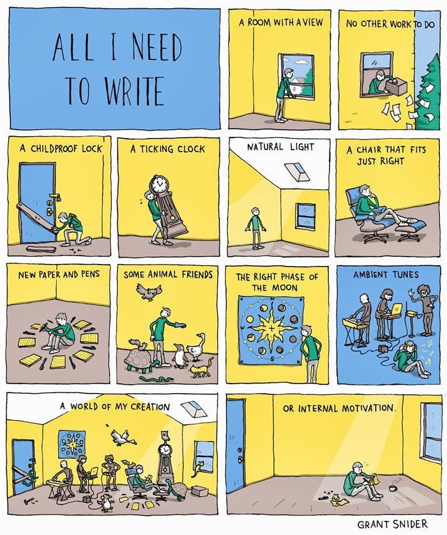
What do we need to write?

Slide 7
Project Management:
Break up large tasks into smaller ones
Goal setting and accountability
Track deadlines/completion dates
Notes:
What are the component parts of the lit review?

Slide 8
Reading & note-taking I:
Consider:
The themes/categories that are emerging
How researchers classify their data, literature, etc.
The major achievements in the reviewed field
The main areas of debate
The outstanding research questions
Notes:
This is all very important- specifically with respect to discipline specific research.
Pass out Critical reading handout

Slide 9
Reading & note-taking II:
Consider the writer’s purpose:
Historical background & contemporary context
Theoretical underpinnings
Definitions & discussion of terminology used in the research
Signaling the gap in previous research and using this to justify own
The significance of a problem for research
Notes:
READING CRITICALLY!!!!!
When you are reading you need to be considering the content.
Also will help with respect to what you take notes on
This could be put in an annotated bibliography etc. - *Note the difference between annotated bibliographies and literature reviews
Also look at how the authors/researchers you are reading organize their material
In which conversations are the authors participating?
Notice what the authors are doing. Examining? Addressing? Arguing? Proposing? Demonstrating?

Slide 10
What is a Literature Review?
a piece of discursive prose, not a list describing or summarizing one piece of literature after another
organized into sections, presenting themes or identifying trends
not a list of all the material published – it involves synthesis and evaluation of the material
Notes:
*It is usually a bad sign to see every paragraph beginning with the name of a researcher. Don’t ‘list’.
** including relevant theory
*** according to the guiding concepts of your thesis or research question(s)
Emphasize the function of summary and synthesis

Slide 11
What is the purpose of a Literature Review?
Establishes the foundation for your research question
Gives validity to the research question
Provides necessary background/precedent/history to situate your research question within the body of research of your field
Engages with relevant work done by others
Identifies pertinent theories
Image credit: Puzzle Piece by Magicon from the Noun Project
Notes:
Your research is a small piece in this complicated jigsaw puzzle, it does not stand alone
It is dependent on what others have done before and will contribute to an ongoing story or debate
Your reader needs to know about the whole puzzle and not simply about the shade and shape of the piece
Conceptualizing your work- describing the bigger picture provides the background and creates the space or gap for your research
Just generally to read about the subject
Think of research within any given field as
a large, complicated jigsaw puzzle

Slide 12
What might your Literature Review look like?
Can be a chapter or a set of chapters
Titles vary and can often be topic-related instead of being called the “Literature Review”
Usually near the beginning of the thesis
Some theses integrate the literature review throughout the chapters, rather than making it a separate chapter
Contains an introduction, body and conclusion
Creates an outline of your research and your thesis
Notes:
The literature review will have a thesis, or a main point or argument
Show so-what: how/why is this connected to your thesis/research project

Slide 13
Structuring a Literature Review
Transitions between sections are important
No prescribed uniform structure
Organizational principles
Distant to Close
Chronological
Comparison & Contrast
Notes:
Impossible to prescribe a uniform structure of a lit review. There are some organizational principles that you can draw on, maybe as combinations
1. Distant to Close
Most distantly related to work → most closely
Long shots/medium shots/ close-ups)
2. Chronological
Earliest related work → most recent
3. Comparison and contrast of different approaches or particular features or characteristics of relevant theories
One approach → an alternate approach → another approach
Trend (changes, developments)
Theme
Methodology
Degree (order of importance, greater/lesser)
Position (for / against)
Chronology (time/history, process, steps)

Slide 14
Starting to Write:
Identify the main ideas/points you want to make
Begin by formulating an outline
Identify different sections
Organize in a coherent order that leads the reader to understand the context and significance of your research question and project
As you organize, keep track of the supporting ideas, examples, and sources that you will be using for each point
Notes:
Consider how the literature review will support your research project overall.
What do people need to know about the choices you have made, the context you are working in, the work that has already been done,…
*Note the need to discern – to narrow the focus usually means excluding some things, too.
Sections may be themes/trends, methods, time periods, depending on the structure.
You may want to ‘audition’ different outlines until you find one that works. Once you decide on one, stick to it while you write your first draft.

Slide 15
What to include in your Literature Review:
Acknowledge:
What has already been written on the research question(s)
Information that has been gathered through research
Any contradictory research, or gaps in the literature
Demonstrate:
A thorough understanding of the field
A dialogue with other researchers in the field
An argument for the significance of your research
Makes connections between one reference and another
Makes explicit links between your sources and your own work
Notes:
What has already been written on the research question(s)?
Relevant background/history/precedent
Explaining how this material is relevant to research question
Must be able to justify the inclusion of any material & show relevance – be choosy
Information that has been gathered through research
Synthesize, evaluate, and explain significance, relevance of all works included
Examine each work on its own and in relation to other works
They can be compared and contrasted for analysis with respect to several dimensions
Dimensions:
Topic
Argument
Results found
Conclusions drawn
Methodology
Theoretical approach
Key words
Include an overview of the subject, issue or theory
Be explicit about the objectives of the literature review
Your lit review helps you make your point (overall thesis). Make sure it points back to your thesis.
To conclude: Instant review / feedback review
Ask participants to summarize what they’ve just heard

Slide 16
Let’s talk about research…
Notes:
Librarian starts here
GOOD NEWS: your critical thinking skills are very much key here.
Everything I am showing you today are just tools.

Slide 17
Remember the purpose of your literature search
There are tools for:
Establishing the foundation & covering the background
Searching for relevant work & pertinent theories in subject databases
Strategically using sources to find more sources
Considering & evaluating each source
Just generally reading about the subject
Managing & citing the sources you find
Notes:
This is an outline of tools/strategies covered. These are re-formulated bullet points from the slide on the purpose of a literature review. Just a refresher to view these tools through the lens of how they will help you achieve these purposes.

Slide 18
Establishing a foundation & covering the background
Tools:
Research Guides: CMNS 800 and CMNS 801
Encyclopedias
Bibliographies (eg Oxford Bibliographies Online)
Research methodology resources (eg Sage Research Methods Online)
Dissertations, theses & review articles
by shopping sherpa
Notes:
Go to the research guides, show the background information tab and point out subject-specific encyclopedias
Go to the Catalogue Search (Primo) and show how to search for dissertations
- Go to Summit and show how to browse by department for SFU theses.
To identify the field and specific context in which your work is situated.
A means of extending your understanding of the key concepts, theories, and methodologies in your field.
Identify key people, organizations, and texts which are relevant to your research.
To find out what others have done in the area so as to avoid duplicating previous work.
It will help you identify the type of data you might collect and use, sites of data collection, the sample size, and how you might analyze this data.
It can assist you in identifying your approach to the research and the methodology you wish to adopt.

Slide 19
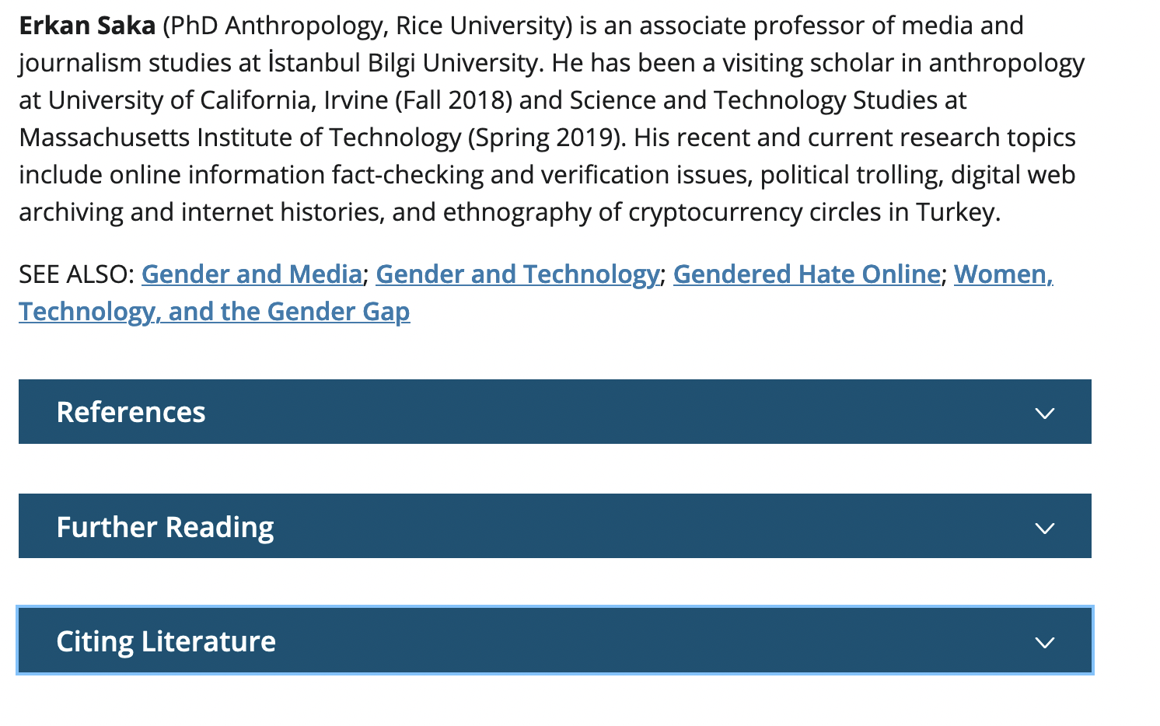
Encyclopedias

Slide 20
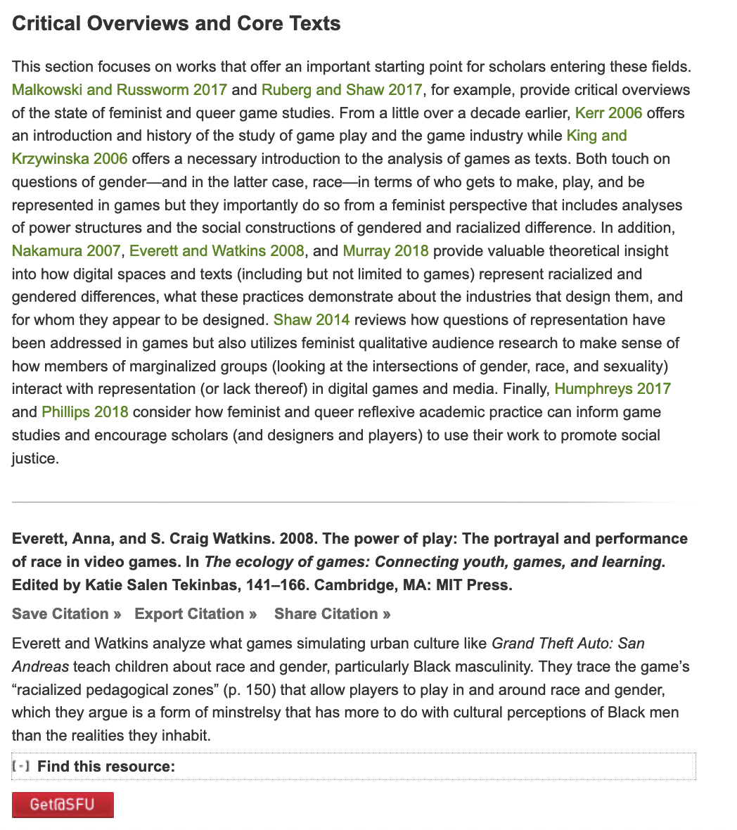
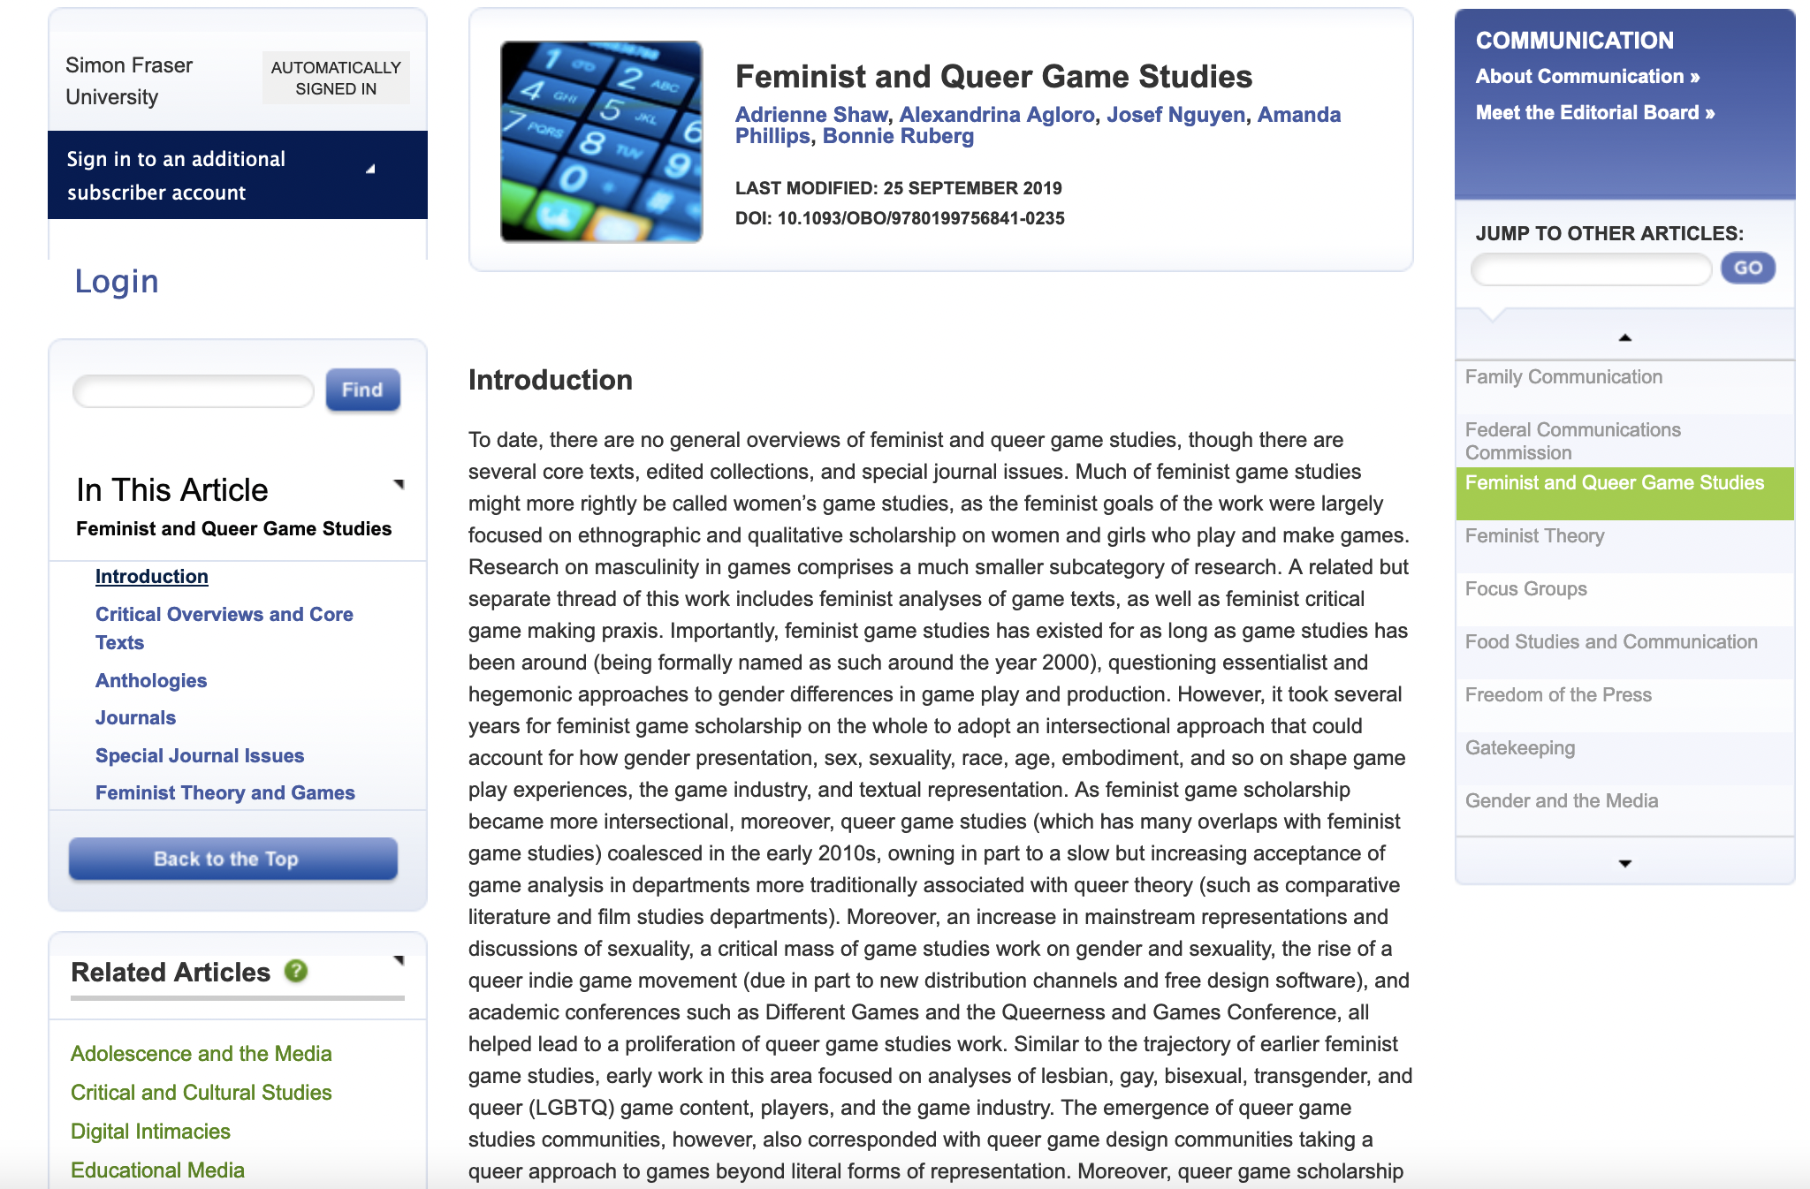
OXFORD BIBLIOGRAPHIES ONLINE

Slide 21
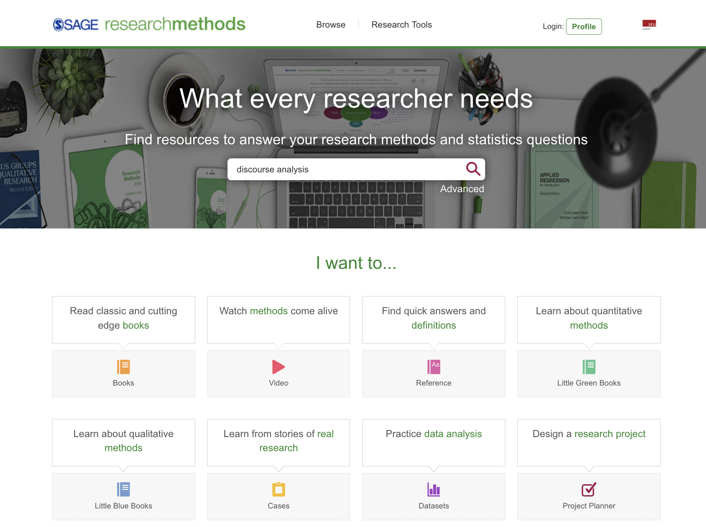

Slide 22
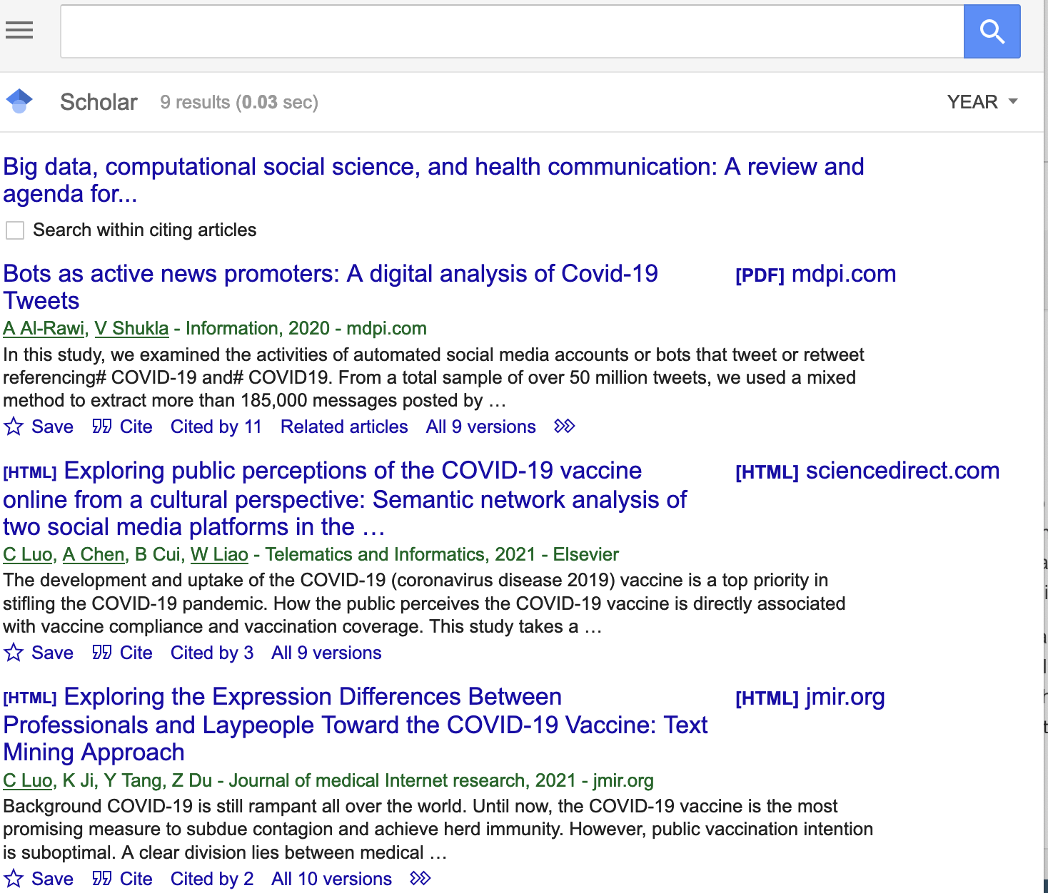
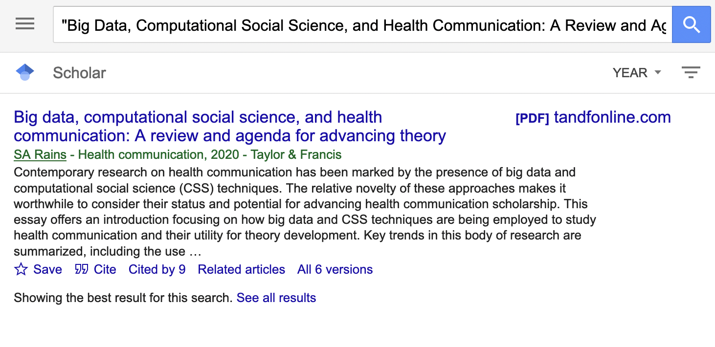
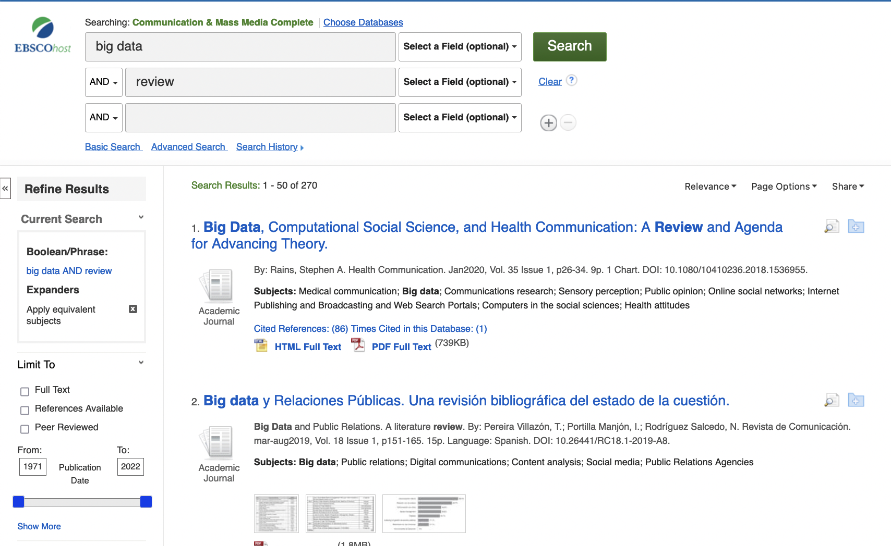
Review articles

Slide 23
Searching in subject databases
What subject databases are you familiar with?
Notes:
Follow-up question: How and why do you use it? Discuss strengths of databases, search techniques
Information searching is a contextualized, complex experience that affects, and is affected by, the cognitive, affective and social dimensions of the researcher
Searching for information is often nonlinear and iterative, requiring the evaluation of a range of information sources and the mental flexibility to pursue alternate avenues as new understanding develops

Slide 24
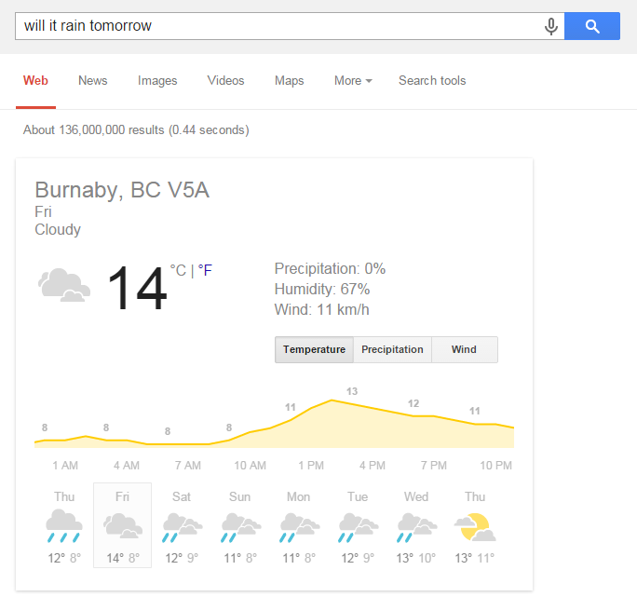
Thinking like an information scientist I: What works in other search engines?
Notes:
Use the next 3 slides only if needed. Taking a step back to frame why and how to search academic databases.
Explain semantic search
Optional. One things to be aware of – semantic search may contribute to the research findings that have shown that, while students tend to have fairly high confidence levels in their to search and find information, their confidence level doesn’t necessarily match their actual ability level. This shows that students may not know what they don’t know and over-estimate their abilities.

Slide 25
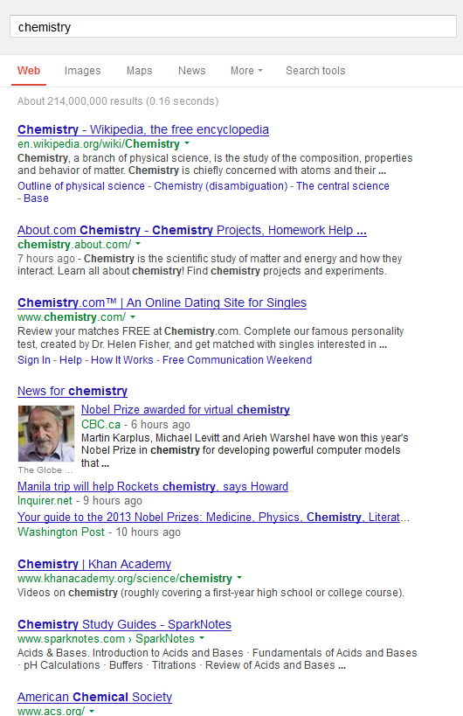
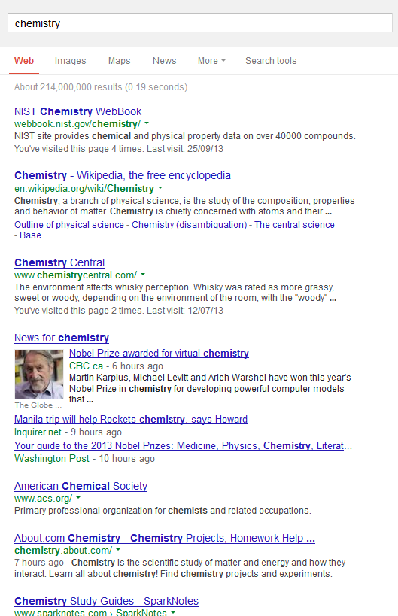
Thinking like an information scientist II: How do other search engines work?
Notes:
- Explain filter bubbles (personalized results based on your search history)

Slide 26
‘Natural language’
Boolean
Thinking like an information scientist III: How are academic databases different?
16 results total
344 results total
Notes:
3. How are academic databases different?
Research databases don’t yet have semantic search – they don’t understand your intent, so you can’t use natural language
Research databases don’t personalize your search results – your past searches will not affect the results you get, so you and I will have the same search results
But they do have Boolean!
Why use Boolean?
It’s about speaking the database’s language – so you have more control over your search results!
Boolean operators allow you to create a more thorough, less ambiguous search
Explain how Boolean works to search the database more thoroughly (more search results) and to identify ‘key’ articles missing from a natural language search (point out highly-cited search results).

Slide 27
Google Scholar?
Advantages
High volume of results
Most popular articles
Algorithm compensates for poor search strings
Excellent for known items
Helpful for unique terms (people and places)
Times cited tool
Includes grey literature & other academic information items
Disadvantages
No specific discipline
Less search sophistication (pseudo-Boolean)
Algorithm & unknown search coverage
Not replicable
Missing deep data (stats)
New articles may not be pushed up
Challenging to search for common terms

Slide 28
Constructing your search in the database’s language
What would be the steps?
I’m interested in early adolescent self-perceptions and Instagram activity.
Notes:
Your literature review is powered by a set of research questions that use can answer by consulting the literature. Before we take a break, take a moment to revisit your brainstorming and formulate one idea into a research question for your literature search.
Taking the time to formulate a research question helps you:
Express what you’re looking for in words before you start searching
Clarify your intention
Break your literature review down into manageable chunks
Identify new and different angles you may need to cover
A reference point for determining the relevance of the sources you find

Slide 29
Search strategies
Identifying keywords
Triangulating your research question
Cycling a search
Finding better keywords as you go
Mining bibliographies of articles
Keywords vs subject headings
Find articles ABOUT your topic rather than ones that mention it
Boolean searches (coming up next slide)

Slide 30
Boolean search techniques
Narrow/decrease | Expand/increase
Using AND to include another concept, e.g. youth AND Instagram AND review Using quotation marks to search for a phrase, e.g. “early adolescence” or “Vitamin C” Using limiters to refine your search, e.g. limit to “Dissertations” or limit by “Publication Years” Field searching, e.g. searching only within the “Title” field Using NOT to filter out irrelevant concepts (use carefully!), e.g. antibiotic NOT antibiotic-resistant | Using OR to include another related terms, e.g. youth OR teenager Using an asterisk (truncation), e.g. adolescen* for adolescence, adolescent, adolescents, etc. Using broader keywords, e.g. social media instead of Instagram Looking at cited and citing articles, related articles, bibliography (see next slide)
Notes:
Besides for Boolean operators, there are other techniques you can use to adjust your search results and exert control over what the database gives you.
Narrow/decrease:
Adding in new concepts with AND
Using quotation marks, e.g. “Vitamin C” instead of Vitamin C
Using limiters to refine your search
Sorting by relevance or times cited
Using NOT to filter out irrelevant concepts, e.g. antibiotic NOT antibiotic-resistant
Expand/increase:
Adding more related terms with OR
Using an asterisk, e.g.
Using broader keywords, e.g. citrus fruits instead of oranges
Looking at cited and citing articles, related articles, bibliography
Add MeSH terms (see handout)
* Productivity tools: search alerts, table of contents alerts
Pitfalls: not taking advantage of your liaison librarian!
DEMO: in PsycINfo
Adolescent AND Instagram AND self-perception
(Adolescent OR youth OR teenager) And Instagram AND self-perception
(Adolescent OR youth OR teenager) And (Instagram OR social media) AND self-perception

Slide 31
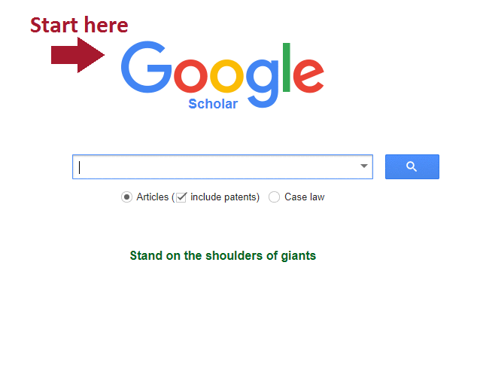
Strategically using sources to find more sources
Bibliography mining & using forward chaining (times cited)
Notes:
Google Scholar? Often researchers doing a literature review will use both Google Scholar + subject-specifics databases.
Advantages of Google Scholar:

Slide 32
Track your search terms, strategies and results to enable you to systematically improve and reproduce these in other databases and over time
Note potentially relevant journal names, conferences, authors, research centres
Strategic use of social media and news media because of knowledge mobilization trends
Check scholar’s CVs
More “pearl-growing” tips
Notes:
Pearl Growing is in this context the process of using one information item (like a subject term or citation) to find more information.

Slide 33
Considering & evaluating each source
Ask yourself:
The purpose – Who is the intended audience? Does the author have a financial or political interest that would unduly bias the methodology/findings?
The publisher – Does the journal’s publishing practices seem trustworthy? Is the peer-review legitimate? Is the journal predatory?
The claims – Have the results been discussed or cited by other researchers? Have they poked holes that concern you?
Currency – If you’re looking at a very new topic, consider non-traditional sources, like social media or blogs, conference proceedings, new scholars

Slide 34
Authority is constructed
Consider the quality and nature of each source that you consider including in your review. What role is it playing in support of your research?
How is the authority of the source established?
How can diverse voices be found in published scholarship?
Notes:
Relationship building – networking, seek biographical information to see how people identify, follow social media feeds
"Social media outlets like Twitter are a good place to identify BIPOC scholars that are in your field but outside of your professional bubble.”
Research scholars to see how they identify in their own work
Specialized groups within professional associations, e.g. ICA Ethnicity and Race in Communication https://www.icahdq.org/group/eric
Authors, editors and reviewers of “special issues” of journals and “themed” conferences

Slide 35
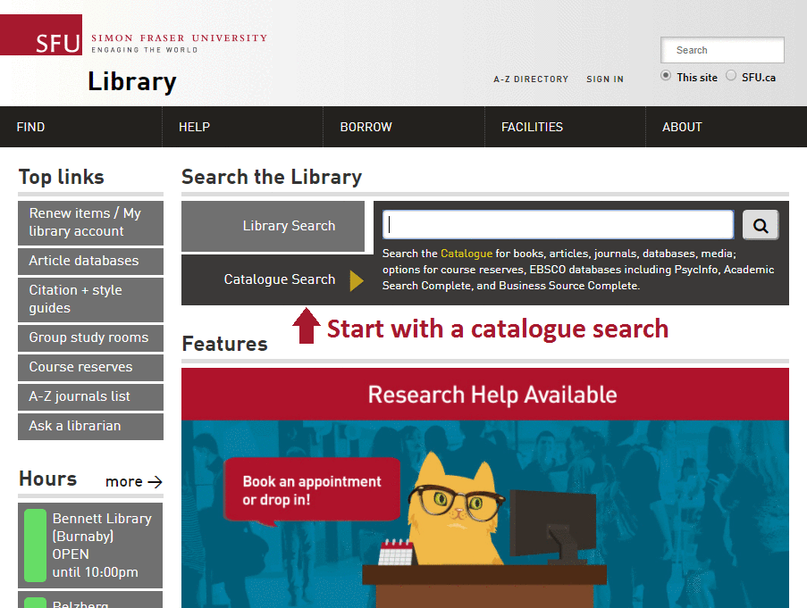
Just generally reading about the subject
Strategies:
Browsing the shelf
Browsing the virtual shelf
BrowZine

Slide 36
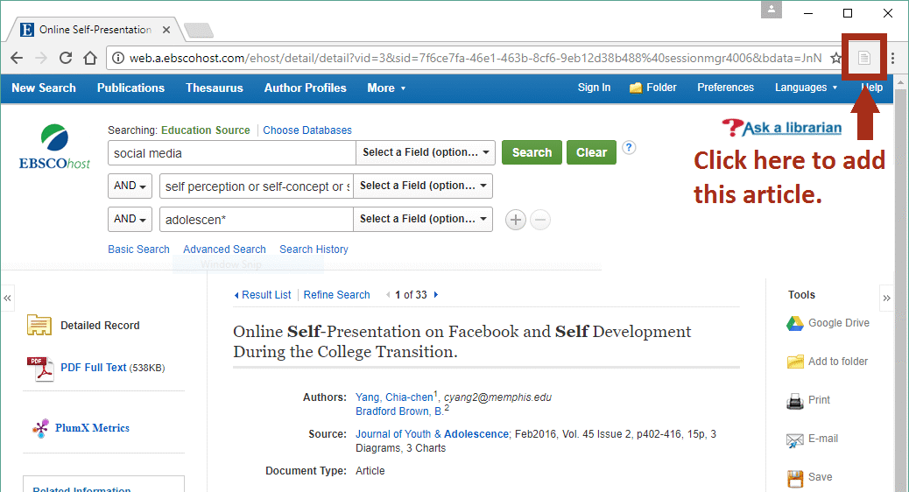
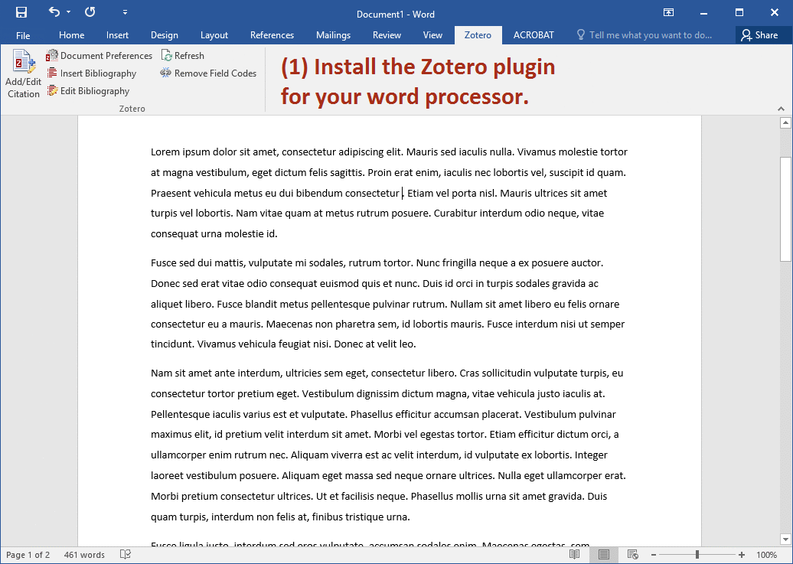
Managing & citing the sources you find
Use a tool like Zotero or Mendeley to keep track of your sources & simplify the citing process
Saving your sources
Citing your sources
Notes:
Search strategies:
Helps you develop your search strategy in a methodical way. You can run searches, save them, and then combine them in various combinations.
You can re-run a well-executed search.
Break up your research (come back to complete the review of the results.
Create search alerts
Documentation: track and remember your searches systematically.

Slide 37
Keep track of your research
NVivo: a qualitative data analysis software, which you can use to manage, organize, code, and analyze the materials for your literature review.
Making Literature Reviews Easier with NVivo for Windows
Monday, February 7, 2022 - 10:00am to 12:00pm
Making Literature Reviews Easier with NVivo for Mac
Friday, February 11, 2022 - 1:00pm to 3:00pm
Saved searches: in many databases, you can make an account and keep track of your searches & search strategies.
Notes:
Search strategies:
Helps you develop your search strategy in a methodical way. You can run searches, save them, and then combine them in various combinations.
You can re-run a well-executed search.
Break up your research (come back to complete the review of the results.
Create search alerts
Documentation: track and remember your searches systematically.

Slide 38
Critical writing
Present logical arguments which lead into your conclusions
Provide sound evidence and reasons to support your argument
Evaluate, select, organize, and categorize theories and findings to provide a coherent framework which forms the basis of your research.
Notes:
*handout: critical writing

Slide 39
2 ways assert your voice:
Taking control of the text and leading your reader through the content
Making your own position clear in relation to the source material that you incorporate, and being explicit about how you will be drawing on particular aspects of previous work for you own research
Notes:
Can be done by making your own assertions with appropriate citations to provide support, and by including explicit linking words and phrases to show connections between citations and the different sections and chapters in the text.
Not only presenting what others have said – what do you have to say about the material, the ideas.
This is why you should be starting with a thesis or at least a narrow focus
Paraphrasing is done based on your notes – not the original text.
*Difference between paraphrasing and
Talk about transitions chart – linguistic strategies to show connections, and to show that you know the relationships between things.

Slide 40
You are not alone!
Research help – Sylvia Roberts, sroberts@sfu.ca Contact your liaison librarian for problems big & small
Thesis help - researchcommons.sfu.ca Anise Ladha, Assistant for Theses
Graduate writing help - researchcommons.sfu.ca
Read Ahead Service & Writing Consultations
Graduate Open Writing Lab
Writing workshops
Notes:
ELYSE / EMILY

Slide 41
Celebrating Progress

