Slide 1
CMNS 487 : Collective Memory and Public Discourse
Sylvia Roberts
CMNS librarian
sroberts@sfu.ca

Slide 2
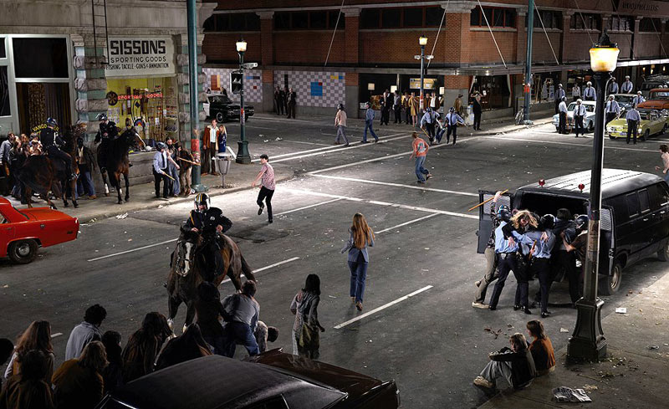
Notes:
Stan Douglas Vancouver artist Abbott and Cordova 7 August 1971
photography often addresses the history of the location of one of his installations and as well, the creation of those installations themselves.[
Douglas' reading of Gilles Deleuze's essay "Humour, Irony and the Law" about the arbitrary nature of law and law enforcement influenced Douglas to reconstruct "forgotten incidents of social confrontation between local Vancouver police and members of the public at various times throughout the last century."^{[38]} Abbott & Cordova, 7 August 1971 depicts an event in which the police
violently intervened in a public protest against undercover police tactics and in favour of the legalization of marijuana. The composition was realized using cinematic staging and digital compositing techniques to assemble 50 different images taken with the camera in the same position. Striving for historical accuracy, Douglas undertook extensive research, collecting archival photographs and conducting interviews with witnesses and participants to recreate the scene in painstaking detail. Using complex production methods similar to those of the film industry, the details of local businesses, commercial signage and period clothing were carefully replicated to represent the past. The combined use of theatrical and digital processes enabled a heightened form of realism. A focus on individuals in the crowd reveals the reactions on their faces.^{[38]}

Slide 3
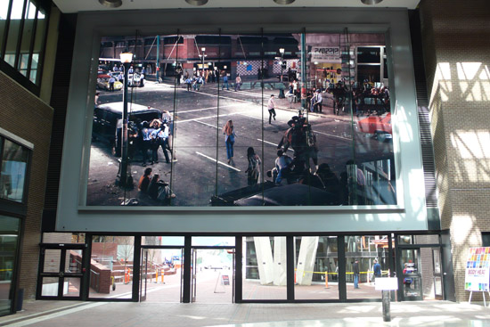

Slide 4
Thinking about the object
Does this photograph fit the concept of a commemoration?
Whose collective memory does this invoke?
How would you relate it to course readings?

Slide 5
Where would you look for info?
On the commemorated event
On the context of the commemoration
Public discussion of the commemoration
Choices relating to the depiction
Intended audience
Which aspects of the phenomenon does it emphasize? Omit?

Slide 6
Sources
Course readings
Histories relating to the event (articles, books)
Information about the people / organizations responsible for the commemoration (web sites, articles, books)
News: contemporary to the event, of the commemoration
Opinion: news, blogs, twitter, media

