Slide 1
CMNS 262 research guide
Sylvia Roberts
Liaison Librarian, Communication
Summer 2012

Slide 2
Assignment #2
Build on Assignment #1’s direct observation exercise
Define a more focused, specific research question
Select 2 additional research methods to explore your question
Use a minimum of 5 scholarly sources:
  To justify choice of methods
  To situate research project in context of qualitative research practice
  Select sources from reading materials or library research
Notes:
If you do a broad search, capturing the literature that describes your topic, you should be able to determine if anyone has done something similar

Slide 3
Finding scholarly articles:
Identify search terms to describe the focus of your research
Select appropriate search tools
Use search syntax effectively
Assess your search results to select scholarly research publications
Capitalize on your findings and/or modify your search strategy for better results
Notes:
By the end of this session, students will have learned to :

Slide 4
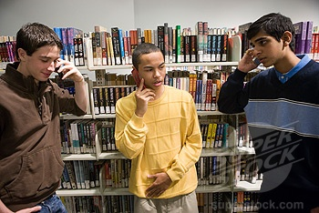

Slide 5
Terminology
Cell phones
Cellular telephones
Mobile phones
Mobile communication
Social
Interaction
Interpersonal
Behavior / behaviour

Slide 6
Terminology
Cell phones
Cellular telephones
Mobile phones
Mobile communication
Public space?
Observation?
Library / libraries
Social
Interaction
Interpersonal
Behavior / behaviour
Etiquette?
Privacy?

Slide 7


Slide 8
Search for CMNS articles
CMNS article indexes
  Communication & Mass Media Complete
  Communication Abstracts
  Geobase
  Sociological Abstracts

Slide 9
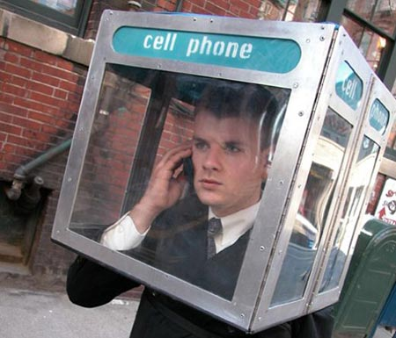

Slide 10
Characteristics of scholarly literature
Use to communication research results and ideas to other scholars around the world
Written by experts, uses language and theoretical approaches familiar to those in the discipline
PEER REVIEWED
Typically, research articles include:
  Research affiliations of authors
  Literature review and sources consulted
  Research methodology
Notes:
Lit review situates study in broader context of what’s known

Slide 11
Examples:
Humphreys, L. (2005). Cellphones in public: social interactions in a wireless era. New Media & Society, 7(6), 810-833. doi:10.1177/1461444805058164
Campbell, S. (2008). Perceptions of Mobile Phone Use in Public: The Roles of Individualism, Collectivism, and Focus of the Setting. Communication Reports, 21(2), 70-81. doi:10.1080/08934210802301506

Slide 12
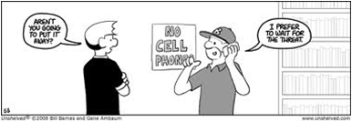

Slide 13
Can’t find anything on topic?
Cutting edge topic?
Too narrow a focus?
Maybe it’s not an area worthy of research or not trendy
Think of related literature that you can use
Consult reference librarians (use Ask Us for options) or contact me
Notes:
If cutting edge, try finding something related field or like something, e.g. same application but another field
Too narrow – try looking in related disciplines
Find articles that discuss the topic but aren’t studies (e.g. theoretical) and use reference lists to find other relevant articles
Find related material talking about technology that has similar characteristics e.g. chat similar to telephone in some respects but with significant differences (e.g. cost, anonymity, geographic scope, pervasiveness) OR explore related topics such as the demographics of people using chat in statistical or commercial sources

Slide 14
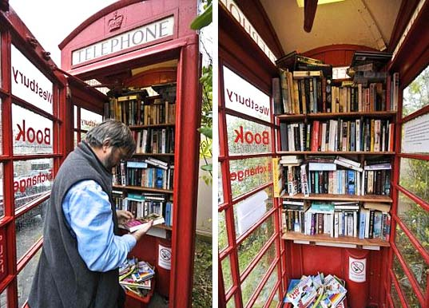

Slide 15
Good luck with your research!
Sylvia Roberts
sroberts@sfu.ca / 604-291-3681

