Slide 1
CMNS 201: Finding empirical research articles
Sylvia Roberts
Communications Librarian
sroberts@sfu.ca
Notes:
Introduce myself as the liaison librarian for Communication. Liaison librarians are knowledgable about the research and teaching at SFU’s School of Communication and familiar with the production and distribution of information sources that support these.

Slide 2
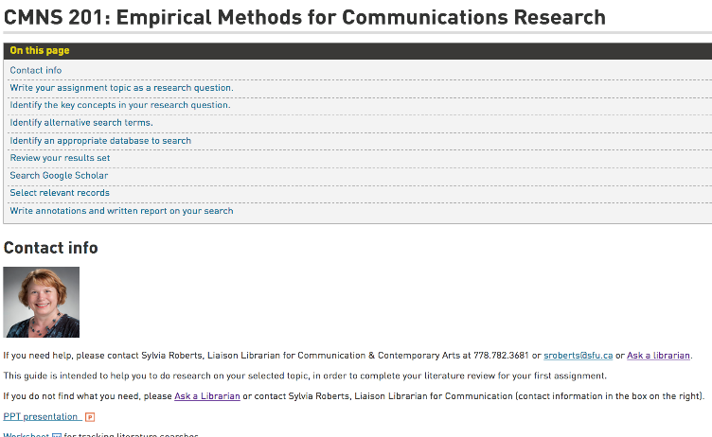
Start by opening the CMNS 201 Library research guide
Notes:
I’ve been asked to speak to students in CMNS 201 about how to do a literature review for your research project as described in Assignment 1 Reviewing the Scholarly Literature & Planning a Study
There is also a research guide for CMNS 201 with a link to the PPT slides so that you don’t have to worry about making notes and can concentrate on participating in the tutorial.
(Demonstrate how to find using Library search box to search “CMNS 201” and help students find this page).
We’ll come back to this page a bit later when you’re searching for articles.

Slide 3
TUTORIAL OVERVIEW
What is a literature review and how does it help with research planning
How to recognize empirical research articles
How to find empirical research articles on your topic
Notes:
(review the bullet points on the screen. The last point is expanded on the next slide)

Slide 4
TUTORIAL DELIVERABLE
In Canvas, submit a citation for an empirical research article that relates to your topic.
Use APA citation style.
Sample APA citation:
Wynne, E., Wright, W., & Alvermann, D. (2021). Creating Gaps in Understanding: How Gen Z Disrupts Gender Norms on TikTok. International Journal of Critical Media Literacy, 3(1), 1–23. https://doi.org/10.1163/25900110-03030001
Notes:
At the end of this tutorial, you will submit a citation in Canvas for an empirical research article that relates to your research topic.

Slide 5
If I can see further, it is by standing on the shoulders of giants.
(Isaac Newton, 1676)
How does this relate to your use of research articles?
Notes:
This quotation is attributed to Sir Isaac Newton, 17th century scientist. Newton’s achievements in the field of science contributed to the birth of empiricism. This was the belief that knowledge acquired through sense experience is the only true meaningful knowledge. Newton was a significant contributor to the first English language publication to share the results of empirical research, the Philosophical Transactions of the Royal Society of London.
Considering this background, what do you think he meant by this quotation?
(Ask students to volunteer answers)
(After a few students respond, summarize by answering)
Yes, this refers to the nature of scientific research "using the understanding gained by major thinkers who have gone before in order to make intellectual progress". "discovering truth by building on previous discoveries“
In our time, scholars use research journal literature to discover what research was done in the past

Slide 6
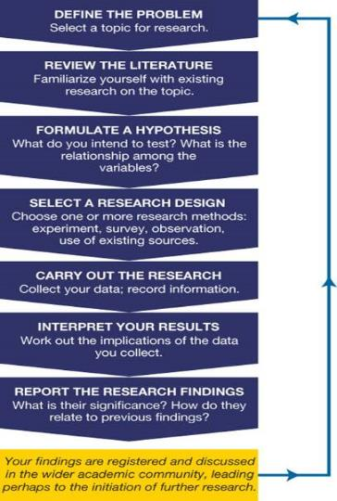
Academic research literature is important, both at the beginning and the end of a research project.
At the start of a research project, reviewing the research literature helps to provide context and a rationale for why is important research.
Sharing research findings, by publishing results in an academic journal article, contributes to the ongoing scholarly conversation.
Notes:
This is model of the research process. Does it look familiar to you? Did you talk about it in class?
Engaging with the research literature, the records of successful research projects, is an essential part of empirical research at universities. You’ll see that the red boxes who where research literature comes into the research process, at the beginning and at the end.
Researchers begin with a literature review so they can place their research in context, benefit from finding related literature and then as a way to share the results of research with your researcher peers around the world.
We’re going to focus on the first step, finding and reviewing relevant academic literature so it can inform your own research

Slide 7
A Literature Review is both the process and the product
The process involves a systematic review of prior scholarly works that relate to the research question and method.
The product is a descriptive summary of existing books, articles and other information sources on a topic.
Notes:
A literature review as a process helps you discover how your research complements or challenges what’s known in the field.
One requirement for academic research is that it’s contributing new knowledge. To get funding or to get published, you have to demonstrate a need for this research, whether a brand new question or a new approach to an old question.
Academic research article usually contain a literature review to help readers understand how their research project complements or challenges research that has been done by other scholars.

Slide 8
Why start with a literature review?
Essential beginning of academic research articles
Provides context for the research project
Demonstrates expertise in the field
Supports the value of this research to scholarship and society
Shows how your research topic fits within the CMNS discipline, relating to previous research and gaps to be filled
Provides examples of effective research methodologies, definitions of concepts, how research questions are framed
Peer-review process acts as quality control
Notes:
Literature reviews are a key step in the research process. A literature review helps to establish
You’re familiar with key research that is related to your research topic
Shows gaps in in the research done in this field,
Reveals methodologies used by those doing similar research
One convention of empirical research articles is to include a description of their research methodology. This enables other researchers to verify the results by repeating the research, to see if they can get the same results. As a student researcher, you can draw on these to develop your own research questions and means to explore them. Articles related to your research interests can serve as models of successful research projects that you can adopt, whether recruiting your study population, choosing a data coding scheme or a method to gather data.
Peer review is quality control for the article. Who is familiar with peer review? (ask for brief student response)

Slide 9
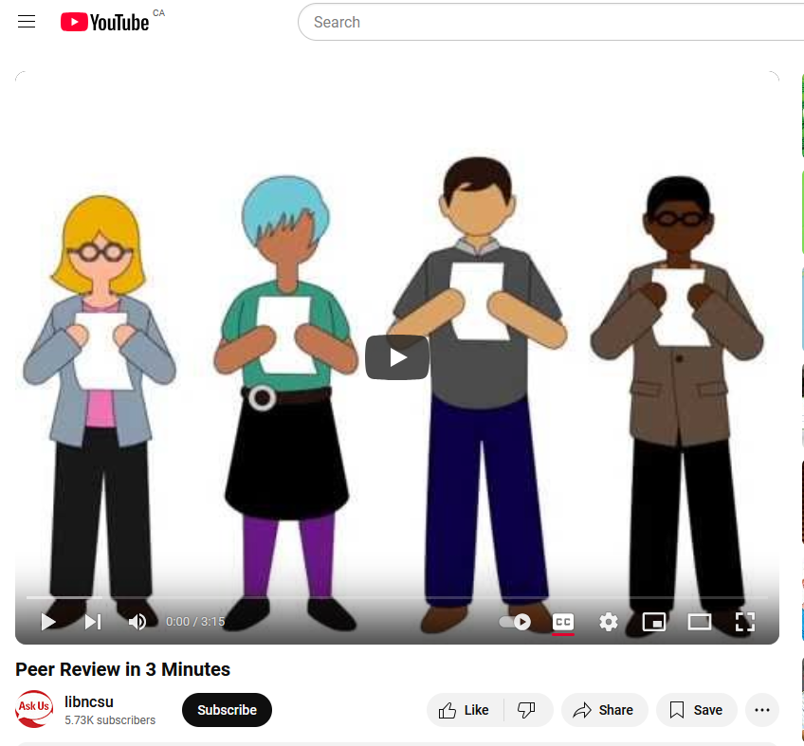
https://youtu.be/rOCQZ7QnoN0
Notes:
This 3 minute video will provide an overview of the peer-review process
(NOTE: to show the video, you need to have the link open in a different browser window open OR stop the PPT slides)
Any questions about the peer-review process? Or why you need to start your research with a lit review?

Slide 10
Empirical research studies
Not all peer-reviewed journal articles report on empirical research. Some can discuss theory or news or review books.
An empirical research article reports the results of a study that uses data derived from actual observation or experimentation.
Data can be quantitative (numbers) or qualitative (non-numerical, often textual).
What would be an example of an empirical research methodology?
Notes:
Not all articles in peer-reviewed articles report on empirical research; some may be news reports or focused on theory.
An empirical research article is an article which reports research based on actual observations or experiments.
Empirical research may use quantitative research methods, which generate numerical data and seek to establish causal relationships between two or more variables.
Alternatively you may find that they use qualitative research methods, which objectively and critically analyze behaviors, beliefs, feelings, or values with few or no numerical data available for analysis.
While empirical research articles will include a description of the specific research method used, the word “empirical” is not likely to appear. There is an assumption that the readers of research literature can recognize specific research methods as empirical or not. You will gain expertise in these methods through CMNS 201 and other courses.
(Ask students to volunteer a few examples of research methodologies used in the field of Communication. Answers could be surveys, content analysis, discourse analysis, focus groups, etc.)

Slide 11
Anatomy of an empirical research article
Authors are experts, affiliated with a research institution
Written for researchers (and students)
Long, usually 7+ pages but organized in sections
Abstract
Literature review (sometimes included with the introduction)
Methodology
Findings, discussion, conclusion
Citations and reference list
Formal writing style, might include formulas, tables
Published in a peer-reviewed journal
Notes:
You can learn to recognize empirical research articles by the form of the article and these features that are typical.
(Review the bullet contents briefly with students)
Now we’ll look at how these features appear in a real research article, to prepare you to recognize them as you do your own research.

Slide 12
Empirical article sample
APA citation:
Wright, C. L., & Hang Duong. (2021). COVID-19 Fake News and Attitudes toward Asian Americans. Journal of Media Research, 14(1), 5–29. https://doi-org.proxy.lib.sfu.ca/10.24193/jmr.39.1
Persistent link to database record:
http://proxy.lib.sfu.ca/login?url=https://search.ebscohost.com/login.aspx?direct=true&db=ufh&AN=149428024&site=ehost-live
Notes:
This is an APA citation for an empirical research article like you will need to submit during today’s tutorial.
Lets see what this looks like when you look at results from a database search.

Slide 13
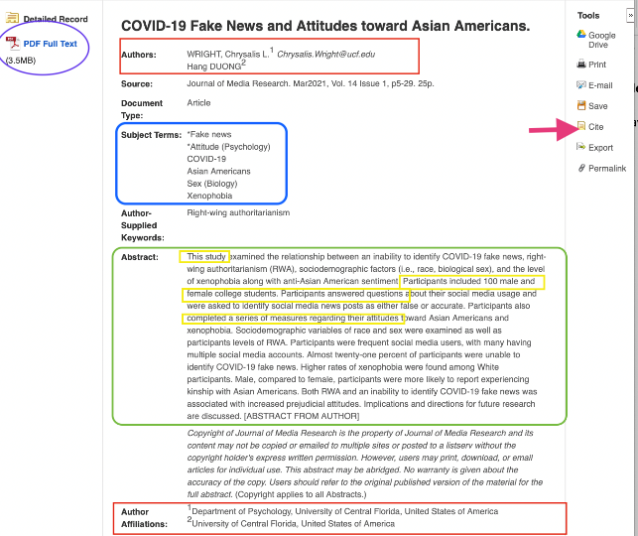
This database record is from Communications and Mass Media Complete.
Databases contained records representing articles published in issues of scholarly journals.
Each record includes finding information (article title, authors, journal title, date of publication, etc.) and descriptive information (abstract, subject terms, author keywords).
Databases can be devoted to research from a single discipline or can be multidisciplinary.
Notes:
This is a database record from Communication and Mass Media Complete which indexes articles in CMNS journals. Databases contain records describing articles, providing both finding information and descriptive information.
(Point out the authors & author affiliations as a sign of expertise, i.e. that they’re affiliated with a research institution, have a PhD and record of successful research to get a position at a university.)
The abstract gives a summary of the article including evidence of having been an empirical research study, “study” is a clue to this as well as the description of the study population and how data was gathered.
Subject terms are standard terminology used to help searchers identify the major focus of articles so you can use them, along with the abstract, to decide whether the article might be useful to you.
Notice that this record links to a PDF of the article. Sometimes you might see a red “Get at SFU” button that you can use to see if the full text of the article is available in another database or ejournal holdings.

Slide 14
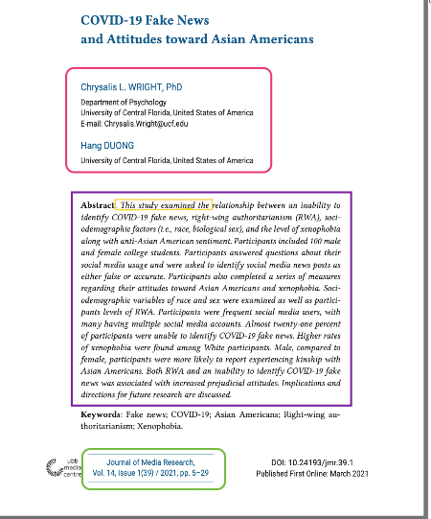
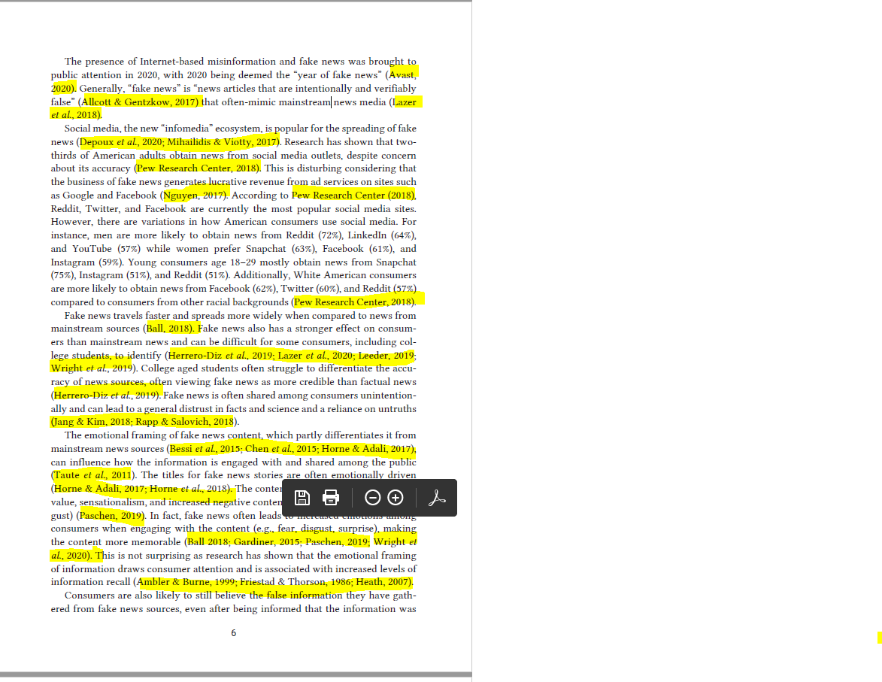
Notes:
If we look at the full text of the article, you’ll see some of the features that I described:
The authors’ names and research affiliation
The abstract, including a brief description of the research questions, methodology and conclusion
The journal name, issue, volume, date of publication and page numbers
The text starts with an introduction to the research, including the literature review. The term “literature review” might be used as a section heading or it might be imbedded as part of the introduction. It’s at the beginning of the article to help readers know how this specific research is situated in what’s be done previously.
Notice all of the highlighted text? These are in-text references that show key sources as part of the literature review, helping to establish the context for this research study. You can go from the in-text reference to the alphabetical list of references at the end of the article, to get the full citation for finding the article. So, if you find something related to your own research question, you can find the original article.

Slide 15
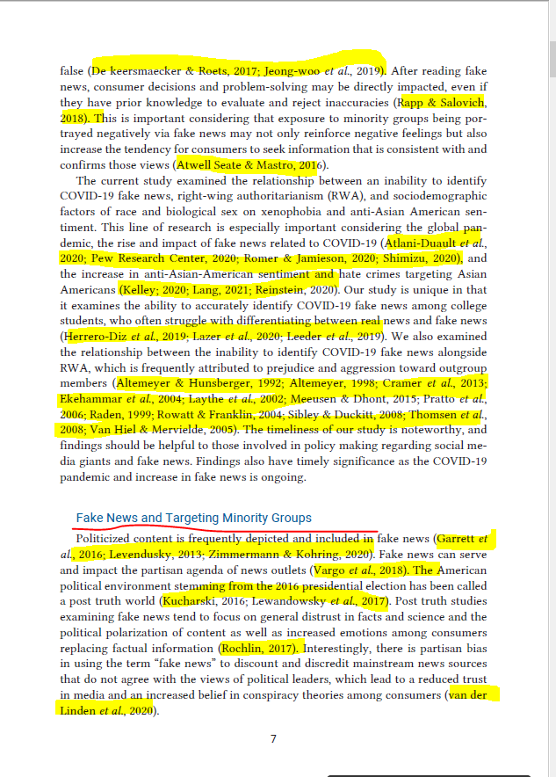
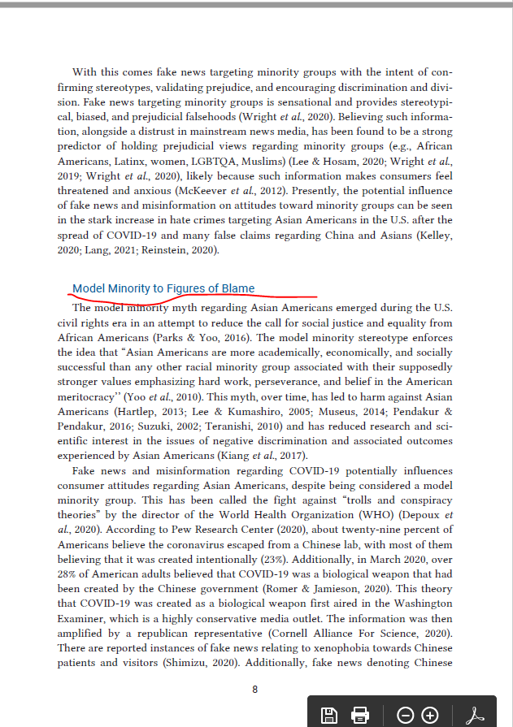
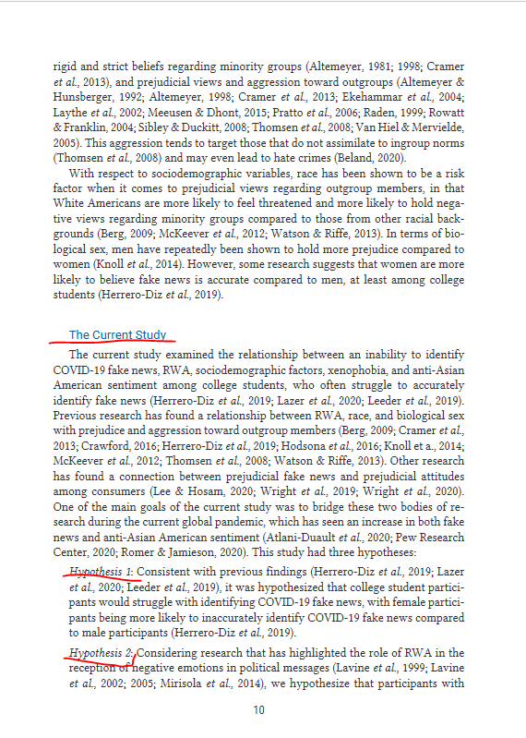
Notes:
As we turn to the next pages of the article, notice that the in-text references continue. I stopped highlighting after page 7 but the references go on through page 10.
Literature reviews can be long (several pages), often divided into different aspects by section titles, in this case, literature related to fake news and to model minorities.
You’ll notice that the last section “The current study” presents the hypotheses. Sometimes these are labelled as research questions rather than hypotheses. These describe the research gap that this study intends to fill.

Slide 16
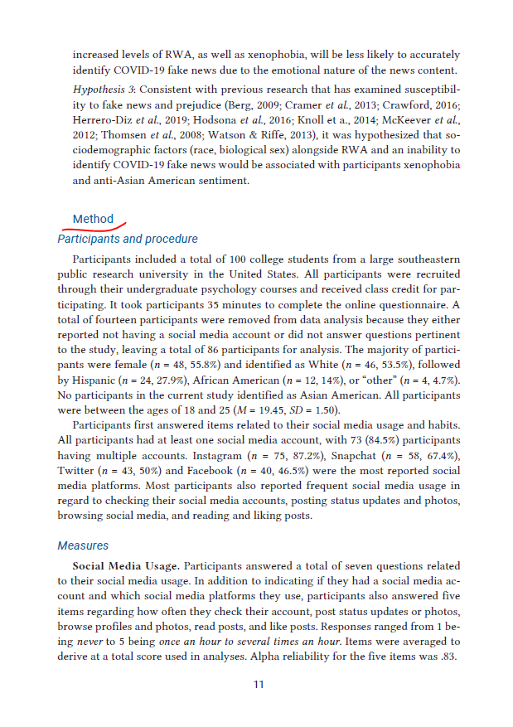
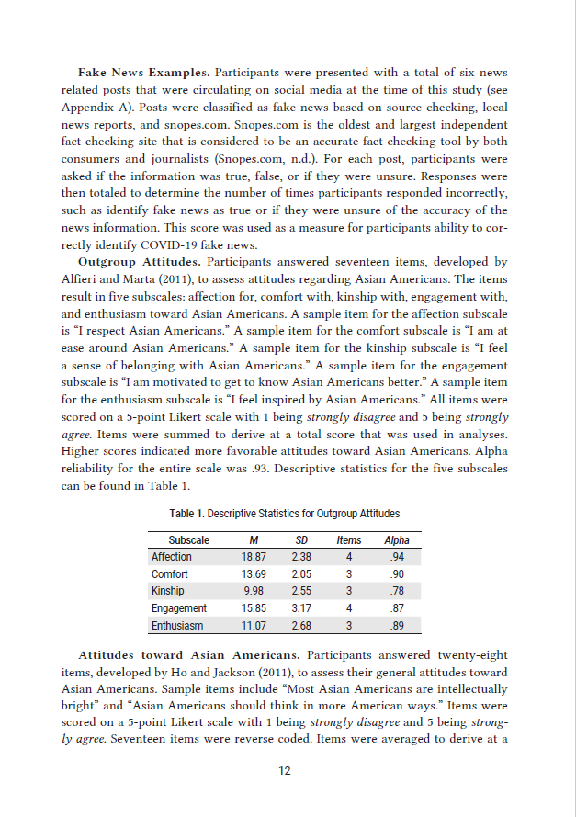
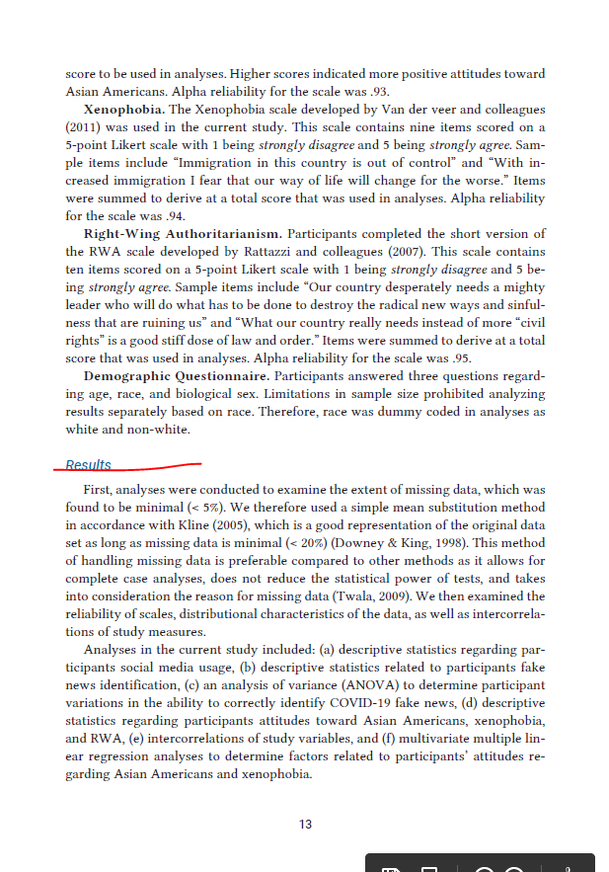
Notes:
After the research questions/hypotheses are stated, the method or methodology heading shows us how these will be investigated, e.g. how the participants were recruited, how data was gathered and analyzed, what measures were used, etc.
Following the methodology section, the discussion of the research results begins.

Slide 17
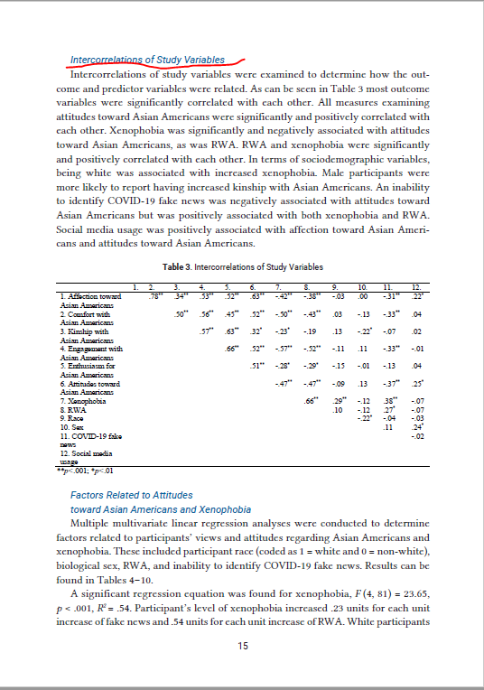
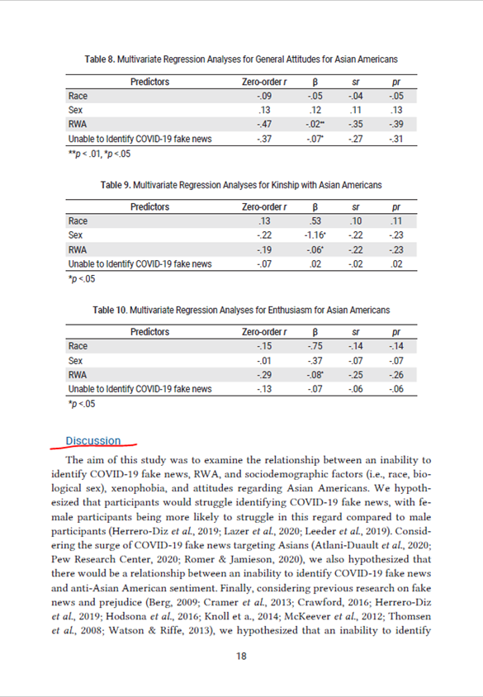
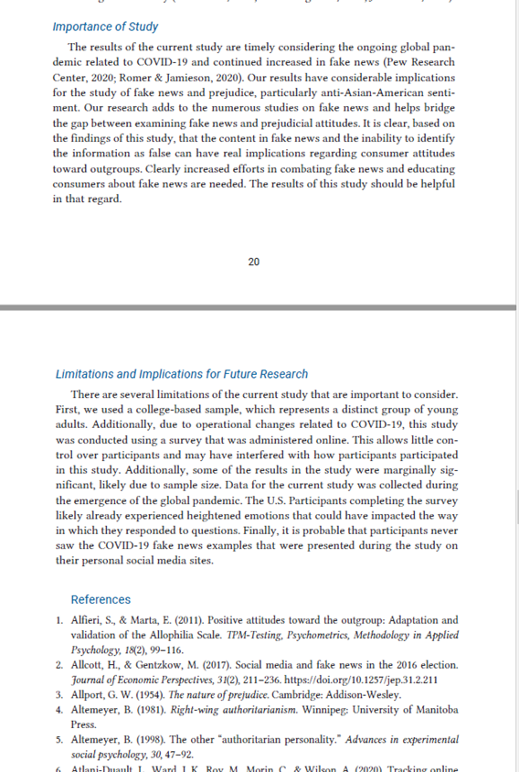
Notes:
After description of the study results, a discussion of the findings follows.
Usually the research article will end with some conclusions about how these findings are significant, for the field of CMNS and perhaps for society. There is also often a section near the end that discusses what the study did not do (limitations) and what questions are yet to be answered.
And of course the article ends with a list of references for those information sources included in the article, including the full citations for all the articles in the literature review.
QUESTIONS?

Slide 18
Your research topic
“…an assessment of the value of social media use in communication.”
Notes:
Okay, now we’ll turn to the task of finding articles that describe research related to your own interests.
One thing that I want to emphasize is that research articles may be useful to you even if they are not a perfect match for your topic. Maybe only part of the article is useful to you, e.g. how to recruit a study population of students or suggests a method that might be suitable for your study or looked at a similar (but not identical) social media platform. If it’s useful in helping you plan for your research project, it can be included in your literature review.

Slide 19
Hashtags in activism
https://youtu.be/oqsyi0RLHuU
Notes:
https://youtu.be/oqsyi0RLHuU

Slide 20
Notes:
I joke that I came to Tiktok for the cat content but stayed for the activism

Slide 21
Starting research question
Write one sentence to summarize your research interests, ideally, in the form of a question
You can use the worksheet linked from the CMNS 201 library research guide to keep track of your search strategy and results
My sample research question (which will be refined with research) Are hashtags an effective social media tool for activism?
Notes:
If I was going to make a plan to find related empirical articles, it might follow these steps.
Take 1 minutes to write your own research question down – you’ll use this to find the article that’s your deliverable for this tutorial

Slide 22
Key concepts = search terms
Identify the key concepts in your research question
Research question Are hashtags an effective social media tool for activism?
Key concepts: hashtags activism
TIP: it’s helpful to use nouns as search terms
Notes:
Identify the key concepts in your research questions, use 1-2 concepts and find the best words to describe them (often nouns, plural forms of nouns)
Circle or highlight the main research concepts in your question : these should refer to some aspect of social media, some behavior you want to explore and potentially a population that you may study

Slide 23
Alternative search terms
Research question Are hashtags an effective social media tool for activism?
Key concepts hashtags activism
Identify related terms for each of your key concepts hashtags activism: activist, protest, social movements
Notes:
Identify the key concepts in your research questions, use 1-2 concepts and find the best words to describe them (often nouns, plural forms of nouns)
Circle the main research concepts in your question : should refer to some aspect of social media, some behavior you want to explore and potentially a population that you may study
You don’t have to think of all the words because you’ll find others as you search. However, if you don’t find anything with your first search, changing the search terms is the first step to improving your results.

Slide 24
Boolean operators: OR, AND
Activism
OR
Hashtags
activism OR protest OR social movements
AND
Social movements
Protest
Notes:
OK, now that you have your search terms, you need connect them in a way that the search system understands
Unlike Google, the Library database search systems do not work with natural language searches. Instead, they use Boolean logic to interpret how to execute the search.
This image shows how Boolean operators can be used to connect search terms in a meaningful way. On the left side of the screen, each of my search terms is shown in a circle representing all of the records that contain that term. If you want to use conceptually related words (i.e. different words with related meanings), use OR between the terms in your search. This tells the database that all of the records that contain one or more of these terms are relevant to your search. In this case, search results would contain records that contain one or more of the terms: activism OR protest OR social movements
You can also use the Boolean operator AND to add specificity to your search. Using AND between search terms tells the database that you require both words to be in the same record. So, to get a set of results that are about the use of hashtags and activism, you can search using both operators. I’ll show you how that looks in the database search.

Slide 25
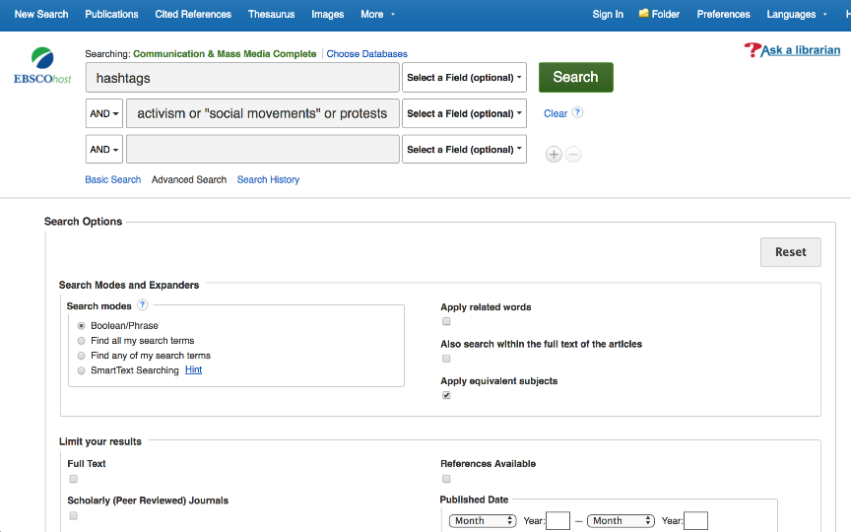
Notes:
(review the placement of the terms and the operators)
(also point out that they can limit results to peer-reviewed journal articles by checking this box)

Slide 26
Assessing search results
Sorted by relevance
Select peer-reviewed articles as a filter
Look at title words, publication date, subject words to assess value to research
Notes:
Once you’ve entered the search terms, you’ll need to look at your results and make selections as to which articles best meet your needs. (point out the parts of the article citation in the results, author, article title, journal title, vol/issues, date of publication, page numbers AND how the 3 bullet points are represented on the screen capture)
REMEMBER that I said that an article doesn’t have to be a perfect match for your topic AND that you’ll have to look at the articles more closely to see if they’re an empirical research article

Slide 27
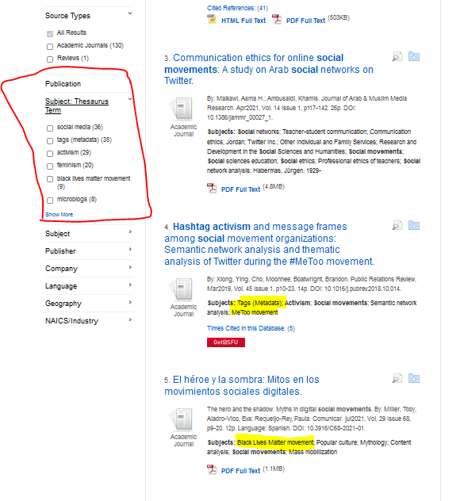
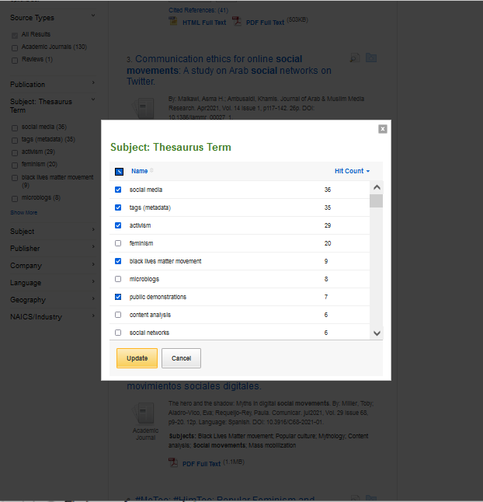
Notes:
If you get too many results or the results look like they’re not a great match for your interest, expand the subject/thesaurus terms list. These are words that are used in the records to describe the subject of the articles.
You can click on “show more” to get a box that shows you the subject terms and how many of the results have each subject term. You can select all that seem to be a good match and click the update button. This will then filter your results so that only the records with your subject words remain in the results.
If you want to know more about any of these articles, click on the title link.

Slide 28
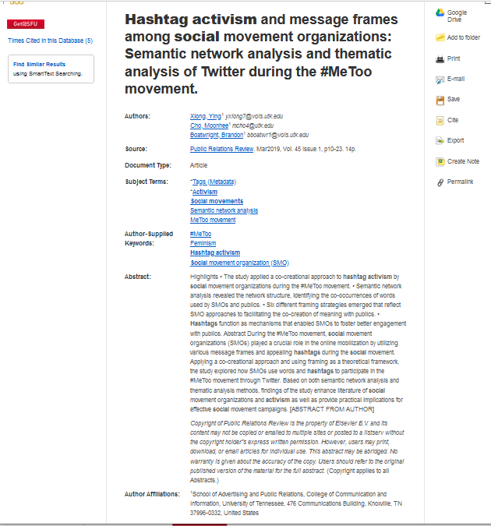
Notes:
This is a sample record from my results that looked promising. Even though the focus of the activism is different, the article might provide useful information for planning my research.
Notice the subject terms for this article. As these are applied to all records with a major focus on the topic, it is advisable to include these in your search statement in order to include all relevant records in you results.
The abstract contains the word “study” and describes the research method used so I feel confident that this is an empirical research article.
If you can’t tell enough from the abstract in the database record, you can confirm that this is an empirical research article by looking for the methodology section in the article itself. To find the full text for this record, you could use the red link labelled Get at SFU.
Notice, too, that there are links in the right sidebar that enable you to email or save the record. You’ll also be pleased to know that clicking on the cite button will give you a formatted citation in the citation style of your choice. For this class, choose APA.

Slide 29
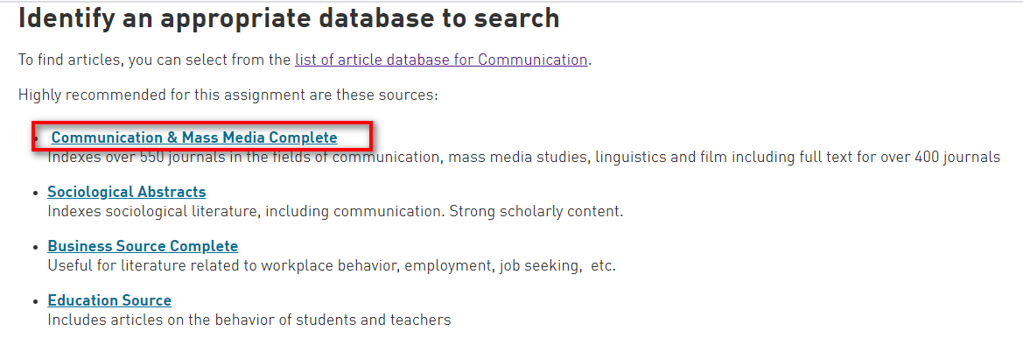
TIME TO SEARCH YOUR own TOPIC
Notes:
(Depending on timing you could demonstrate the same search live OR you may choose to just have students go to the database and start searching; ideally they’ll have 10 minutes to search before the end of class)
Now it’s time for you to search. I’ll circulate to ask you about your topic and offer coaching on search terms or search construction. If you want to consult me about your research, wave me over
(You can leave the next slide on the screen as a reminder to students about process. Circulate and look at the student searching, offer help if they’re struggling or ask them to tell you about their research interest)

Slide 30
Search and evaluate
Search Communication & Mass Media Complete
Use your search terms, limit to scholarly articles
Review results list for promising articles
Modify search if necessary (try related terms)
Click on promising titles to get detailed record with abstract
Skim the abstract to see if research methodology is described, indicating an empirical research article; if you’re not sure, check the full text of the article for the methods section
Email/download & capture promising citations for bibliography

Slide 31
Assignment support after this class
Notes:
(Conclude by showing this slide and telling them how they can get help with research and writing)
Ask a Librarian (research help)
Citation style guides
Writing and Learning support (Student Learning Commons)
Thanks to all of you for your attention and your contributions!

