Slide 1
BUS 347
Consumer Behaviour
Literature Review Assignment
BUS 347: Consumer Behaviour
Mark Bodnar
mbodnar@sfu.ca

Slide 2
Warm-up #1
What’s your favourite season?
BUS 347: Consumer Behaviour
Mark Bodnar
mbodnar@sfu.ca

Slide 3
Warm-up #2
What’s another word for “scent”?
Summarize the current state of research on a consumer behaviour topic and discuss its application to a business situation.
How does scent affect consumer behaviour?
BUS 347: Consumer Behaviour
Mark Bodnar
mbodnar@sfu.ca

Slide 4
Choosing tools
Where do you normally look for research (journal) articles?
BUS 347: Consumer Behaviour
Mark Bodnar
mbodnar@sfu.ca

Slide 5
Choosing tools
How would you describe/define a good database for this type of research?
Topic breadth, depth, and exclusivity?
Specific functionality?
BUS 347 Research Guide
BUS 347: Consumer Behaviour
Mark Bodnar
mbodnar@sfu.ca

Slide 6
Shortcut to the Lit Review video
The remaining slides are from the video you were asked to watch.
Do you have any questions about that video?
BUS 347: Consumer Behaviour
Mark Bodnar
mbodnar@sfu.ca

Slide 7
Tool (Google Scholar, Business Source, PsycInfo…)
Only 4 Steps
keyword
All the information in the world!
keyword
All the info on your topic (not to scale)
keyword
A
A
W
B
Cycle your search
Authors
Subjects
References
Times cited
Efficiency
& Importance
BUS 347: Consumer Behaviour
Mark Bodnar
mbodnar@sfu.ca

Slide 8
Metaphors
1
Playing darts…
blindfolded?
BUS 347: Consumer Behaviour
Mark Bodnar
mbodnar@sfu.ca

Slide 9
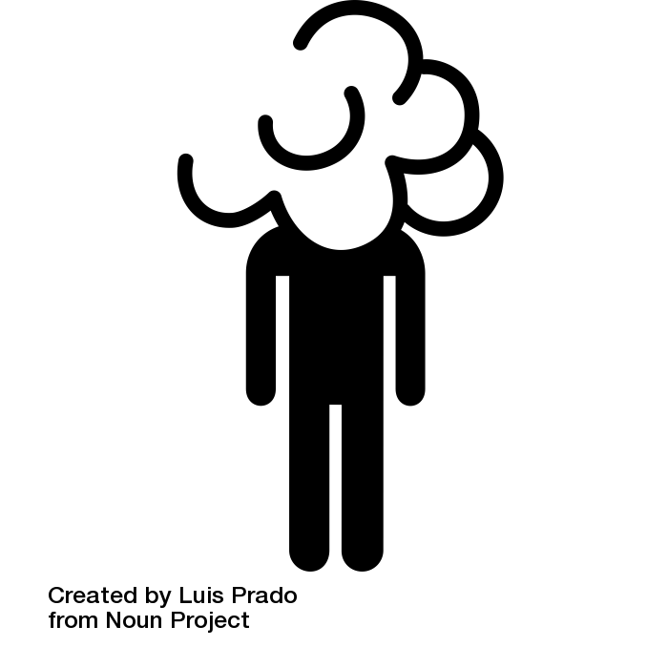
Metaphors
2
A scavenger hunt in a dense fog?
BUS 347: Consumer Behaviour
Mark Bodnar
mbodnar@sfu.ca

Slide 10
Metaphors
3
Spying on a conversation?
BUS 347: Consumer Behaviour
Mark Bodnar
mbodnar@sfu.ca

Slide 11
Metaphors
Whose ideas are being discussed the most?
Which ideas cause excitement and lots of further discussion, and which are largely ignored?
Spying on a conversation?
Explore References
& Cited by/Times cited
BUS 347: Consumer Behaviour
Mark Bodnar
mbodnar@sfu.ca

Slide 12
Metaphors
Do some people occasionally pause and sum up everything that has been said so far?
Spying on a conversation?
Look for Literature Review articles on the topic.
BUS 347: Consumer Behaviour
Mark Bodnar
mbodnar@sfu.ca

Slide 13
Metaphors
Are some people listened to more than others?
Spying on a conversation?
Maybe they are known experts, or maybe they are publishing in the highest quality journals?
BUS 347: Consumer Behaviour
Mark Bodnar
mbodnar@sfu.ca

Slide 14
Metaphors
Do some people just confirm what has been said before without adding any substantial new information?
Do some people take the conversation into completely new areas?
Do some people provide strong counter arguments?
Spying on a conversation?
BUS 347: Consumer Behaviour
Mark Bodnar
mbodnar@sfu.ca

Slide 15
Tools & Techniques
Business Source Complete
Main business article database
“Times Cited in this database” feature
PsycInfo
Covers marketing + applied psychology journals
“Times Cited in this database” feature
99% academic research articles
Can limit to literature reviews
BUS 347: Consumer Behaviour
Mark Bodnar
mbodnar@sfu.ca

Slide 16
Tools & Techniques
[Limiting search to peer-reviewed journal articles.]
Link to this search (sort of…):
https://bit.ly/bus347-scent
BUS 347: Consumer Behaviour
Mark Bodnar
mbodnar@sfu.ca

Slide 17
Tools & Techniques
Stage 2 searches
Tools to help you cycle by Times Cited
Google Scholar
Broadest coverage of citing articles
Sample
More? BUS 347 Research Guide
Web of Science
Advanced trend analysis of citing articles
BUS 347: Consumer Behaviour
Mark Bodnar
mbodnar@sfu.ca

Slide 18
Questions?
BUS 347: Consumer Behaviour
Mark Bodnar
mbodnar@sfu.ca

