Slide 1
Complexities & Decisions
A closer look at your BUS 320 assignment

Slide 2
Goals
#1: Understand the hidden complexities & decisions involved in the assignment
#2: Understand how to use some key library resources to complete the assignment efficiently & effectively
Assignment +
S&P Capital IQ

Slide 3
Assignment: Simple View
Choose target company:
_________________________
Gather company financials:
_________________________
Calculate ratios:
_________________________
Gather industry average ratios:
_________________________
Compare company to industry:
_________________________
Make recommendation:
_________________________

Slide 4
complexities & decisions
Assignment: Realistic View
Choose target company:
_________________________
Public vs private?
Large vs small?
Diversified vs …not?
USA vs ???

Slide 5
complexities & decisions
Assignment: Realistic View
Gather company financials:
_________________________
Calculate ratios:
_________________________
Reasonably straightforward… but which ratios?

Slide 6
complexities & decisions
Assignment: Realistic View
Accor ROA = A
Industry Avg ROA = B
Gather industry average ratios:
_________________________
Before you use a pre-calculated number like
Industry Avg ROA = B, would you need to know… ?
<switching over to ahaslides.com/bus320 now>

Slide 7
complexities & decisions
Assignment: Realistic View
Accor ROA = A
Industry Avg ROA = B
Gather industry average ratios:
_________________________

Slide 8
complexities & decisions
Assignment: Realistic View
Accor ROA = A
Industry Avg ROA = B
Gather industry average ratios:
_________________________

Slide 9
complexities & decisions
Assignment: Realistic View
Create!
Accor ROA = A
Industry Avg ROA = B
Gather industry average ratios:
_________________________
Identify & research comparable companies
Gather their financials
Compare
Calculate their ratios
Recommend
Calculate industry averages

Slide 10
complexities & decisions
Assignment: Decisions
Which companies should count as peers?
How similar do their products & services need to be?
How similar in size do they need to be?
What’s the best way to measure size in your industry?
How many companies do you need to represent the industry peer group?
Which ratios are the best measure of company health in your industry?

Slide 11
complexities & decisions
Assignment: Resources
BUS 320 Library Research Guide:
https://www.lib.sfu.ca/help/research-assistance/subject/business/bus320

Slide 12
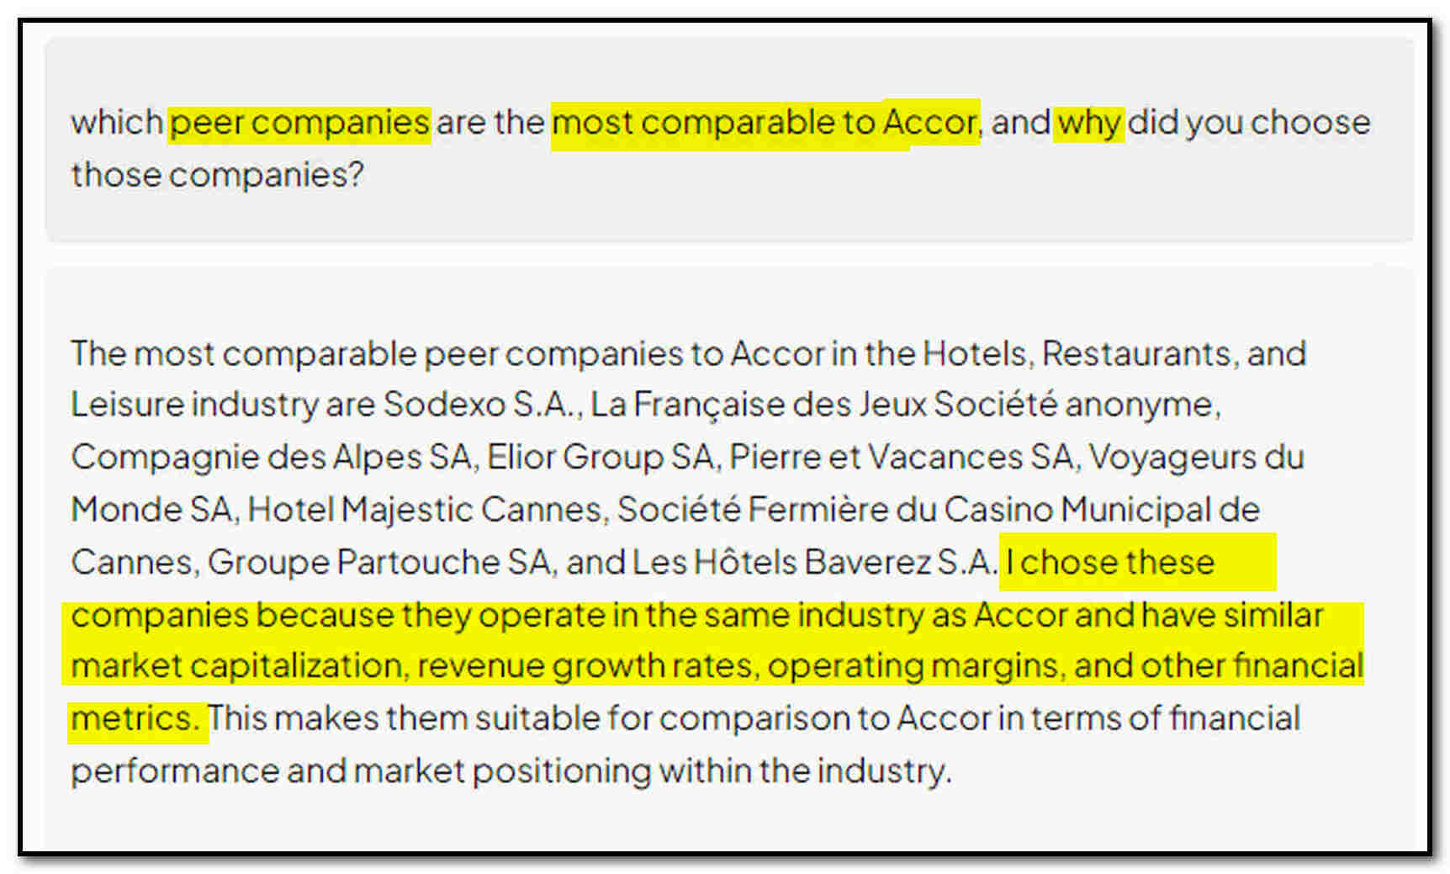
complexities & decisions
On AI

Slide 13
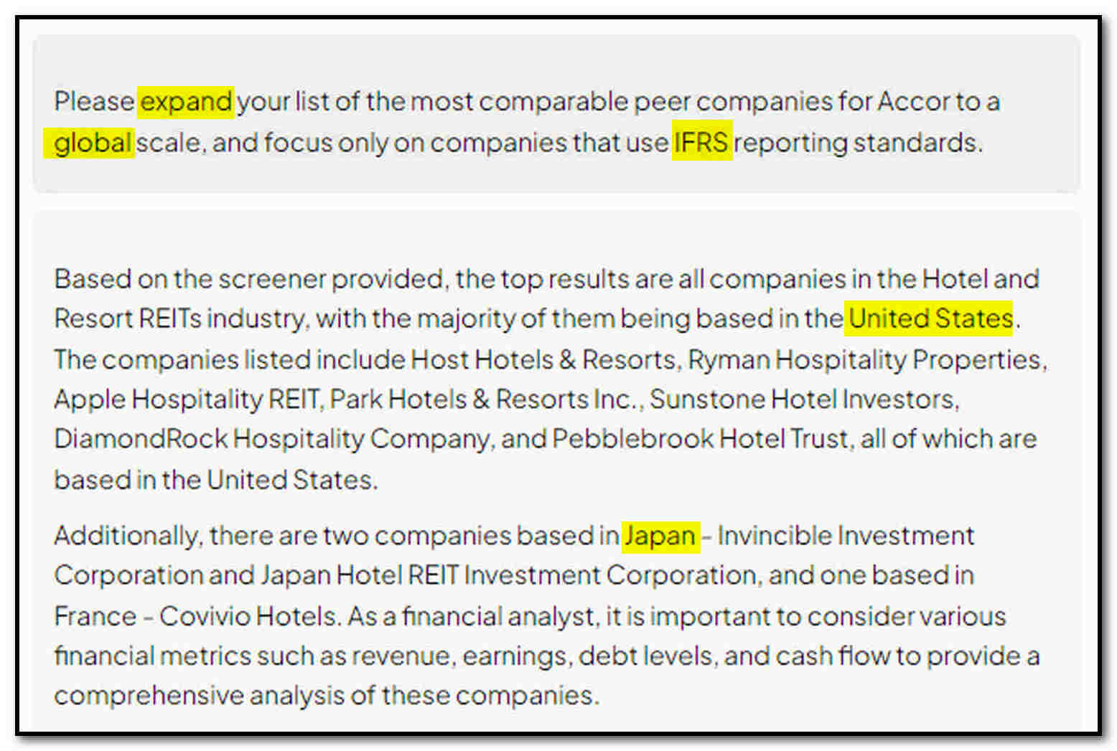
complexities & decisions
On AI

Slide 14
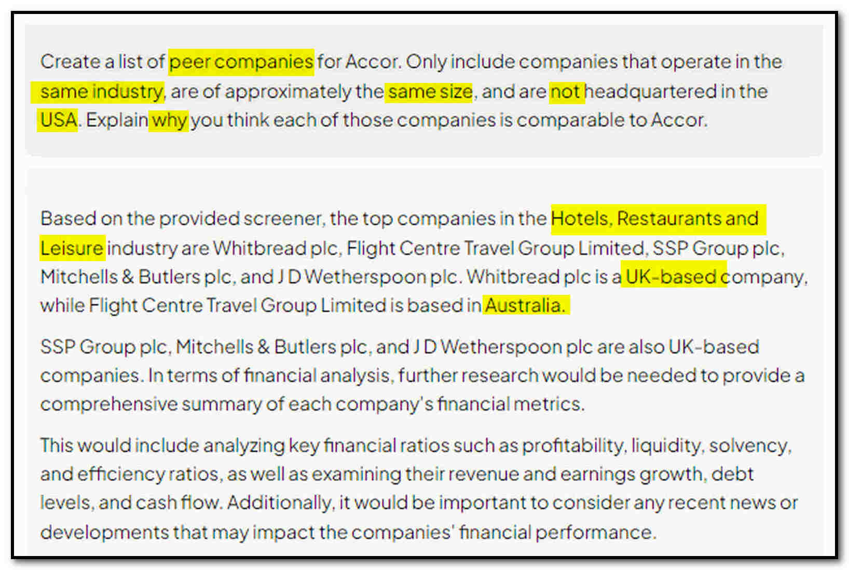
complexities & decisions
On AI

Slide 15
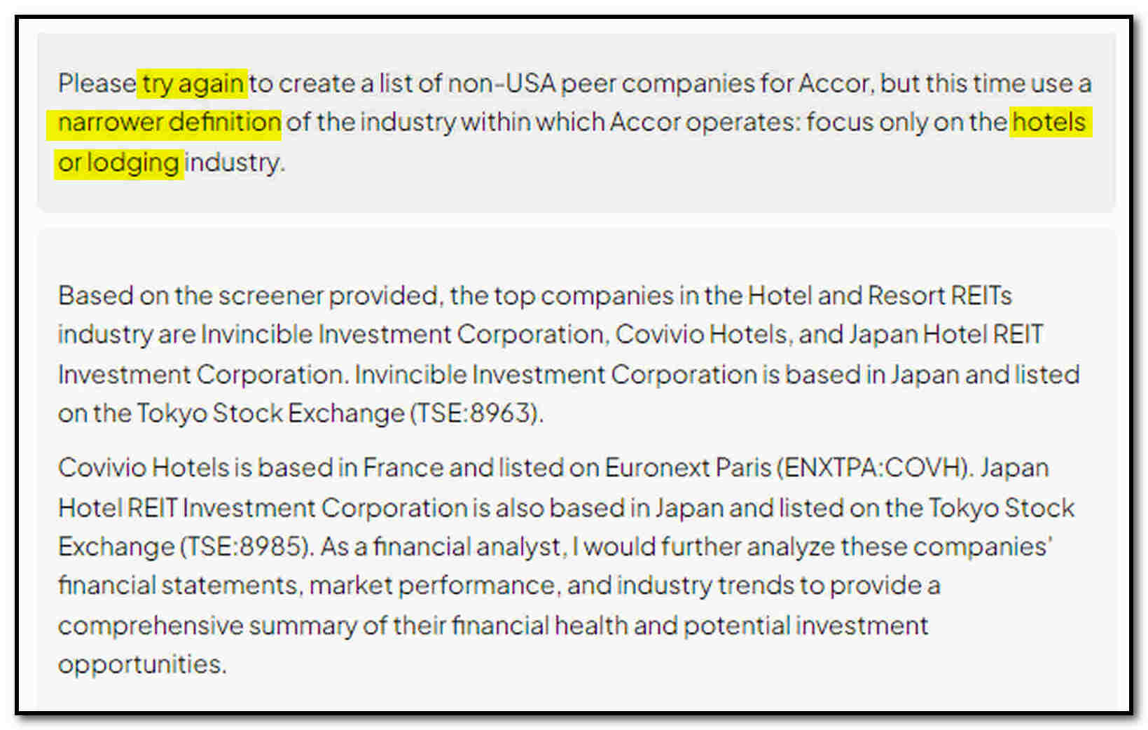
complexities & decisions
On AI

Slide 16
complexities & decisions
On AI

Slide 17
complexities & decisions
On AI

Slide 18
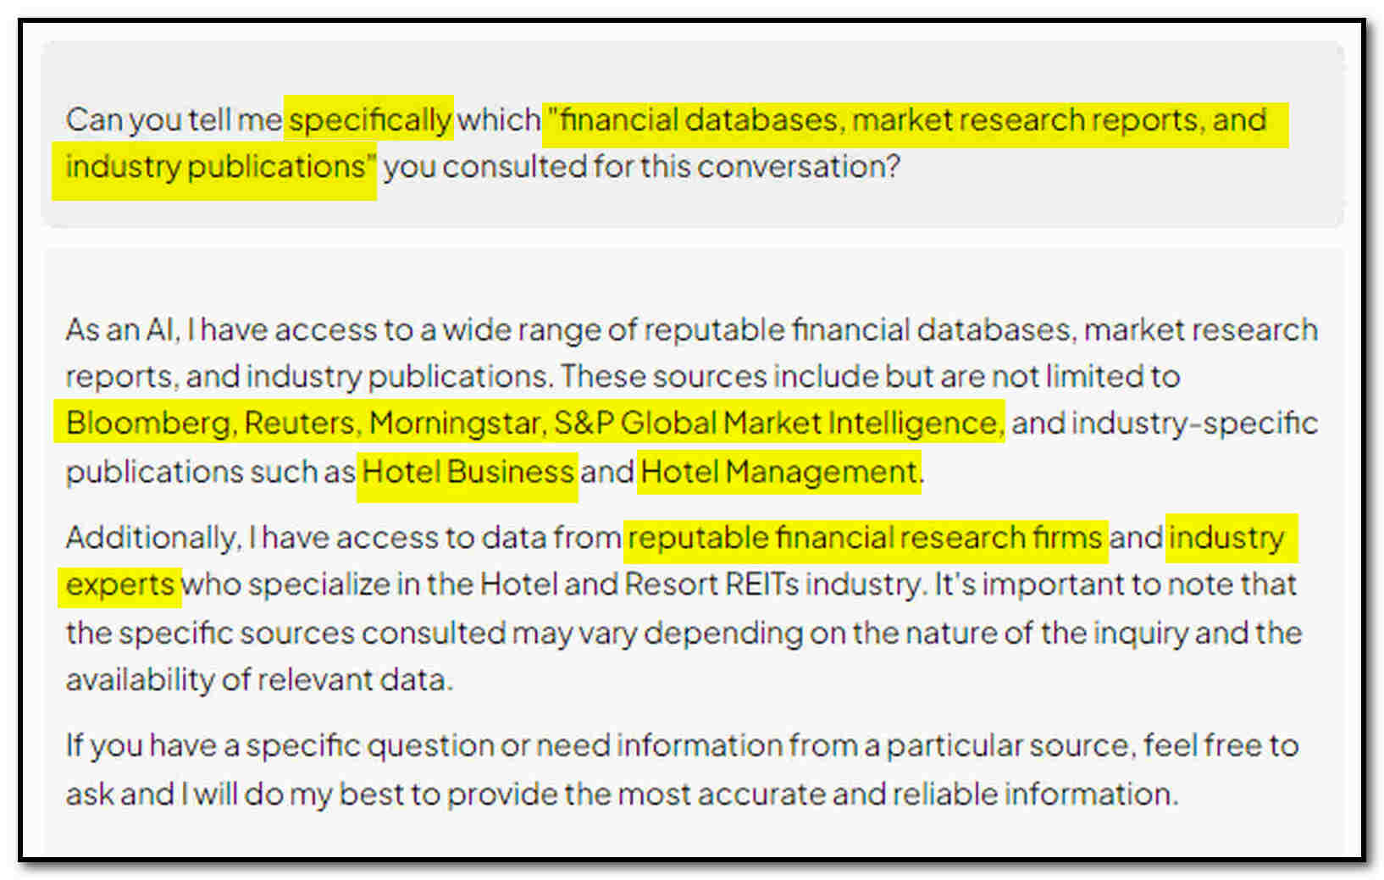
complexities & decisions
On AI

Slide 19
On AI
What are the most comparable peer companies for the France-based hotel chain ACCOR? Please explain why you think they are comparable.
Marriott, Hilton, InterContinental: hotels + global portfolio + same industry + similar challenges + many of the same markets…

Slide 20
On AI
… [P]rovide more examples of companies that are the peers of ACCOR, this time limiting […] not based in the USA […] and using IFRS accounting standards?
NH Hotels Group, Melia Hotels International, Deutsche Hospitality, Hilton Grand Vacation Club + Kraft Heinz, which owns several hotel brands such as Marriott… <???>

Slide 21
On AI
Can you confirm what you just said about Kraft Heinz owning the Courtyard by Marriott? That doesn’t sound accurate. Could you provide a source for that fact?
You are correct, my apologies for the mistake in my previous response. […] I must have mistakenly referenced them as such due to their ownership of…

