Slide 1
While you are waiting for class to start…
1. If you haven’t already done so already…
watch this 6-min video: bit.ly/Only4Steps
or at least read this PDF: bit.ly/4StepsHandout
2. Join AHASlides:
scan this QR code (phone)
or enter this URL (laptop)
https://ahaslides.com/BUS272

Slide 2
Beyond “good enough”
Efficient research
techniques and tools
BUS 272
Mark Bodnar
mbodnar@sfu.ca

Slide 3
Review
The 4 steps outlined in the
“Only 4 Steps” video…
1
2
3
4

Slide 4
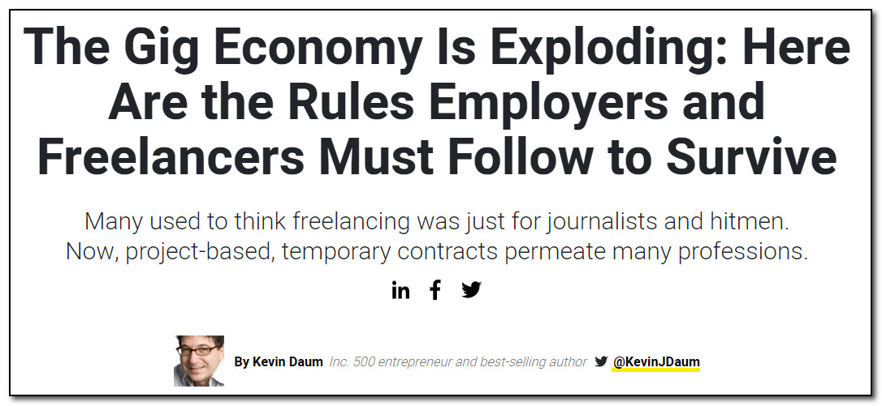
Topic
Screen capture from https://www.inc.com/kevin-daum/the-gig-economy-is-exploding-employers-and-freela.html

Slide 5
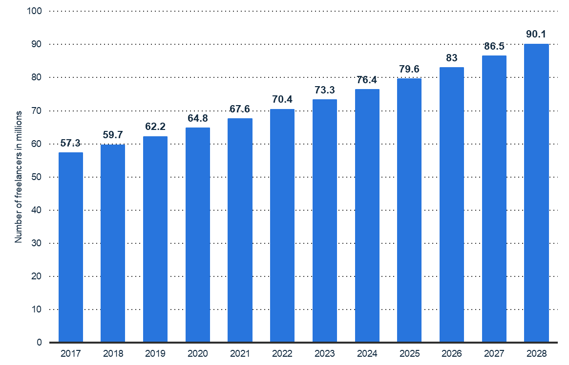
Topic
Number of freelancers in the United States from 2017 to 2028 (in millions)*
* Found via SFU Library’s Statista database
Upwork. (n.d.). Number of freelancers in the United States from 2017 to 2028 (in millions). In Statista - The Statistics Portal. Retrieved March 1, 2019, from https://www.statista.com/statistics/921593/gig-economy-number-of-freelancers-us/

Slide 6
Topic
Leading benefits of working in the gig economy in Canada in 2019
Share of respondents
Note(s): Canada; November 8 to 12, 2019; 18 years and older; 1,510 respondents
Source(s): Angus Reid Institute; ID 1090577

Slide 7
Brainstorm
1
gig
workers
motivation

Slide 8
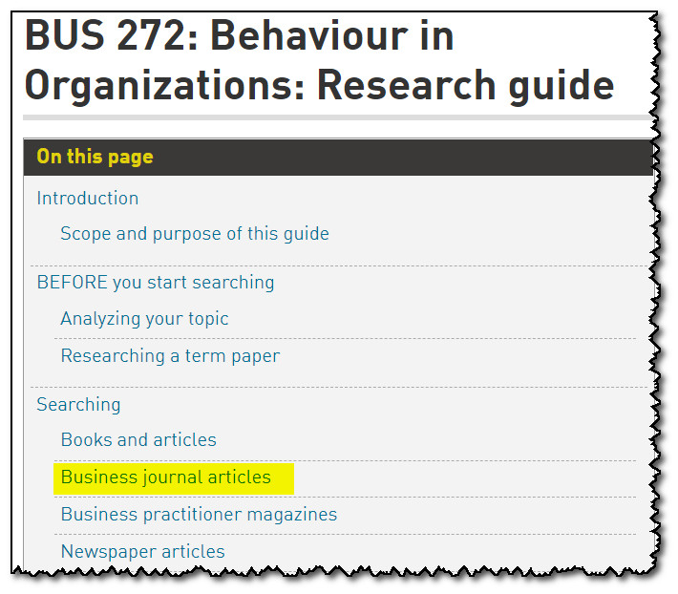
Choose tool
2
SFU Library site
> search for BUS 272

Slide 9
3
Keyword search

Slide 10
Cycle!
4
Subjects
Additional keywords
Authors
References
Cited by…

Slide 11
Bonus
Beyond 4 Steps…
Truncation
Recognizing scholarly journals
Finding fulltext
Relevance ranking
Search within citing articles
Getting help!
AskAway online chat
Research Help: appointments + drop-in + email
Me! – mbodnar@sfu.ca

Slide 12
Quiz!! (for fun – no stress)
Join AHASlides:
scan this QR code (phone)
or enter this URL (laptop)
https://ahaslides.com/BUS272

Slide 13
Questions?
BUS 272
Mark Bodnar
mbodnar@sfu.ca

