Slide 1
SFU Library
Research Commons
Resources & Services
Chloe Riley
Research Commons Librarian
car11@sfu.ca

Slide 2
SFU Library is located on the unceded, traditional, and current territories of the xʷməθkwəy̓əm, Sḵwx̱wú7mesh Úxwumixw, Səl̓ílwətaɬ, q̓íc̓əy̓, and kʷikʷəƛə̓ m Nations

Slide 3
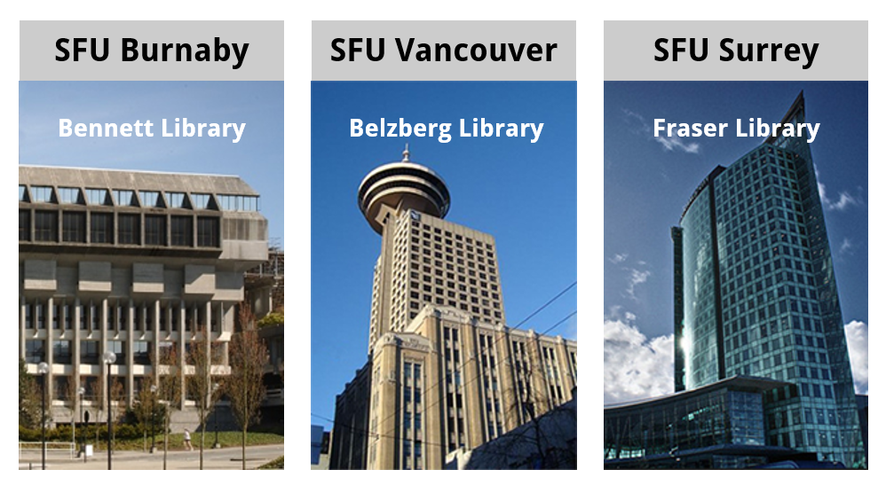
SFU Library - 3 campuses, 3 libraries

Slide 4
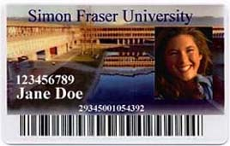
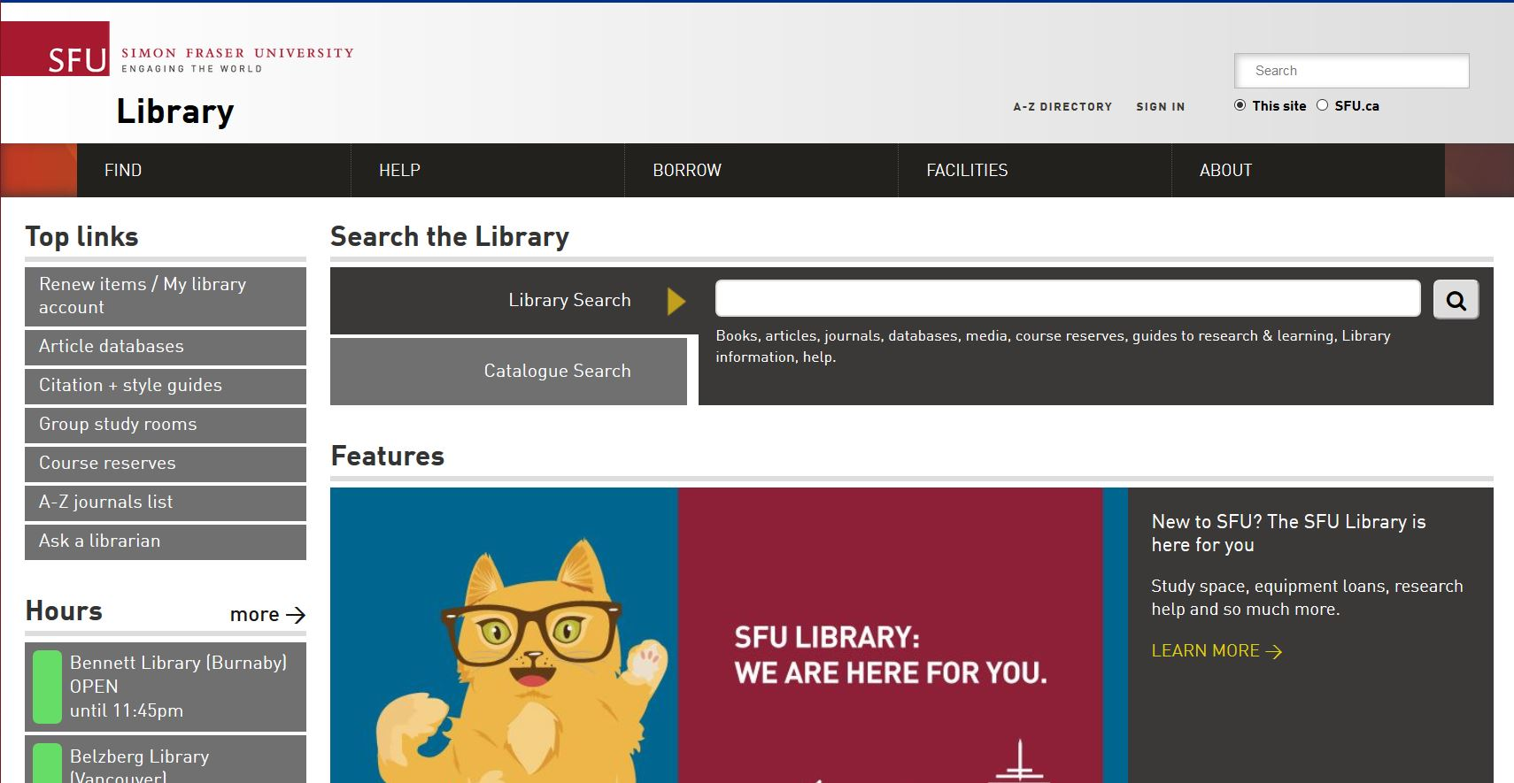
Your library account
Your SFU ID = your library card
View your library account

Slide 5
Your library card has superpowers
As grad students, you have reciprocal borrowing privileges at any of the 22 university libraries that comprise the Council of Prairie and Pacific University Libraries (COPPUL), and also most university libraries in Ontario, Quebec & the Atlantic provinces
Visit an SFU Library loans desk in-person to obtain a COPPUL card before visiting another Canadian university library. Already out of town? Email loans-mgmt@sfu.ca for assistance
Reciprocal borrowers are required to adhere to the policies in place at the libraries they are visiting

Slide 6
Research help - from anywhere
Contact Jenna Walsh, your liaison librarian
jmwalsh@sfu.ca | 778.782.9378
Check out our subject guides
http://www.lib.sfu.ca/help/research-assistance/subject
Chat with a librarian (email, phone, or AskAway)
http://www.lib.sfu.ca/help/ask-us

Slide 7
What can you access from off-campus?
Discipline-specific encyclopedias & background resources
Scholarly journal articles & ebooks
Streaming videos on methodology or information resources
Popular magazines & newspapers (historical & contemporary)
Case law, court records, legal resources (historical & contemporary)
Online image collections
Datasets, geospatial data, maps, case studies

Slide 8
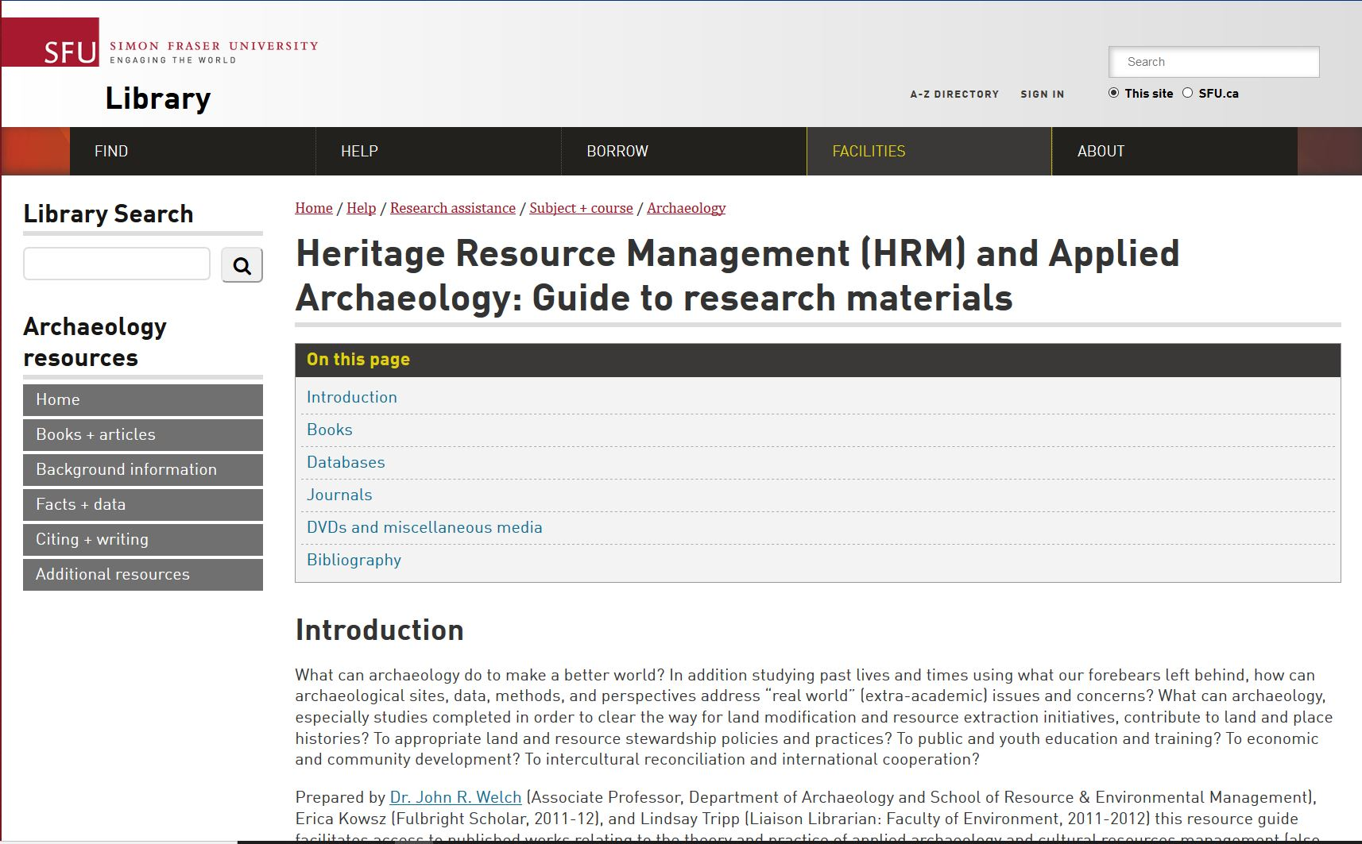
Specialized research guides

Slide 9
Research Commons
Services, supports, and spaces for graduate, doctoral, and post-doc students in all disciplines
Help is available for every step of the research and writing process
Email, call, or set up a skype appointment - you can receive assistance from anywhere
Contact us: research-commons@sfu.ca

Slide 10
What does the Research Commons offer?
Quiet, grads-only study space, with dual-monitor workstations and team rooms
http://www.lib.sfu.ca/about/branches-depts/rc/services/about
Research support software
http://www.lib.sfu.ca/about/branches-depts/rc/research/software
Free, hands-on workshops
http://www.lib.sfu.ca/about/branches-depts/rc/services/workshops
One-to-one or small group in person consultations with experts and graduate peers: email research-commons@sfu.ca for more information

Slide 11
Writing support
Writing workshops & Graduate Open Writing Lab
http://www.lib.sfu.ca/about/branches-depts/rc/services/workshops#writing
Read ahead, writing consultations, & presentation consultations
http://www.lib.sfu.ca/about/branches-depts/rc/services/consultation-read-ahead-request-form
Thesis Boot Camp
http://www.lib.sfu.ca/about/branches-depts/rc/writing/thesis-bootcamp

Slide 12
Qualitative data analysis: NVivo
NVivo is a software package that helps with the organization and analysis of unstructured data. It will help you classify, sort, and arrange information; examine relationships in your data; and guide your data analysis.
NVivo will allow you to:
test theories
identify trends in your data
cross-examine & explore information in multiple ways
Questions? Reach out to nvivo-rc@sfu.ca

Slide 13
Quantitative data analysis: R
R is a freely available open source statistical language that is used for data manipulation, data visualization, and statistical analyses. It is powerful, platform independent, and extensible.
R can also be used to generate publication-quality graphics, including equations.
Questions? Reach out to data-services@sfu.ca for assistance.

Slide 14
Citation management: Zotero & Mendeley
Citation management tools can help you:
Access, organize, and share your reference sources online, all in one place
Import references from library databases, websites & PDFs
Create properly formatted citations + bibliographies in seconds
Questions? Reach out to citation-managers@sfu.ca for assistance.

Slide 15
Research Data Management
The Data Services team offers:
Workshops, tutorials, and one-on-one assistance in data management planning, with a focus on funding agency requirements.
Expertise in data deposit, including deposit into Radar, SFU's Research Data Repository.
Access to secondary data, including datasets, statistics, GIS, and maps from providers such as Statistics Canada.
Research and reference help regarding research data.
Questions? Reach out to data-services@sfu.ca for assistance.

Slide 16
GIS support: ArcGIS, QGIS
Sarah Zhang, the GIS & Map Librarian and Liaison Librarian for Geography can assist you with:
introducing GIS (Geographic Information Systems)
technical issues with ArcGIS or QGIS software
searching for geospatial data
answering questions specific to your project
demonstrating features and techniques.
Questions? Contact Sarah: tza68@sfu.ca

Slide 17
Scholarly publishing and digital projects support
Digital Scholarship librarians can assist with:
Make your work open access, including information on SFU’s Open Access Policy & the Open Access Fund
Explore publishing choices
Research impact & online visibility
Digital skill-building + digital project collaboration with the Digital Humanities Innovation Lab (DHIL)
Questions? Get in touch with digital-scholarship@sfu.ca

Slide 18
English as an Additional Language support
Tim Mossman, the EAL/ESL Specialist, can assist with:
Academic writing: word usage, grammar, sentence structure, making connections between ideas, elaborating and expanding arguments, logical reasoning, paraphrasing techniques, and more.
Academic reading: skimming and scanning, critical reading, comprehension and analysis, and more.
Conversational and academic speaking and listening: comprehensibility, presentation techniques, pronunciation, pragmatic competence, and more.

Slide 19
Copyright support
The Copyright office can answer questions like:
Can I show a video clip in my tutorial?
How do I know if I am allowed to use an image in my slides?
Am I able to include an article I previously published in my thesis?
To receive assistance over email, reach out to copy@sfu.ca.

Slide 20
And more...
Tableau
Thesis template formatting & submission
Git
Python
Grant writing
Time management
Imposter syndrome
Please visit the Research Commons website for more information, or email research-commons@sfu.ca.

Slide 21
Identify the following
Hardesty, D. L., & Little, B. J. (2009). Industrial sites and monuments. Assessing site significance: A guide for archaeologists and historians (pp. 91 - 107). Lanham, MA: AltaMira Press.
Chirikure, S., & Pwiti, G. (2008). Community involvement in archaeology and cultural heritage management. Current Anthropology, 49(3), 467-485. doi: 10.1086/588496
Tsilhqot'in Nation v. British Columbia, 2007 BCSC 1700, CarswellBC 2741.
Canadian Environmental Protection Act, 1999, SC 1999, c 33.

Slide 22
Key databases
Web of Science | Most comprehensive science database
Anthropology Plus | Anthropological journal articles
Google Scholar | Scholarly literature in google
CanLII | Canadian case law and statutes
GEOBASE | Human and physical geography
For help with US case law & legislation, see our research guide: http://www.lib.sfu.ca/help/research-assistance/subject/criminology/legal-information/united-states-case-law

Slide 23
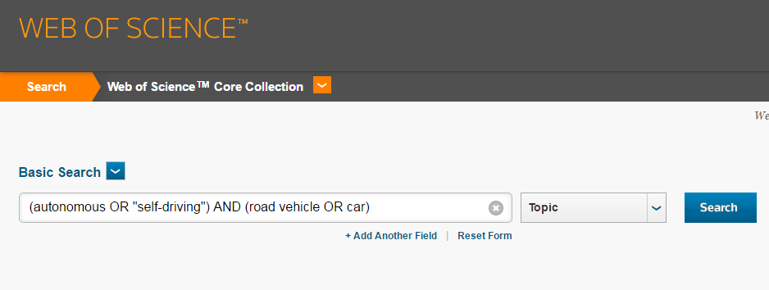
Boolean Logic: AND & OR
Notes:
Explain boolean –allows you to create more thorough, less ambiguous search
Speak the database’s language
Demo

Slide 24
Database search techniques
Narrow/decrease your search results | Expand/increase your search results
phrase searching using quotation marks e.g. “road vehicle” using AND e.g. “self driving” AND car using limiters e.g. by date or browse Conference Papers | truncation e.g. Canad* wildcards e.g. colo#r using OR e.g. “road vehicle” OR car OR truck
Notes:
Besides for Boolean operators, there are other techniques you can use to take control of your search results and speak the database’s language. Let’s take a moment to brainstorm some additional techniques you can use to quickly adjust your search.
Introduce activity
Ask for students to call out any strategies they know
If they aren’t very chatty, have the students talk to the person next to them
(10 min) Database search techniques activity
fill in slide as students suggest strategies
Narrow/decrease
Adding in a new concept with AND, e.g. classroom environment AND student learning AND early childhood AND (music OR art)
Using quotation marks, e.g. “classroom environment” instead of classroom environment
Using limiters to refine your search, e.g. limit to “Academic Journals” or “Scholarly (Peer Reviewed) Journals” or “Publication Years”
Sorting the results by “Date Newest”
Using NOT to filter out irrelevant concepts, e.g. early childhood NOT primary education
Using narrower keywords, e.g. seating arrangements instead of classroom environment
Field searching, e.g. searching only within the “Title” field
Expand/increase
Adding more related terms with OR, e.g. (classroom environment OR classroom design) AND (student learning OR educational benefits) AND (early childhood OR preschool)
Using an asterisk, e.g. educat* for educate, education, educator, educating, etc.
Using broader keywords, e.g. school environment instead of classroom environment
Looking at bibliography or “Cited References”
Timing (minutes in): 55

Slide 25
Delegate work to the internet! (Search alerts)
There are at least three kinds of search alerts you may find useful:
Table of Content alerts: you are emailed the TOC of your favorite journals upon publication of each issue
Citation Alerts: do you have a key article or author in your field? Be notified whenever either is cited
Search Alerts: keeps your excellent database search strategy "active". Newly-added articles and sources that meet your existing search criteria will be forwarded to you.

Slide 26
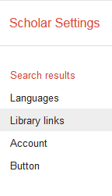
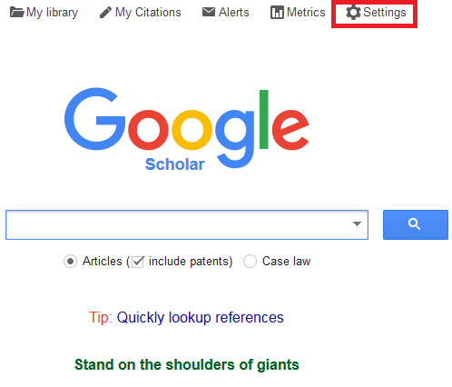
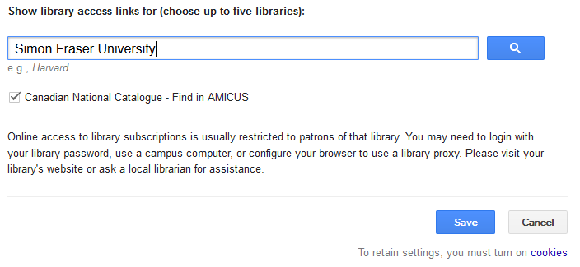
Getting the most from Google Scholar

Slide 27
Find
Jenna’s contact info
The HRM research guide
Anthropology Plus
Remnants of the Past
Encyclopedia of Global Archaeology

Slide 28
Ask us!
Chloe Riley car11@sfu.ca
Keshav Mukunda kmukunda@sfu.ca
Jenna Walsh jmwalsh@sfu.ca

