Slide 1
Find a peer-reviewed article in Social Science Journals
Moninder Lalli
Librarian: Sociology / Anthropology, GSWS, LBST, Graduate Business
Email: moninder_lalli@sfu.ca

Slide 2
Steps
Identify database(s) for Social Sciences (Sociology/Anthropology, Gender, Sexuality, and Women’s Studies)
  Journals from these disciplines will be indexed in these databases
Choose a database
Before searching in the database
  “Brainstorm” about your research topic
  Identify “key concepts”
  Create a “search strategy” using “keywords” that describe your topic
Try the search
Identify useful articles by examining the “titles” and “abstracts”
Use “limits” (such as “scholarly” or “peer-reviewed”, “subject” or “date of publication”) to increase relevancy
Download or email the article(s)
If full-text of article is not available in the database, use the “Get@SFU” link to find a copy.
If Library does not own the journal, then obtain a copy through Library’s “Inter-Library Loans” service
Figure out how to “cite” the article(s) using a citation style (APA, MLA, Chicago, etc.)

Slide 3
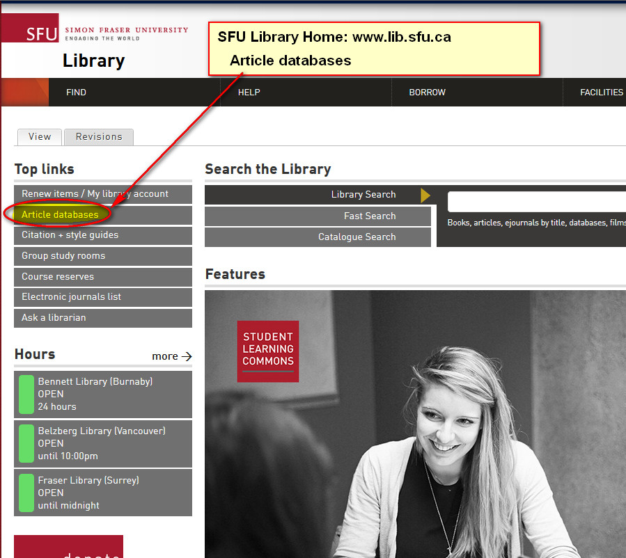
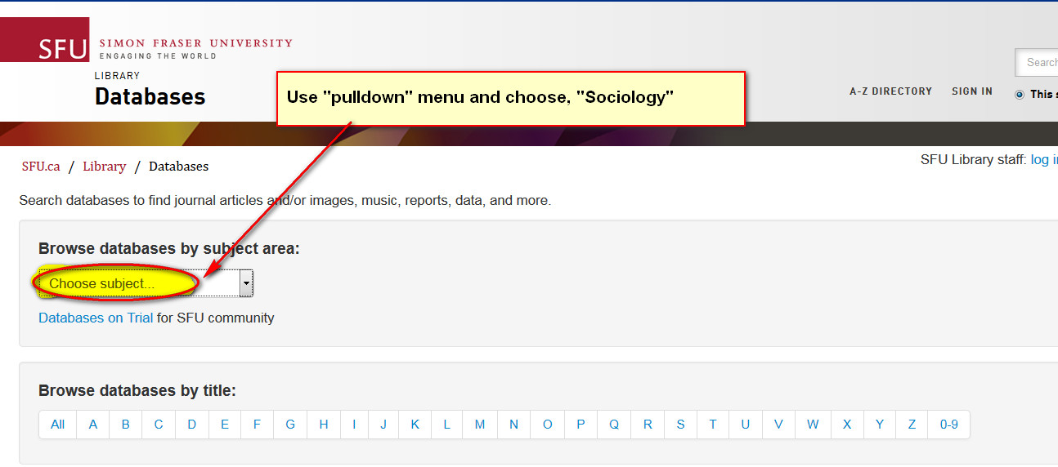
Article databases

Slide 4
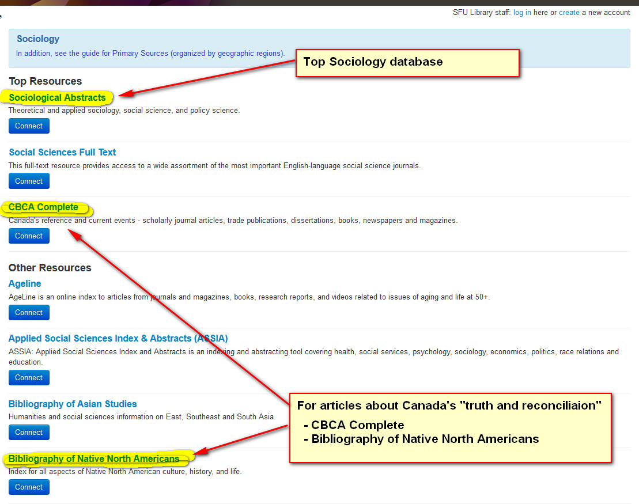
Sociology Databases

Slide 5
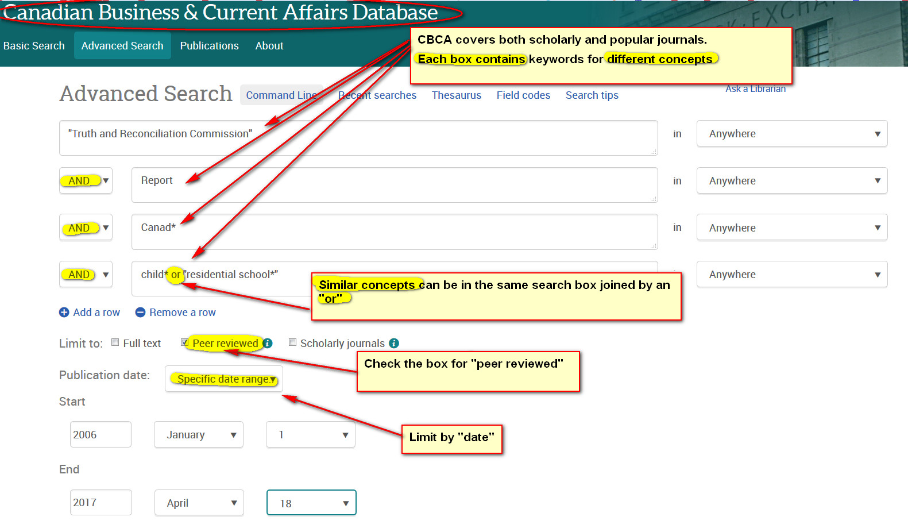
Searching in CBCA database

Slide 6
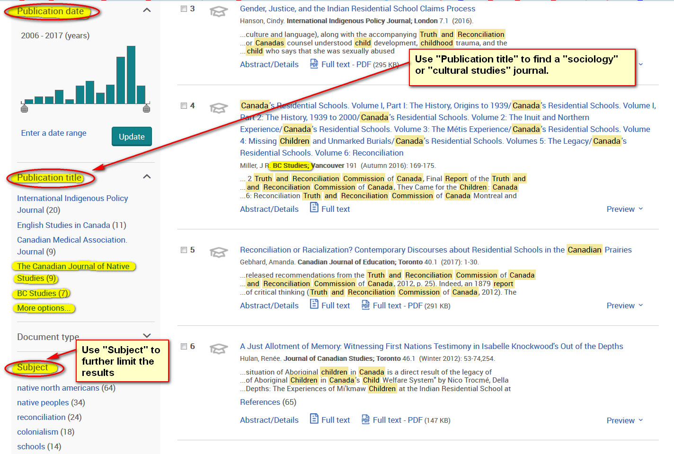
CBCA database -Limit results by “publication type” or “subject

Slide 7
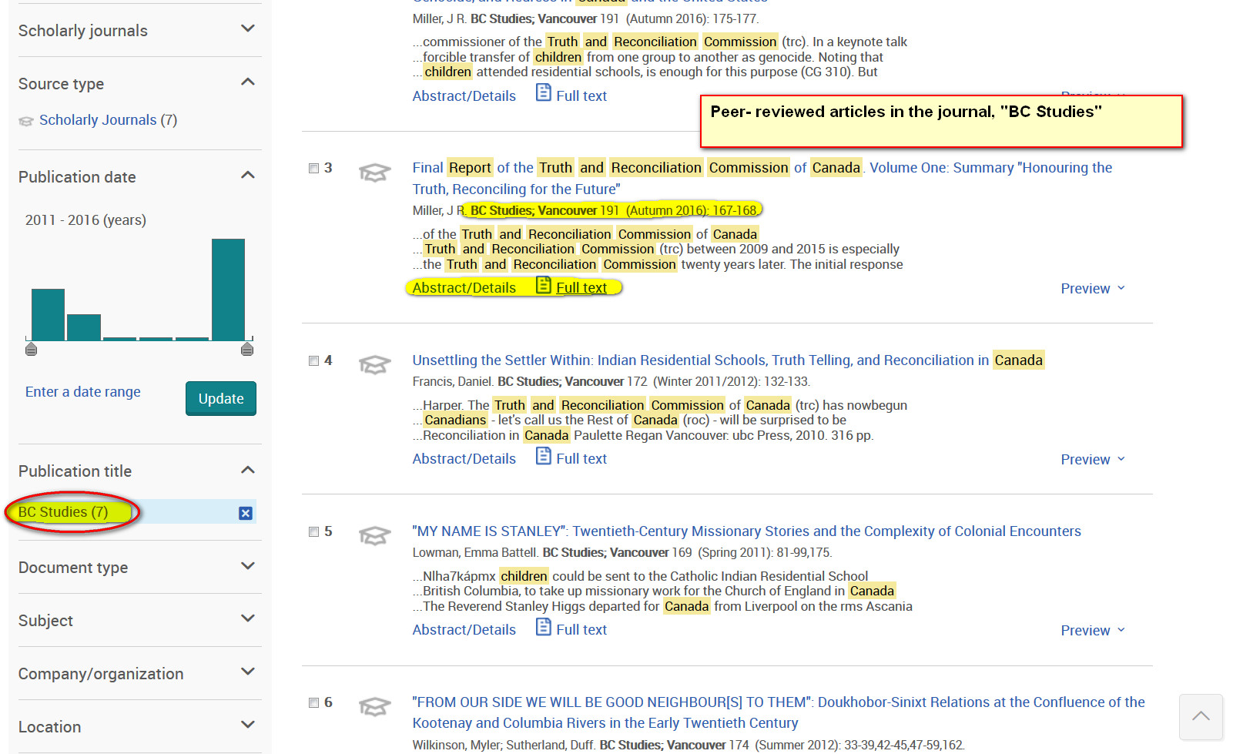
Peer-reviewed Articles in BC Studies

Slide 8
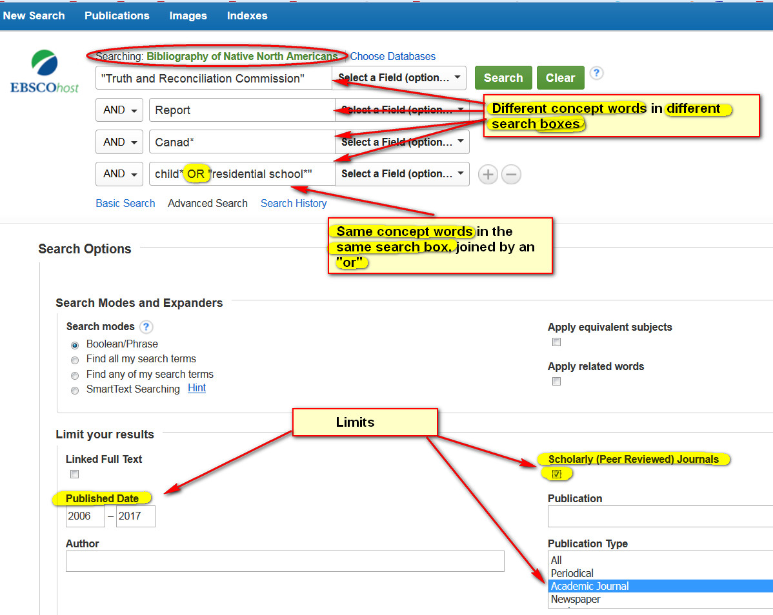
Search in Bibliography of Native North Americans

Slide 9
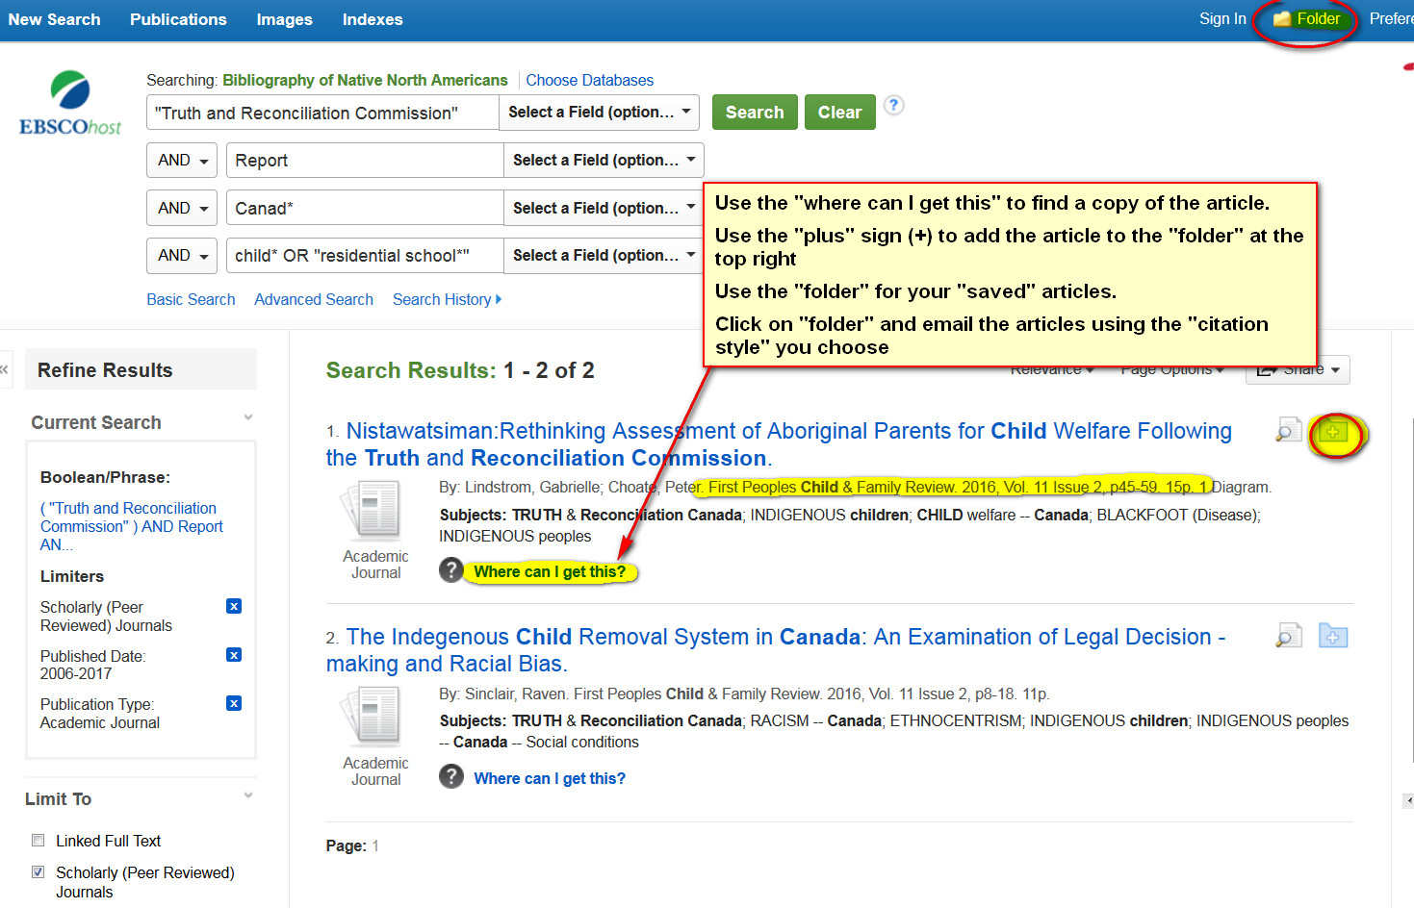
Find a copy of the article if “full-text” not in the database
Note: “Get@SFU” has replaced the “Where can I get this” link

Slide 10
Find a copy of the article if “full-text” not in the database

Slide 11
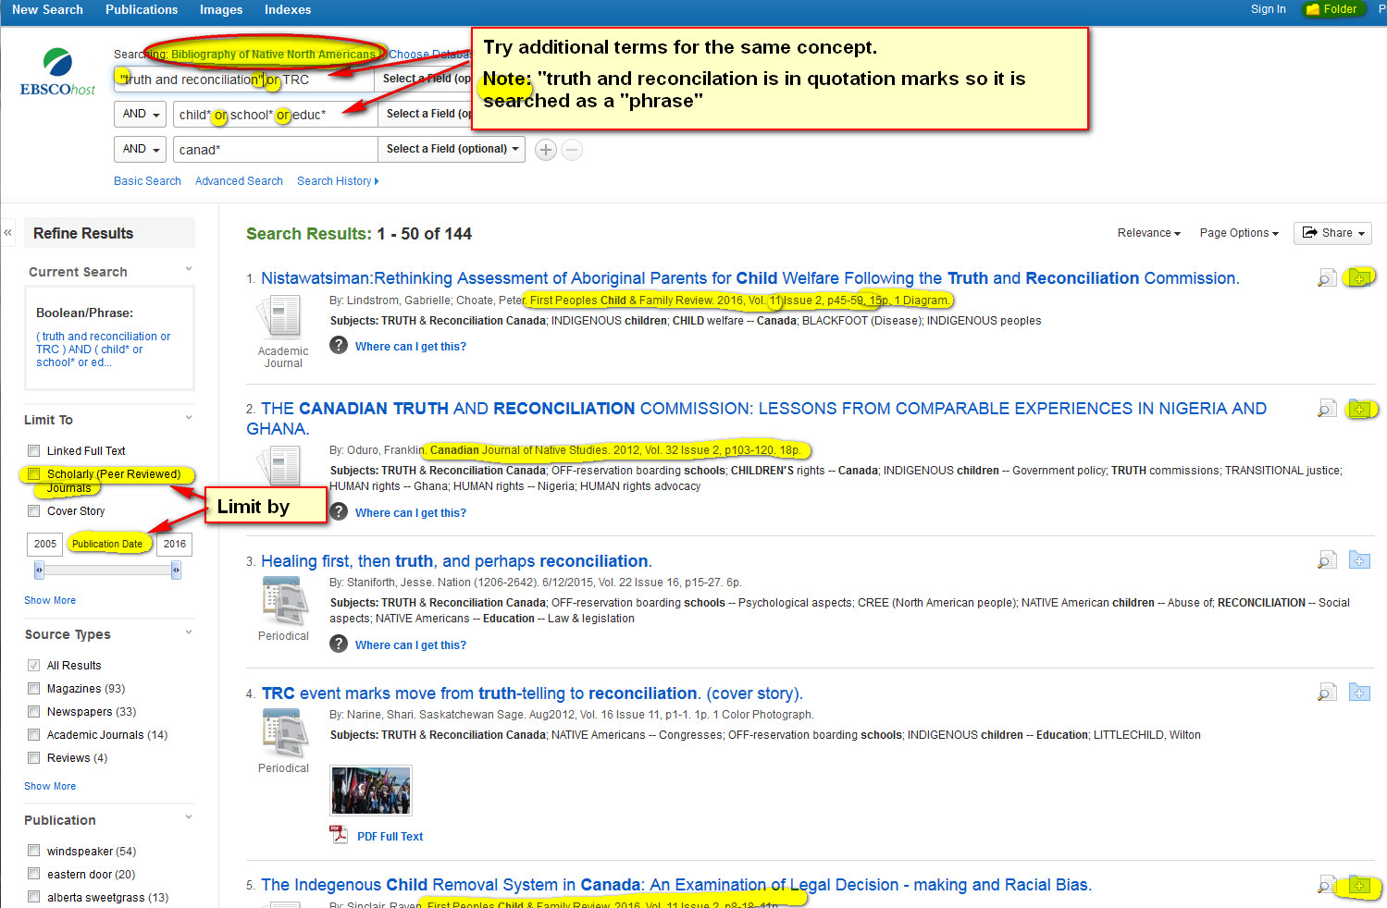
Additional Search Terms

Slide 12
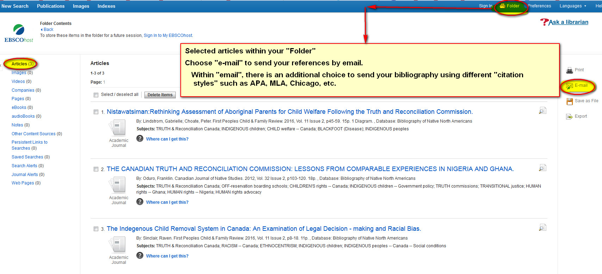
Emailing Selected Articles

Slide 13
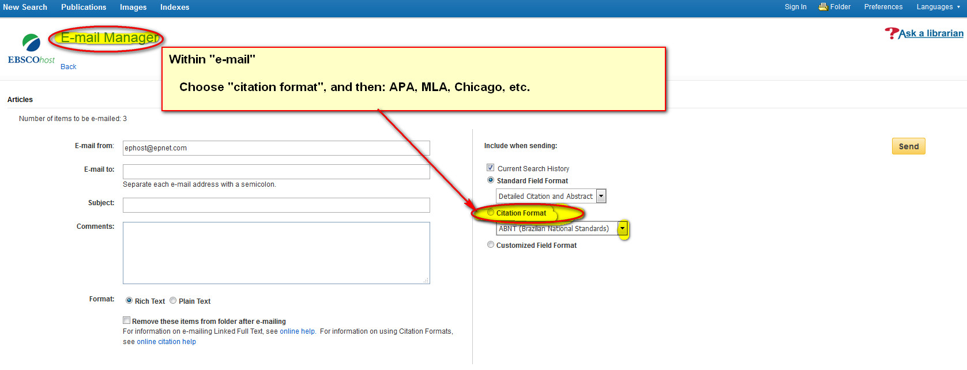
Databases might help with citing

Slide 14
Links
Selected Databases in Social Sciences
  Sociological Abstracts
  (http://cufts2.lib.sfu.ca/CRDB4/BVAS/resource/5565)
  Women's Studies International
    (http://cufts2.lib.sfu.ca/CRDB4/BVAS/resource/5725)
  CBCA Complete
  (http://cufts2.lib.sfu.ca/CRDB4/BVAS/resource/5838)
  Bibliography of Native North Americans
  (http://cufts2.lib.sfu.ca/CRDB4/BVAS/resource/5889)
  Social Sciences Full Text
  (http://cufts2.lib.sfu.ca/CRDB4/BVAS/resource/12165)
Subject Guides & Tutorials
(http://www.lib.sfu.ca/help/research-assistance/subject)
Citation and Style Guides
(http://www.lib.sfu.ca/help/cite-write/citation-style-guides)
Citation Management Software & Tools
(http://www.lib.sfu.ca/find/research-tools/citation-software)

Slide 15
More questions?
  Moninder Lalli
  Librarian: Sociology/Anthropology | Gender, Sexuality, and Women’s Studies| Labour Studies | Graduate Business
  moninder_lalli@sfu.ca
  Ask a Librarian:
  (http://www.lib.sfu.ca/help/ask-us)

