Slide 1
Copyright and Your Thesis
Don Taylor, Copyright Officer
Jennifer Zerkee, Copyright Specialist
copy@sfu.ca | copyright.sfu.ca
Nothing in this presentation is intended as or should be construed as legal advice.
Notes:
Disclaimer: the Copyright Office is not staffed by lawyers; this is not legal advice.

Slide 2
What is copyright?
Rights include
copy
perform in public
publish
translate
adapt to another format
record a literary, dramatic or musical work
broadcast
exhibit an artwork
authorize others to do these things
Happens immediately and automatically
Term “Life plus 70”
Notes:
Copyright protects literary (written) works, artworks, dramatic works, and musical works, as well as performances, communication signals, and sound recordings.
Copyright includes the right to copy something, but also the right to publish, translate, and the other rights you see listed here – including the right to authorize others to do these things.
Copyright is effective immediately and automatically when a work is created, so as soon as you started that first draft of your thesis, you owned copyright in it.
Copyright doesn’t last forever though – it does expire. In Canada copyright lasts for the life of the creator plus 70 years. Once copyright expires, the work enters the public domain, meaning anyone can use it in any way without permission or payment.
Every country has its own copyright laws, so while your work that you create in Canada is protected in most other countries, be aware that their rules might be different.

Slide 3
Open Access and open licenses
Open Access publications
Creative Commons licenses: e.g. “CC BY,” “CC BY-NC” or
Notes:
An author or copyright owner might decide that they want to allow greater use of their work, or that they don’t want people to have to contact them for permission for certain uses. In this case, they might publish or share their work openly, which provides up-front permission to do certain things with it.
Open Access publications work under a model that believes scholarship should be shared, so all content published in an Open Access journal is at least publicly accessible and readable without a subscription, and more likely, published under an open license that permits certain actual reuses of the work without permission. Most OA journals use Creative Commons or CC licenses to make it clear what users can and can’t do with the work, so if you see icons like these, click on them and you’ll see a description.
You can also find open licenses on other types of media, including photos, videos, music, and illustrations. Any kind of content with a CC or similar open license can be reproduced in your thesis without further permission from the rightsholder.

Slide 4
What is fair dealing?
A permitted use of copyright protected material for these purposes:
research satire
private study criticism
education review
parody news reporting
To qualify as fair dealing the use must also meet the “six criteria” test set out by the Supreme Court of Canada.
Fair dealing is most likely to apply to things your reader really needs to see to understand your thesis.
Notes:
Even if a copyright owner wants to protected all of their rights, those rights are not completely exclusive. In Canada, the biggest exception to the rights of a copyright owner is fair dealing, which can be very useful when you’re writing a thesis. Under fair dealing there are 8 specific purposes for which anyone is allowed to copy copyright protected works without permission as long as the use is fair, and this can apply to works in any medium.
That does not mean that you can do anything you want with a copyright protected work just because your thesis is educational or research-based, however; the application of fair dealing depends exactly how you’re using that work within your thesis. There is an analysis that needs to be performed and this is one of the services the Copyright Office does for students all the time.
So when might fair dealing work for you? You might be critiquing an artwork or a design for something, reviewing or comparing different methods or results from other studies, or including an image to help your readers visualize something you discuss. But it needs to be pretty integral to the thesis—something your readers really need to see to fully understand or appreciate your discussion.
When you ask the Copyright Office to do this analysis, if we find your use does qualify for fair dealing, we’ll write you a memo to submit with your thesis so the Thesis Office know we’ve okayed it. If it doesn’t meet those criteria, you will have to remove the work, find a different work to use, or get permission to include it.

Slide 5
Reproducing a figure
Minna, J.D., and Johnson, J.E. (2016). Opening a Chromatin Gate to Metastasis. Cell 166(2), 276. https://doi.org/10.1016/j.cell.2016.06.031
Notes:
This is one of the most common types of material students want to include in a thesis. Fair dealing can apply to your use of a figure from another publication, so check with the Copyright Office if you think this might be the case for you. But if you do need to get permission to reproduce a figure it’s actually usually very easy.

Slide 6
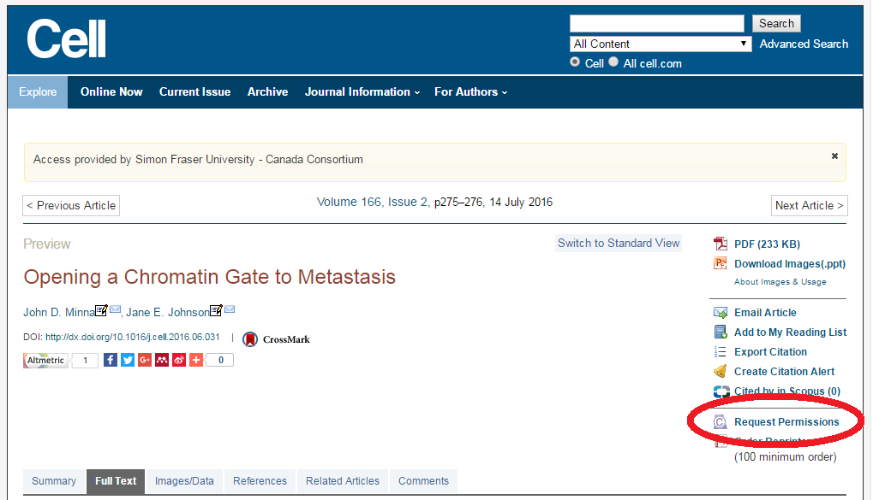
Notes:
On the article’s webpage, look for a link called something like “Request permissions” or “rights and permissions” or “copyright.” Click this link and it will usually take you to a service called RightsLink, which many publishers use for permissions.

Slide 7
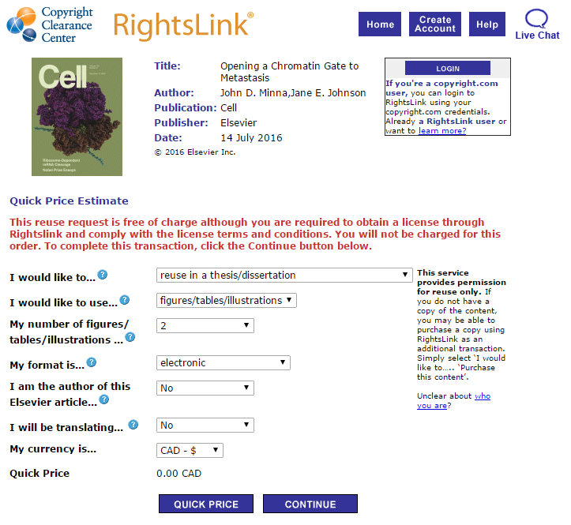
Notes:
RightsLink has a simple webform for you to fill out and submit, and you’ll usually receive a license permitting you to use the figure in your thesis. Keep this license and upload it to the Thesis Registration System when you submit your thesis to the Library.
Some publishers will charge a fee for this permission – this is extremely rare for use in a thesis, but it can happen. The decision to charge a fee, and how much to charge, is entirely up to the publisher who is the copyright owner.

Slide 8
Images found online
Notes:
The other main type of material we see grad students wanting to include in their thesis is images they find online, including photos, illustrations, maps, and screenshots of apps or websites. When you do a Google search, the results show up without any information about where they come from or whether they are protected by copyright or openly licensed. So you have to do a bit more digging to check the status of the image.

Slide 9
Images found online
Notes:
Click through to the original source site for the image (a Women’s Day article in the example here) and then check that site for copyright information.

Slide 10
Reproducing content found online
Website terms of use
User-friendly licenses
Creative Commons
Open Access publications
Legitimate sources for free, open (CC or public domain) images: wordpress.org/openverse, commons.wikimedia.org, pixabay.com, unsplash.com, pexels.com
https://www.canada.ca/en/transparency/terms.html
Notes:
One place to check is the website’s terms of use. It’s pretty rare but a website might explicitly allow some uses of its contents. For example, here are the terms and conditions for Canada’s federal government website (Canada.ca). The terms permit reproduction of the site’s contents for non-commercial purposes, unless a specific webpage states otherwise.
You can also look for a Creative Commons license or similar open permission to reuse the site’s contents. Listed here are a few sources for images that are either openly licensed or copyright-free.
Finally, remember to keep track of where you find your images so you can cite them.

Slide 11
Including your published articles
Does your publishing agreement permit reuse?
Check publishing agreement or publisher website for details, including permitted version and citation requirements
Talk to your co-authors
Not accepted yet?
Let the publisher know it will be in your thesis
Ask for their policy or requirements
Notes:
Often, writing a thesis can overlap with publishing your research. You may be including published papers in your thesis (a cumulative or “sandwich” thesis), or you may plan to publish content from your thesis after it’s completed. The copyright considerations are different for these different scenarios.
If you have already published the article and you are then including it in your thesis, check your publishing agreement or the publisher’s website for their policies on reusing your article in this way. Most scholarly publishers permit this, though you may be restricted to a certain version of the article (such as the accepted manuscript rather than the final published version) and the publisher may require you to include specific citation language. It’s also possible there may be an embargo period before you can make the article public, in which case you may have to contact Graduate Studies to enquire about an embargo (delay in releasing your thesis in Summit).
If you have submitted the article but it is not yet accepted, you can check the publisher’s website for their policies and let your editor know you plan to include it in your thesis.
Finally, if you plan to publish after your thesis is completed, check the publisher’s policies on previously-published work. Most scholarly publishers do not consider a thesis to be a “prior publication” and will accept manuscripts based on a thesis.

Slide 12
Asking permission
What if you can’t get permission?
Omit the work.
Find a substitute you are able to use.
Paraphrase or describe.
Use a smaller (insubstantial) excerpt.
Use the data in your own chart or diagram.
Take your own photo, draw your own map, create your own diagram.
Cite the source as a “see also” or “for further reference” footnote, let readers find it themselves.
Consider fair dealing.
Notes:
If you are unable to get permission to use a work in your thesis, either because the copyright owner said no or because you couldn’t find or reach them, here are some options. You can always check with the Copyright Office to see if fair dealing might apply.

Slide 13
Your rights
You own copyright in your thesis.
However, you are required to grant licenses to SFU Library and Library and Archives Canada.
These licenses only permit SFU and LAC to do specific things with your thesis.
These licenses do not restrict your right to further publish or otherwise use your work.
Notes:
Finally, you own copyright in your thesis. You are required to sign licenses permitting SFU to make your thesis available in Summit and permitting Library and Archives Canada to make it available as well, but these licenses don’t restrict you from doing anything else you want with your thesis.

Slide 14
Questions?
Don Taylor, Copyright Officer
Jennifer Zerkee, Copyright Specialist
copy@sfu.ca | copyright.sfu.ca
Nothing in this presentation is intended as or should be construed as legal advice.
Notes:
Contact the Copyright Office at any time with any questions!

