Slide 1
Sociology / Anthropology Library Workshop Graduate Students
Moninder Lalli, Librarian: Sociology / Anthropology Email: moninder_lalli@sfu.ca Fall 2017

Slide 2
Contents
Library services
Information landscape
Tools
Sources
Search skills

Slide 3
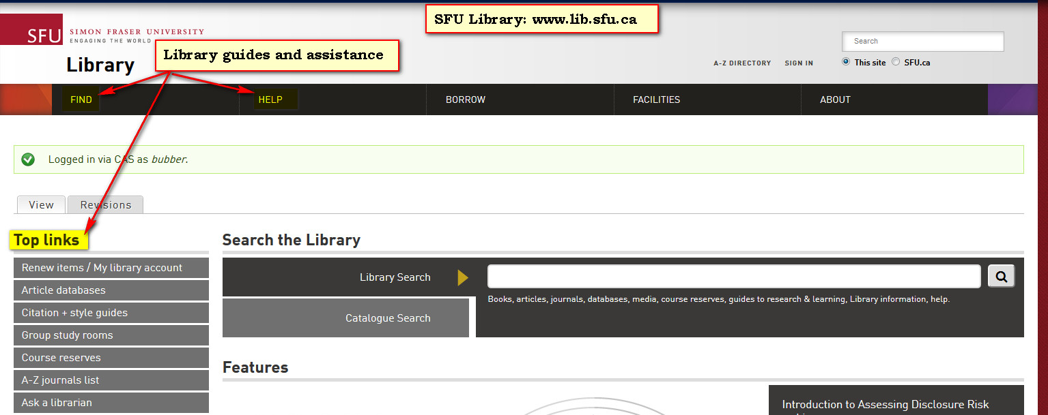
Library Guides & Services

Slide 4
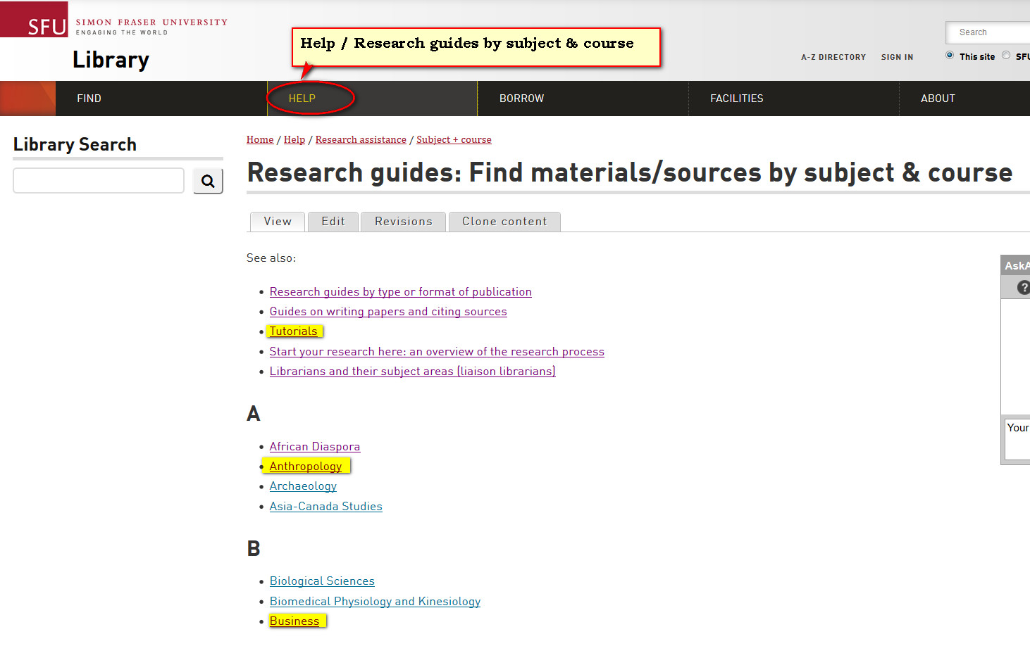
Library Guides by Subject

Slide 5
Who might publish
Scholars
Government
Associations
News Media
Non-governmental organizations (NGOs)
Self-publishing
Other?

Slide 6
Information Landscape
Disciplinary Sources

Slide 7
Learning About a New Discipline
How does this discipline think about, analyze, explain, solve a particular problem / phenomenon?
How does a newcomer to a discipline know what the discipline thinks is important?
Where does one start?

Slide 8
Scholarly Conversations
Critiques
Debates
Frameworks
Methodologies
Theories

Slide 9
Importance
Decided by the scholarly conversations within a particular discipline
By shared agreements / understandings among scholars of a discipline

Slide 10
Entry Points for Scholarly Debates
Overview Sources
Literature Reviews
Bibliographies
New Dissertations
Journal Articles
Books

Slide 11
Overview Sources Identify key ideas, debates, authors, books, journal articles
Encyclopaedias
Handbooks
Reviews
Textbooks

Slide 12
Time Saving Strategies
Identify and search:
Overview sources
Databases for a discipline
Reviewing journals
Recent dissertations
Identify who is “citing” sources (books, articles) that are relevant for your research topic
Stay current by setting up email alerts

Slide 13
Scholarly articles
World of information
Start with databases for a discipline

Slide 14
Find “Grey” Literature
Government agencies
Advocacy groups
Non-governmental organizations (NGOs)
Industry, trade or professional organizations
Institutional Repositories
OpenDOAR (Directory of academic open access repositories) http://www.opendoar.org
Google Search
Search for “domain” or “site” or “file type”

Slide 15
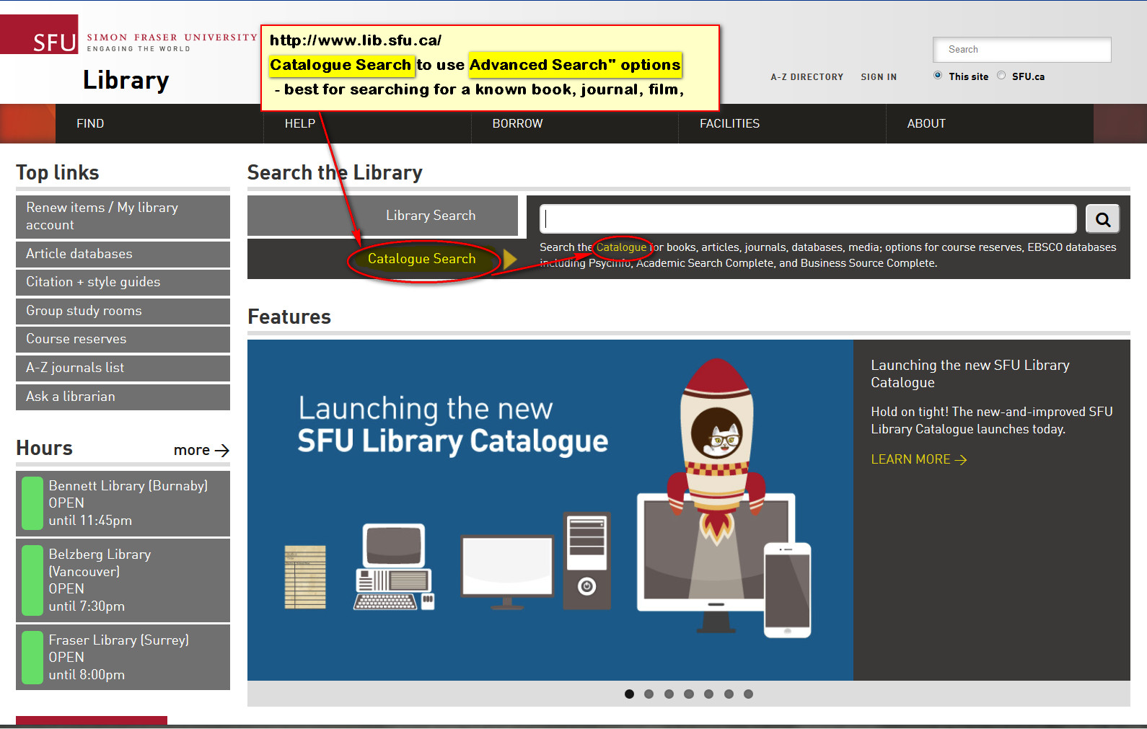
“Catalogue Search”

Slide 16
Sign-in For Access to Electronic
Sign-in with SFU Computing ID/password to:
View your Library record / renew books online
Place a hold on a book that is signed out
Transfer a book from another branch
Request an Inter-Library Loan
Create an E-Shelf of favorite books

Slide 17
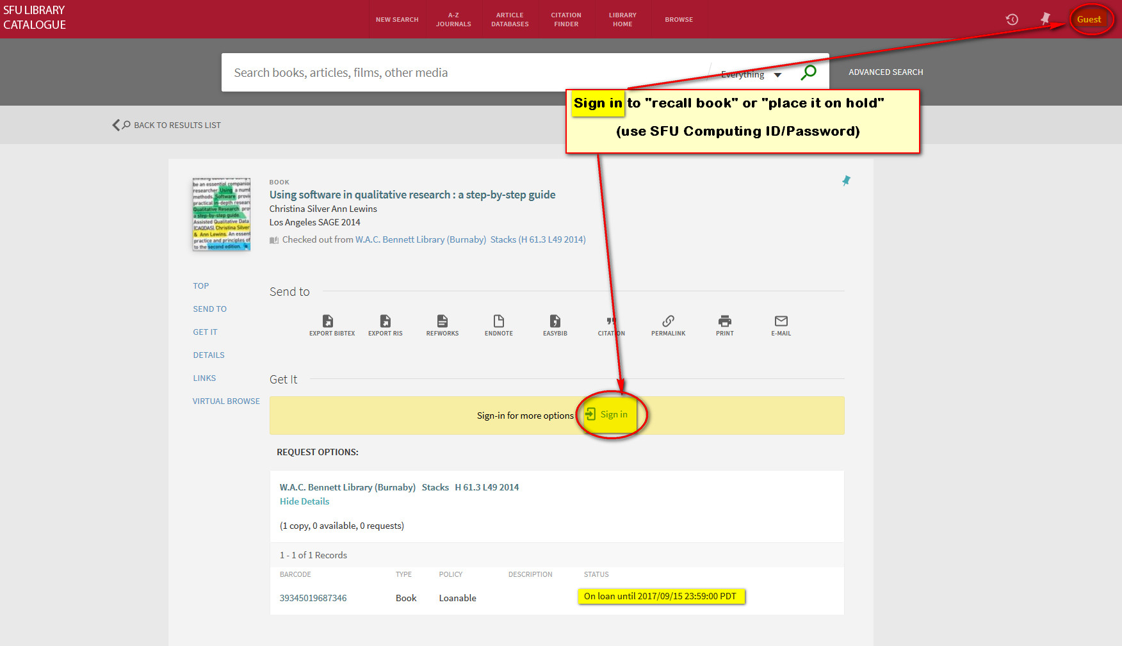
Sign in

Slide 18
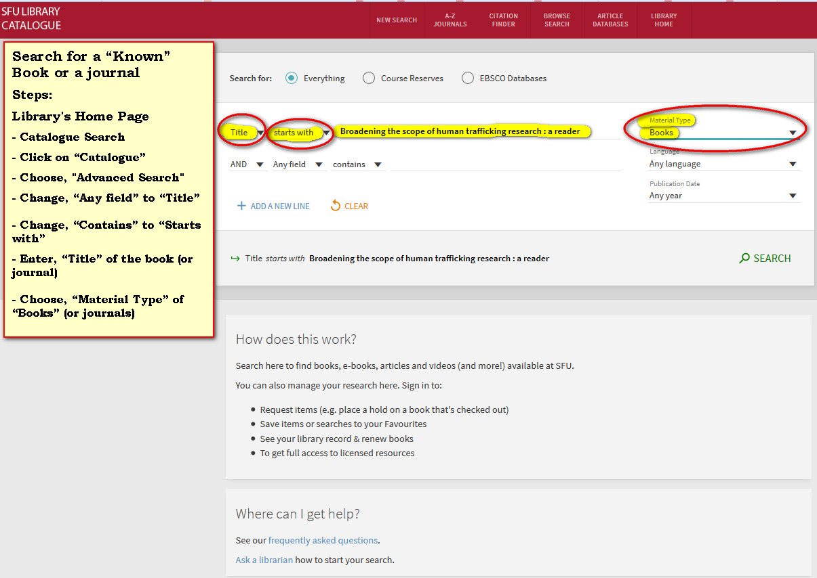
Steps: “Catalogue Search” for A Known Book or Journal

Slide 19
Brainstorming
Create “concept maps”
Identify key terms that describe research concepts
Identify synonyms & related words for each key concept
Combine different concepts

Slide 20
Truncation (wildcard)
In many databases, words can be “truncated” with an asterisk (*)
traffick* will find trafficking, trafficked, trafficker, traffickers
It is the same as if you search in this way:
traffick OR trafficking OR trafficked OR trafficker
OR traffickers

Slide 21
Combine concepts
(slave* OR traffick* OR anti-traffick*)
AND
(human OR women OR men OR labor OR labour)
AND
(neo-liberal* OR neoliberal* OR capital* OR “global political econom*”)

Slide 22
A phrase can be searched using quotation marks (“”) around the words
“human trafficking”
Ensures two words are next to each other
Useful when there are too many irrelevant items

Slide 23
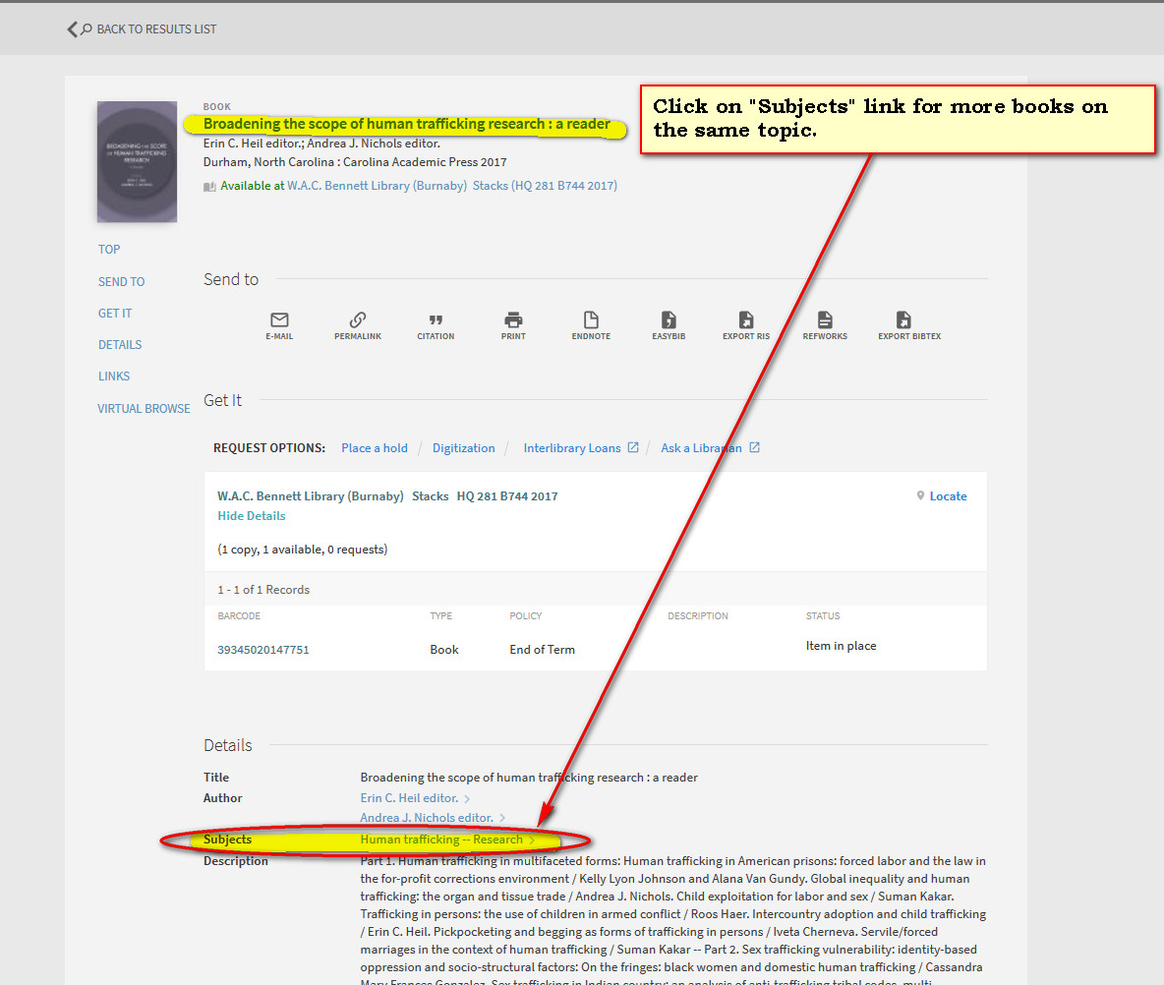
Check the “Subjects” link of relevant books

Slide 24
With “Catalogue” Search, Combine Concepts
Use capitals: “OR”, “AND”
(slave* OR traffick* OR anti-traffick* OR forced)
AND
(human OR women OR men OR labor OR labour)
AND
(neo-liberal* OR neoliberal* OR capital* OR “global political econom*”)

Slide 25
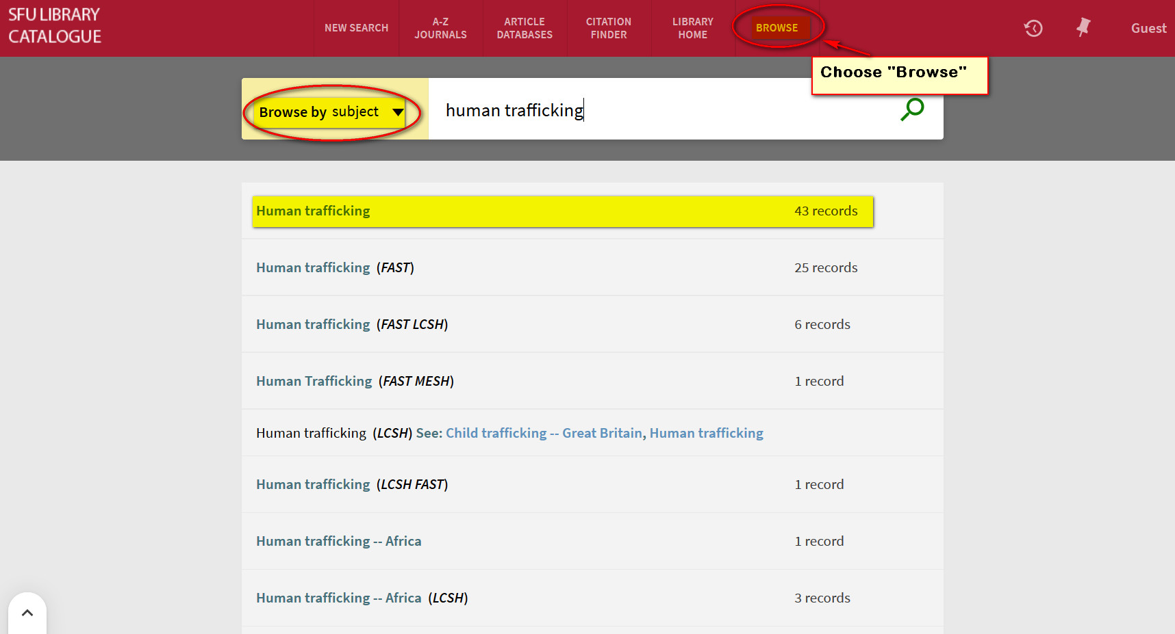
Browse Subject Headings

Slide 26
Citation Searching
Web of Science
Use “Cited Reference” search
Google Scholar

Slide 27
SFU Theses Template
Submitting your thesis:
http://www.lib.sfu.ca/help/publish/thesis
Guide to finding SFU Theses: http://www.lib.sfu.ca/help/research-assistance/format-type/finding-sfu-theses

Slide 28
SFU Inter-Library Loans Service (ILL)
SFU “Catalogue” Search
Sign-in (SFU Computing ID/Password)
Citation Finder/ILL Tab

Slide 29
Tools
Browzine
Tables of Content of scholarly journals
Zotero, Mendeley, EndNote, other
Citation management software
NVIVO
software to assist with organizing research (quantitative & qualitative)

Slide 30
Questions?
Email:
Moninder Lalli,
Librarian for Sociology / Anthropology
moninder_lalli@sfu.ca

